Slide 1

DOWN SYNDROME
Dr. Raed M Kanan
Notes:
Hello everyone thank you for inviting me to present this lecture about down syndrome
I'm doctor Raed Kanan from Biogen labs

Slide 2
DOWN SYNDROME Objectives
What is DOWN Syndrome(DS)?
Clinical features of DS
Incidence of DS IN Arab countries
Incidence of DS IN Developed countries
Genetics of DS
Laboratory diagnosis of DS
Rehabilitation of DS
Notes:
This lecture we are going to identify down syndrome with its clinical features and then we will talk about its incidence in Arab and developed countries
Afterwards we will learn about genetics causes of down syndrome , this will lead us to the lab diagnosis of ds
At the end will discuss ds treatment and rehabilitation .

Slide 3
Down Syndrome
Down Syndrome, also known as Trisomy 21, is a disorder that occurs when an extra chromosome is present on the 21 chromosome.
This takes place when, during meiosis, an egg with 22 chromosomes and a cell with 24 chromosomes are made.
Notes:
DS is a disease named after its discoverer john down in 1866 , this syndrome occurs when an extra chromosome present in the cell ,Normally there is 46 chromosome in any cell 23 from father and 23 from mother, However in this order the father or the mother has 24 chromosomes with an extra chromosome number 21.

Slide 4
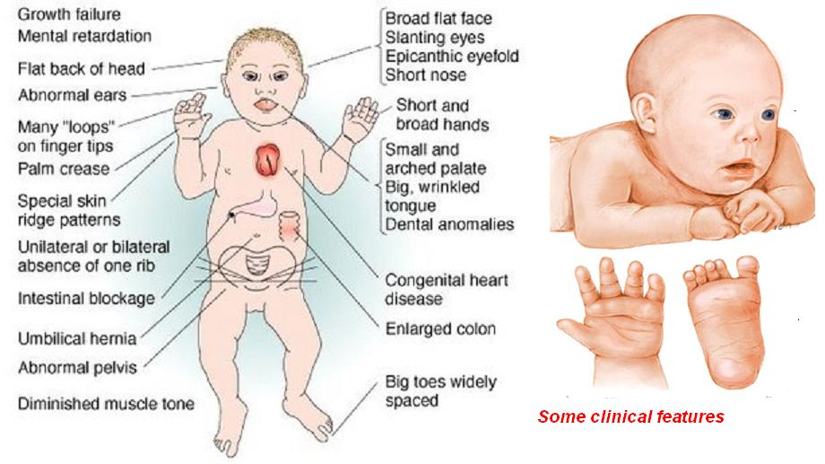
Notes:
A syndrome means a disorder with many pathological sites in the human body.
In DS these sites include head, heart, limps and genital system

Slide 5
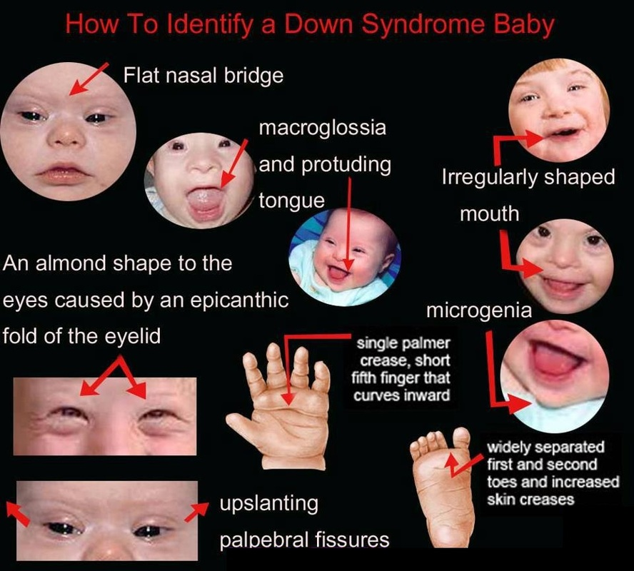
Notes:
Doctors recognize a head and limps features of DS such as up slanting eays,irregular shaped mouth and shore finger and noes.

Slide 6
Clinical symptoms of Down syndrome
Symptoms | Percentage | Symptoms | Percentage
Mental impairment ( Retardation) | 99% | Hematologic disorders | 65%
Stunted growth | 90% | Abnormal teeth | 60%
Umbilical hernia | 90% | Slanted eyes | 60%
Increased skin back of neck | 80% | Shortened hands | 60%
Low muscle tone | 80% | Short neck | 60%
Narrow roof of mouth | 76% | Obstructive sleep apnea | 60%
Flat head | 75% | Bent fifth finger tip | 57%
Flexible ligaments | 75% | Single transverse palmar crease | 53%
Large tongue | 75% | Protruding tongue | 47%
Abnormal outer ears and hearing impairment | 70% | Congenital heart disease | 40%
Flattened nose | 68% | Undescended testicles | 20%
Separation of first and second toes | 68% | Endocrine disorder | 10%
Notes:
As you can notes from this slide mental retardation is the most common feature in DS, Followed by abnormal growth pattern ,then abnormalities in eye,neck and mouth commonly found in DS patient.
Others abnormalities although they are not found in all DS patients nevertheless it cause fatal consequences such-as chronic heart disease and endocrine disorder.

Slide 7
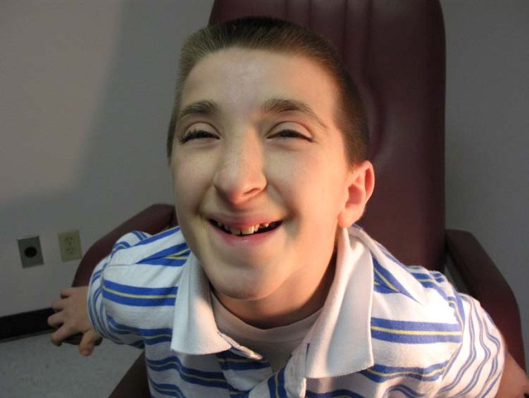
Mental Retardation
Almost all DS babies have MR.
Mildly to moderately retarded .
Starts in the first year of life.
Average age of sitting(11 mon), and walking (26 mon) is twice the typical age.
First words at 18 months.
IQ declines through the first 10 years of age, reaching a plateau in adolescence that continues into adulthood.
Notes:
MR is found almost in all DS babies and start in the first year of life .this could be recognized by abnormal child behavior such-as late setting and walking in addition to inability to speak the first words before 18 months ,also their IQ decline with age.

Slide 8
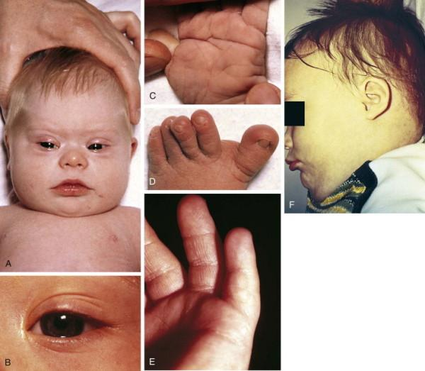
Growth
BW, length and HC are less in DS
Reduced growth rate
Prevalence of obesity is greater in DS
Weight is less than expected for length in infants with DS, and then increases disproportionally so that they are obese by age 3-4 yrs
Notes:
Children growth involve increase in BW,length and head Circumference, However in DS children these parameters decrease.
In addition weight is highly increased compared with normal children.
The weight to length the ratio decrease in DS children which means fatter and shorter children.

Slide 9
Eye problems
Most common disorders are :
Refractory error – 35 to 76 percent
Strabismus – 25 to 57 percent
Nystagmus – 18 to 22 percent
Cataract occur in 5 % of newborns.
Frequency increases with age.
Notes:
Eyes problems in DS patient include many disorders such-as refractory error where children can not see objects in the right angle,also it may involve cataract which may lead to complete blindness. These eye problems become more frequent with age .

Slide 10
Hearing loss
Conductive, sensorineural or mixed
Otitis media Unilateral or bilateral is a frequent problem
Notes:
The problems in ears of DS patients lead to a complete loss of hearing which involve conductive ,sensorineural or both, also inflammation in ear is a frequent problem which can affect right or left ear or both, causing otitis media.

Slide 11
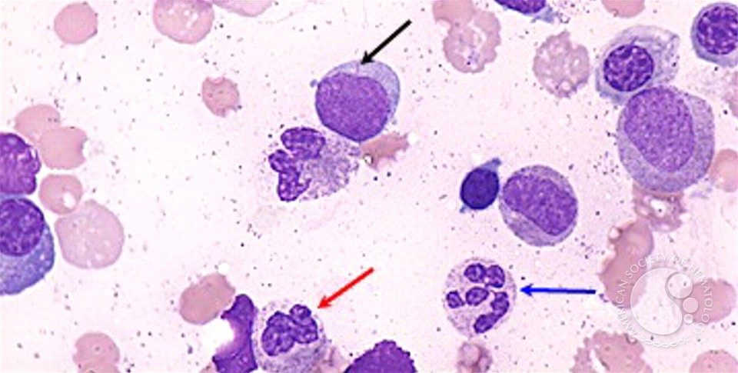
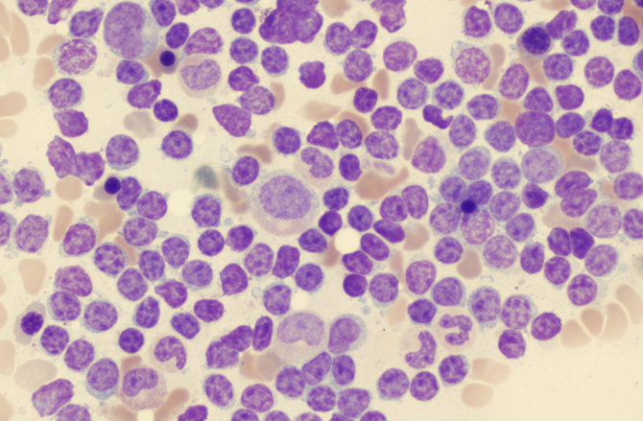
Hematologic disorders
The risk of leukemia is 1 to 1.5 percent.
Risk of AML and ALL is also much higher than the general population.
Transient leukemia – exclusively affects NB.
It is asymptomatic with spontaneous resolution in 2-3 months.
Notes:
The blood picture in DS patient carries a risk of leukemia up to 1.5 % more than normal population, there are tow types of leukemia AML and ALL
Sometimes new born children may exposed to transient leukemia which can be recover at older ages.

Slide 12
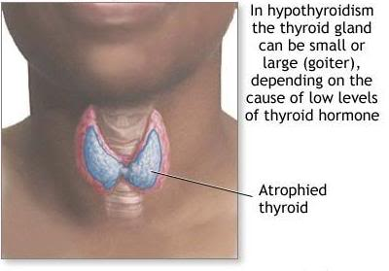
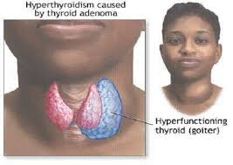
Endocrine disorder
Thyroid disease – Hypothyroidism occurs more frequently than hyperthyroidism.
Diabetes – The risk of type 1 diabetes is three times greater than that of the general population.
Notes:
Other blood problems involve endocrine disorder such-as hypothyroidism, hyperthyroidism and diabetes.
Hypothyroidism is more common than hyperthyroidism and diabetes is three times greater than general population.

Slide 13
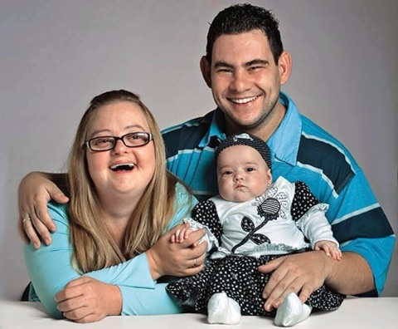
Reproduction
Women with DS are fertile and may become pregnant.
Nearly all males with DS are infertile. The mechanism is impairment of spermatogenesis
Notes:
In the DS patient woman and men are different infertility, woman can be fertile and can become pregnant, while the male is in-fertile this may be due to congenital problems such-as Undescended testicles.

Slide 14
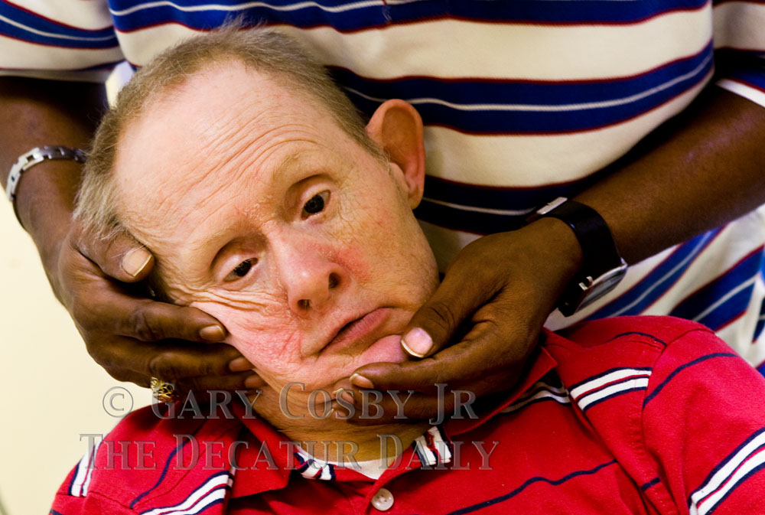
Atlantoaxial instability
Excessive mobility of atlas (C1) and the axis (C2), may lead to subluxation of the cervical spine.
Diagnosis made by lateral neck radiograph.
Patients are advised to avoid contact sports.
Notes:
In this abnormality there is uncontrolled mobility of the head and neck , that can cause subluxation of the cervical spine.
This can be confirmed by radiograph.

Slide 15
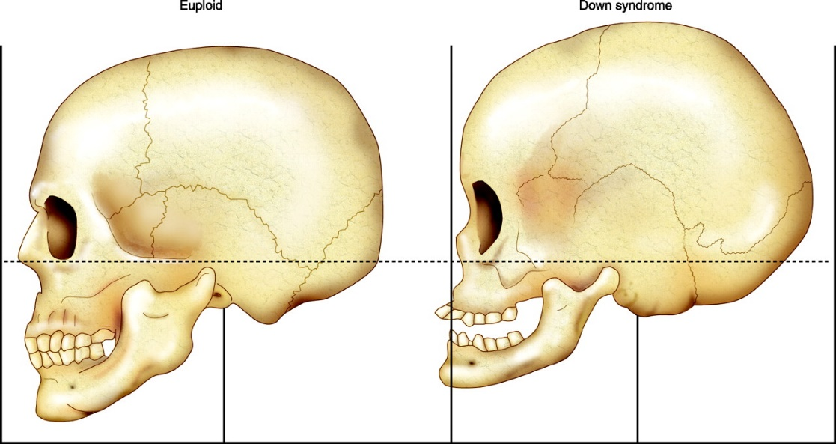
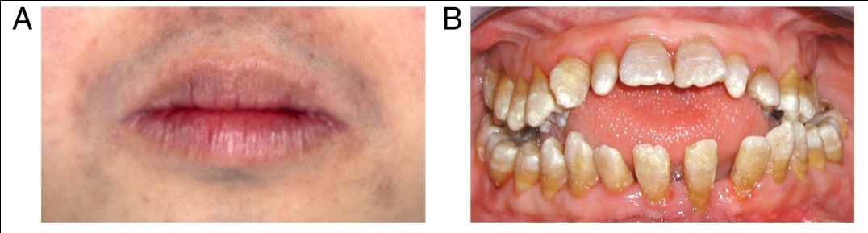
Facial and mouth problems
Underdevelopment or hypoplasia of midfacial region.
Smaller bridge of nose, bones of midface, and maxilla.
Open bite or class III malocclusion.
Tongue may protrude and appear too large.
Notes:
Other problems abnormal formation in middle face which include nose and mouth.
Causing the mouth to have open bite

Slide 16
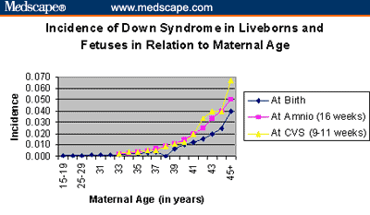
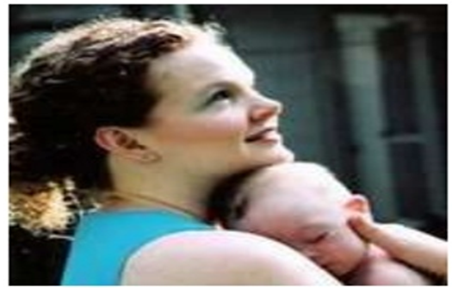
Notes:
The incidence of DS increase with maternal age , a women with age more than 45 have 7% chance to have a DS baby.
Generally the DS risk start at the mid 30s.
Exact reason is unknown but scientists think that with order ages chromosomal abnormalities happen more often.

Slide 17
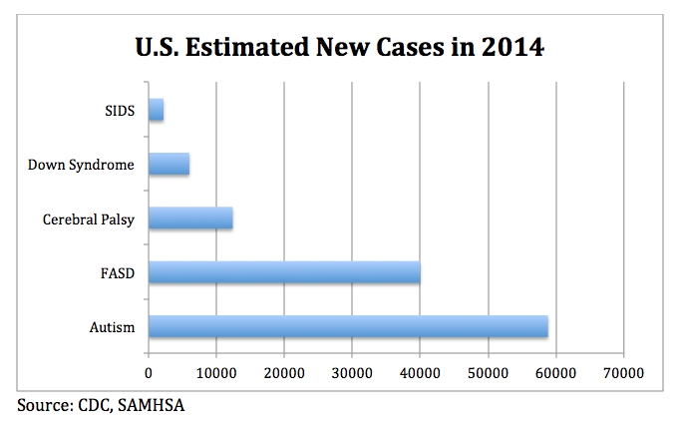
Notes:
DS cases are increasing worldwide , in U.S there is DS is the fourth birth defect following autism and cerebral palsy.
FASD: fetal alcohol syndrome.
SIDS: Sudden infant death syndrome.

Slide 18
Down Syndrome in the Middle East
Gaza strip | 1,656 | 1,324,9912
Iran | 84,379 | 67,503,2052
Iraq | 31,718 | 25,374,6912
Israel | 7,748 | 6,199,0082
Jordan | 7,014 | 5,611,2022
Kuwait | 2,821 | 2,257,5492
Lebanon | 4,721 | 3,777,2182
Saudi Arabia | 32,244 | 25,795,9382
Syria | 22,521 | 18,016,8742
United Arab Emirates | 3,154 | 2,523,9152
West Bank | 2,889 | 2,311,2042
Yemen | 25,031 | 20,024,8672
Notes:
Looking at some figures expected cases of DS increases in middle east specially where population number increase , such-as Saudi Arabia ,Iran, also it may be because of Consanguineous marriages .

Slide 19
Down Syndrome in other countries
USA | 367,069 | 293,655,4051
Russia | 179,967 | 143,974,0592
United Kingdom | 75,338 | 60,270,7082
China | 1,623,559 | 1,298,847,6242
Notes:
In developed countries also DS cases increases with population increase but this may be due to that women marry at older ages.
However in china consanguineous marriages and population number is the main cause

Slide 20
Mortality
Median age of death has increased from 25 yrs in 1983 to 49 yrs in 1997, an average of 1.7 yrs increase per year.
Most likely cause of death is CHD, Dementia, Hypothyroidism and Leukemia.
Improved survival is because of increased placements of infants in homes and changes in treatment for common causes of death.
Survival is better for males and blacks.
Notes:
Although the DS is causing death. With improved medical technology, Patients with DS could live longer life, in 1983 average survival ages was in 25 yrs , this increased to 49 yrs in 1997.
The causes of death mainly because CHD, dementia, hypothyroidism and leukemia .
Treatment of these disease at placement of infants in home improved their survival rate
Researchers also found that black males have a better survival rate

Slide 21
Genetics
Trisomy 21 (47, +21), - 94 %, The frequency of trisomy increases with increasing maternal age.
Robertsonian translocation involving chromosome 21- Approx. 3-4 %, not related to maternal age.
Trisomy 21 mosaicism – 2 to 3 % cases
Notes:
Its will known that the genetics bases of DS , it can be seen 3 different forms , either as an extra chromosome in trisomy 21, in all the body cell or as a translocation
Involving chromosome 21 or as a mosaicism which involve trisomy 21 but not all body cells.

Slide 22
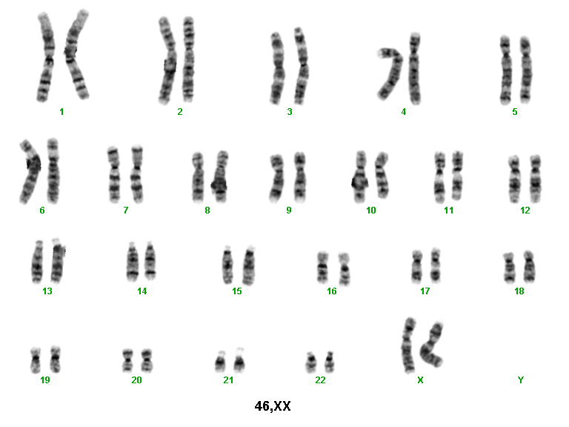
Trisomy
Monosomy (lethal)
Notes:
In this figure will seen non disjunction of chromosome 21 during meiosis, this will lead to uniting of one cell with one chromosome of 21 with another cell with two chromosomes 21 resulting in a zygote with three chromosome 21.

Slide 23
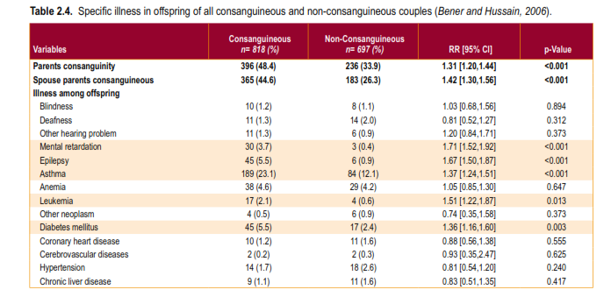
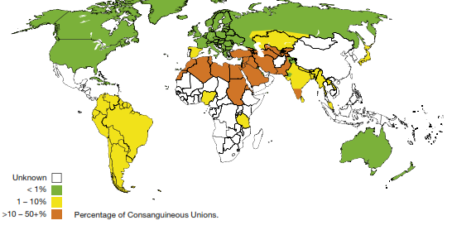
Down Syndrome in Consanguineous marriages
Notes:
Incidence of diseases increases with consanguineous marriages , specially asthma and diabetes followed by mental retardation which include DS.

Slide 24
Laboratory Diagnosis of Down Syndrome
Prenatal screening
If no screening – It is recognized from the characteristic phenotypic features.
Confirmed by Karyotype. Laboratory Tests
Screening and diagnostic tests may be done during a woman's pregnancy, in either the first or the second trimester. Screening tests are not diagnostic; they indicate an increased likelihood of the fetus having Down syndrome.
Notes:
To probably diagnose DS lab test should be done including genetics testing such as Karyotyping .
Now its recommended to do prenatal screening in the first or the second Trimester of pregnancy for people at risk such as older women or consanguineous marriages

Slide 25
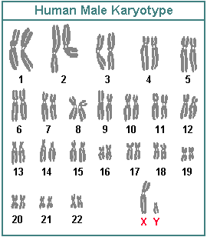
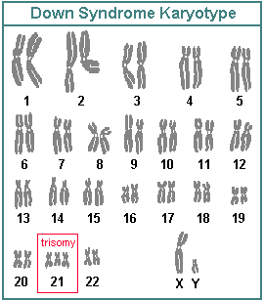
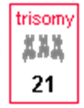
Notes:
Karyotyping is staining of human chromosomes, as the picture show for normal human karyotype there is 23 pairs of chromosomes , one pair of each chromosome.
However in DS there is 3 chromosomes 21

Slide 26
Laboratory Diagnosis of Down Syndrome
Prenatal diagnostic tests may be performed when screening tests are abnormal. They involve taking samples of the fluid or tissues surrounding the baby and evaluating them for an additional copy or portion of chromosome 21.
A very small risk of infection and miscarriage is associated with these diagnostic tests.
Notes:
In the lab commonly we do screening test which involve biochemical markers , however abnormal result confirmed by genetics testing or prenatal diagnosis

Slide 27
Laboratory Diagnosis of Down Syndrome
Chorionic villus sampling (CVS) – 9th to 11th week of pregnancy
Amniotic fluid analysis (amniocentesis) – 14th to 18th week of pregnancy
Chromosomal microarray testing – also uses samples collected via CVS or amniocentesis to examine the DNA of the unborn fetus for abnormalities
Diagnosis after birth
A diagnosis after birth is usually based initially on physical signs and characteristics. However, these signs and symptoms may also be seen in babies without Down syndrome.
Notes:
Prenatal diagnosis as we seed earlier it can be done at the first trimester by CVS , as early as 9th week of pregnancy or at the second trimester by amniotic fluid , as early 14th week of pregnancy . Completed genetic technique such as microarray testing can be used on CVS or amniotic samples.

Slide 28
Laboratory Diagnosis of Down Syndrome
TSH and/or T4 – to detect thyroid disease, especially hypothyroidism. This condition may develop at any age for a person with Down syndrome, so screening is usually done as a newborn and then at regular intervals throughout the person's life.
Complete blood count (CBC) – to detect anemia or infections and sometimes leukemia
Glucose – to identify diabetes
Notes:
Other lab test are important to diagnose diseases that develop in association with DS . As we said earlier some of these diseases are fatal so we do TSH and T4 to test hypothyroidism and CBC test for leukemia , also we test glucose to exclude diabetes
All these diseases are important and fatal in DS cases.

Slide 29
Counseling
May begin when a prenatal diagnosis is made.
Discuss the wide range of variability in manifestation and prognosis.
Medical and educational treatments and interventions should be discussed.
Initial referrals for early intervention, informative publications, parent groups, and advocacy groups.
Notes:
An important aspect is medical counseling for parents with DS children is important to improve life quality for these children and there parents , this will help in making parents understand their children behavior and thus know how to manage the disease also it could over information on possible future treatment

Slide 30
Is There A Cure For Down Syndrome?
No, there is no cure.
It cannot be prevented
Scientists do not know why problems involving chromosome 21 occur.
Down syndrome is not caused by anything either of the parents did or did not do.
Notes:
DS is a genetic disease that can not be prevented or treated , the exact cause of the disease is not known , therefore studies are done to help parents with rehabilitation

Slide 31
Physiotherapy Management
Assessment
  History: health, progress, current status, caregivers.
  Observation of spontaneous movement, quality of movement, positioning and handling by parent
  Postural alignment, resistance to passive movement, strength, range of motion, postural reactions, response to sensory stimuli
Notes:
Physiotherapy is very important and it can be personalized for each case of DS, it is passed the postural alignment , passive movement , strength and postural response to stimuli

Slide 32
Treatment :improve patterns of posture and movement
Improve muscle tone
Improve stability
Strengthening
Transitional/rotational movements
Static and dynamic balance
Notes:
Some of these treatment include improvement of muscle tone and stability

Slide 33
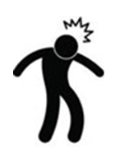



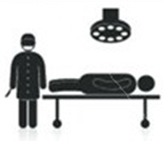




A Little Story
….. then after 9 months
Hi
Hi…..
….. after few years
Notes:
Finally just show you a little story.

Slide 34
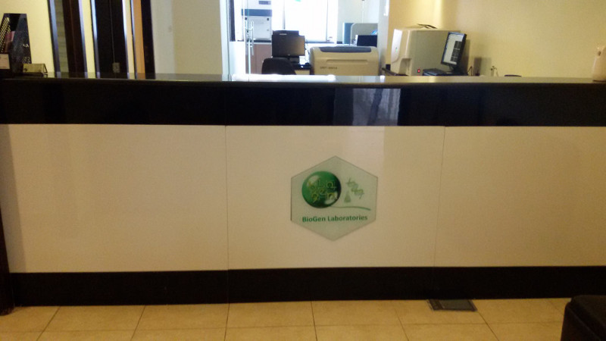
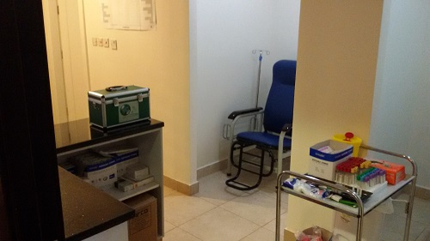
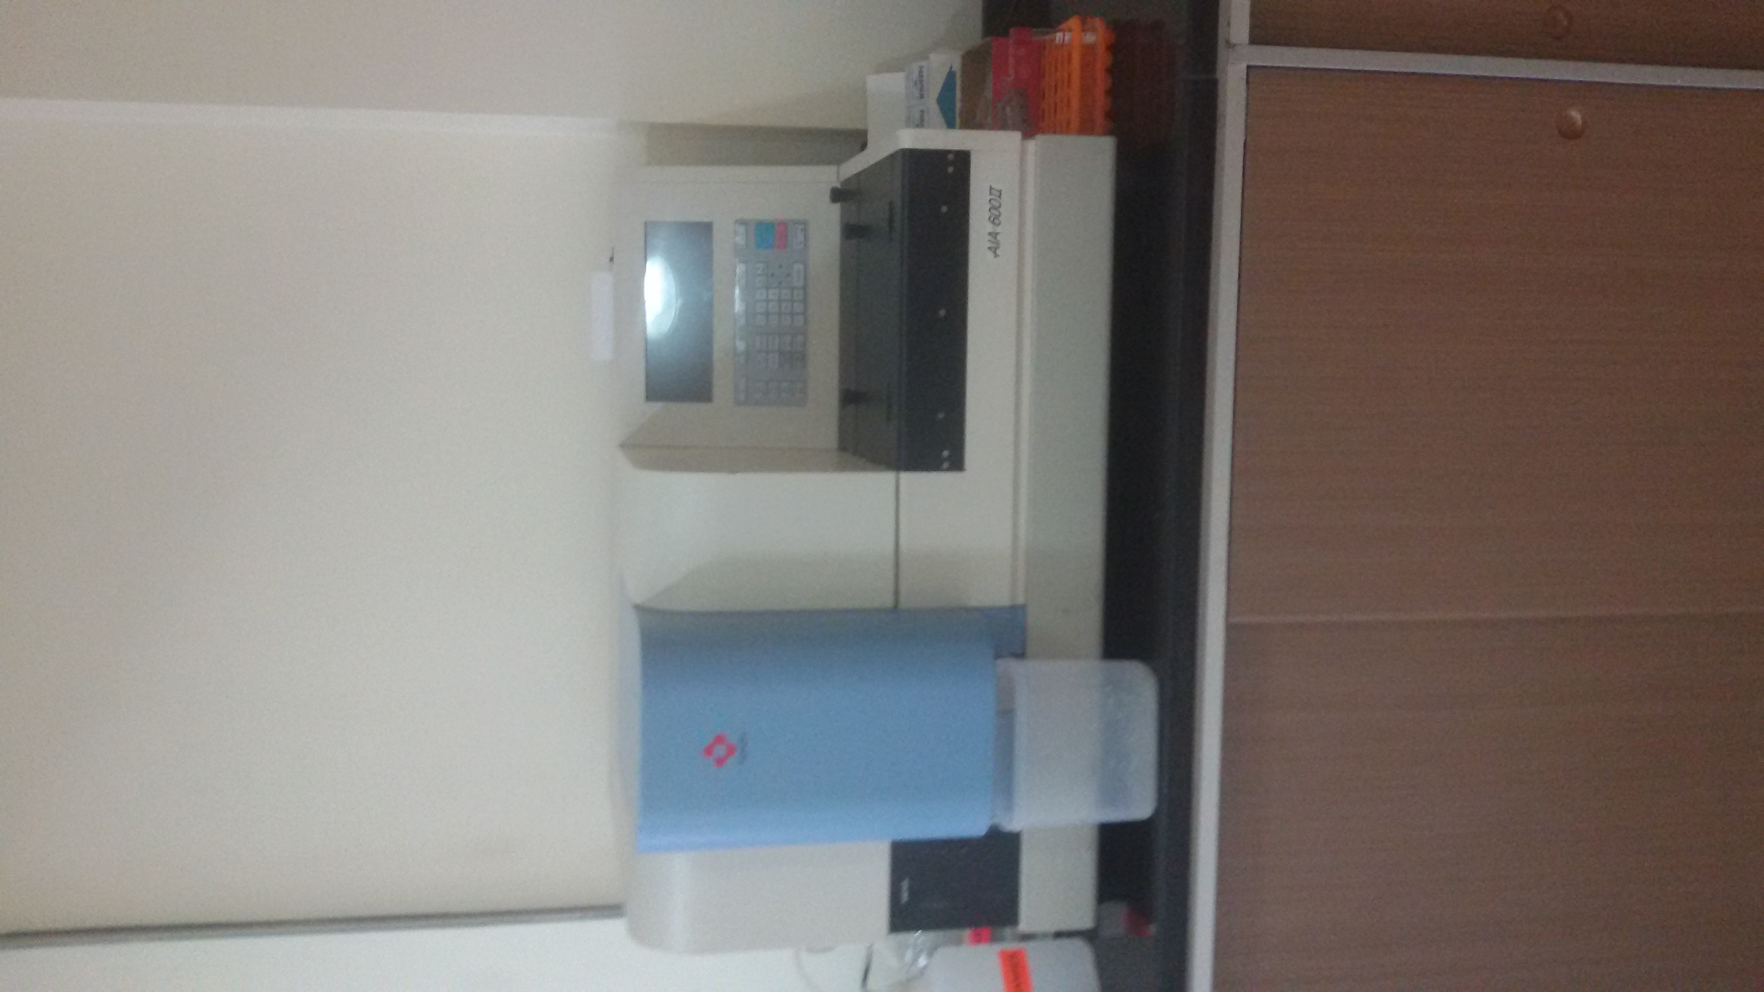
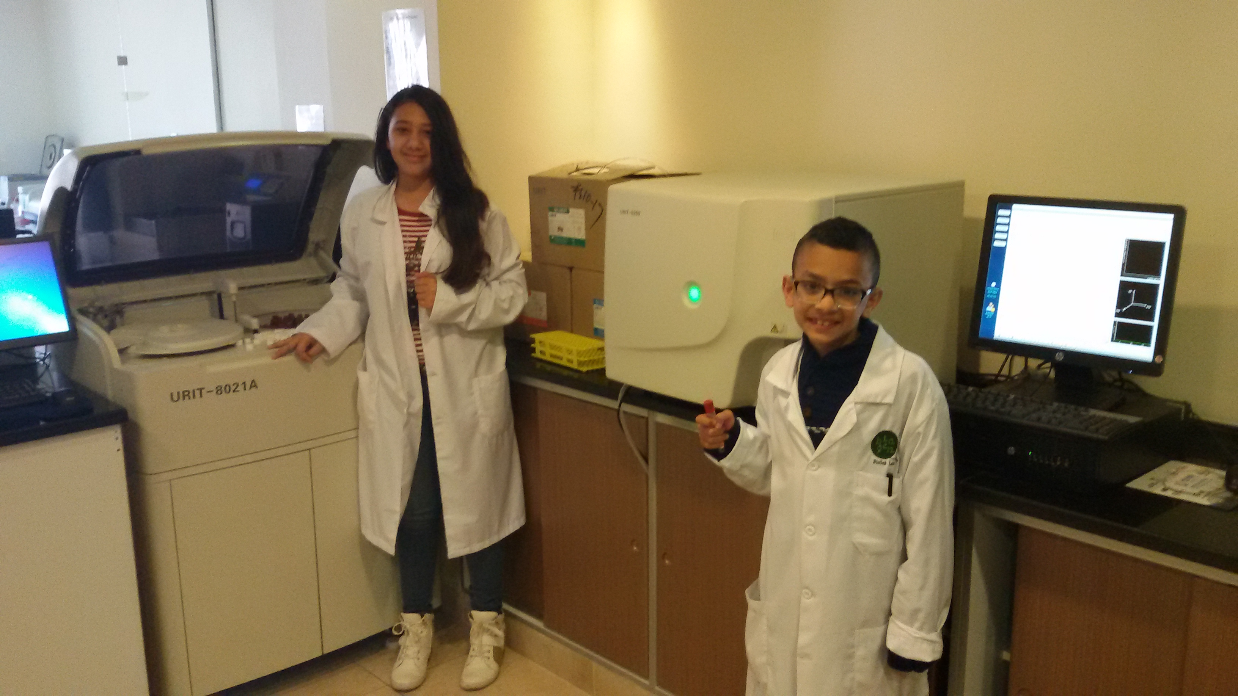
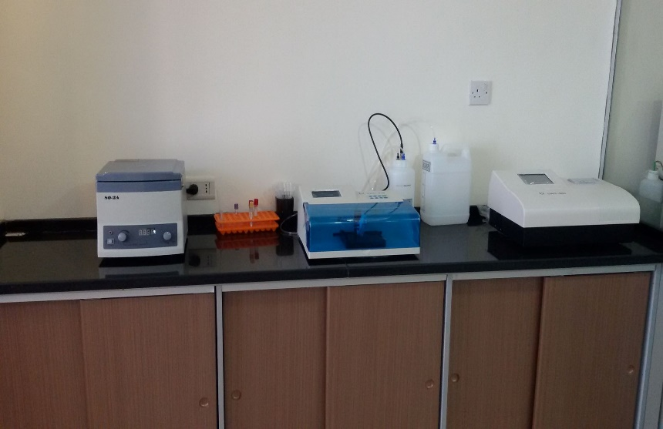
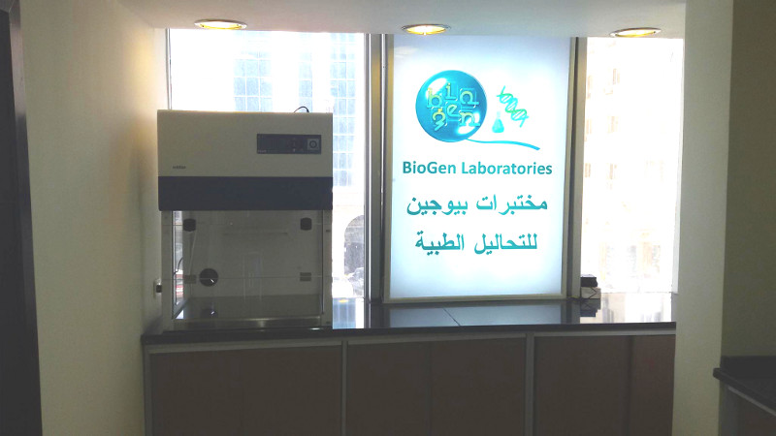

Dr. RAED KANAN

