Slide 1

Biogen Laboratory

Slide 2
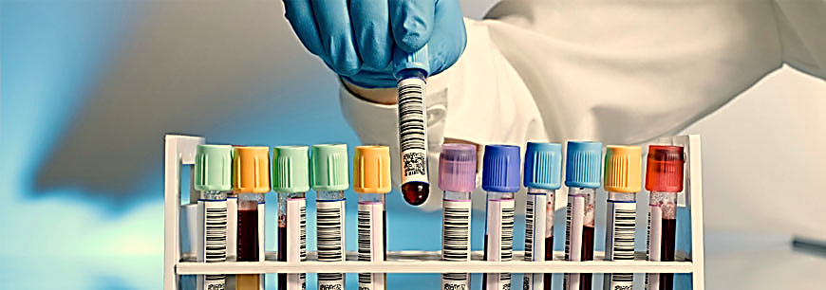
What is a Medical / Clinical Laboratory
A medical laboratory or clinical laboratory is a laboratory where clinical pathology tests are carried out on clinical specimens to obtain information about the health of a patient to aid in diagnosis, treatment, and prevention of disease.

Slide 3

Medical Laboratory Specialty
Clinical Medical laboratories are an example of applied science, as opposed to research laboratories that focus on basic science, such as found in some academic institutions.
Clinical laboratory sciences (also known as medical technology or medical laboratory science) is a biology/chemistry-based bachelor's degree that prepares students for exciting, challenging and dynamic careers in places such as hospital labs and clinics, forensic labs, veterinary clinics, industrial research labs and molecular biotechnology labs.

Slide 4

Medical laboratory specialty goals
Find laboratory technicians ready to keep pace with scientific advances in the field of laboratory medicine.
Graduating qualified cadres from a practical and scientific point of view with the ability to deal with modern laboratory techniques and devices.
Stimulating and promoting scientific research in the field of laboratory medicine.

Slide 5

Jobs chances
Medical complexes, hospitals and medical laboratories to allow laboratory technicians to perform various laboratory tests, such as: blood, urine, and stools, lung and kidney activity tests, liver activity, and clinical blood tests.
They are also allowed to work in food laboratories and factories of all kinds of foodstuffs and juices.
Pharmaceutical factories, and they have the opportunity to work in the fields of biotechnology, medical research centers, and areas of medical product development Such as: medical devices, solutions, and medical information analysis centers.

Slide 6
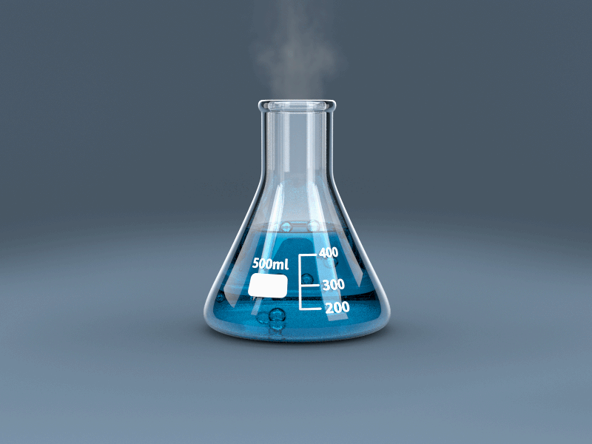
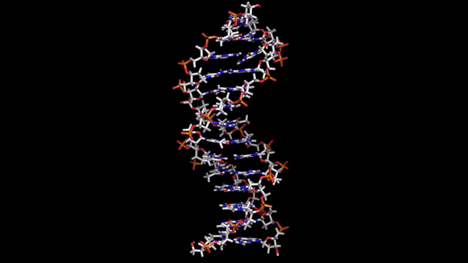

Diagnostics Clinical Laboratory Sections
Clinical Chemistry
Clinical Hematology
Clinical Microbiology
Molecular Diagnostics(Genetics)
Clinical Immunology
Clinical Endocrinology (Hormones)
Tumor Markers
Blood Bank
Routine and Microscopy
Cytology and Pathology

Slide 7
The role of a medical laboratory specialist
Giving accurate and logical information for laboratory analysis.
Knowing the basics of taking samples correctly, knowing the correct samples by collecting different samples from fluids or blood, and specifying specifications for acceptance or rejection in the laboratory.
Use and maintenance of automatic analysis devices.
Monitor the patient's general condition, and help diagnose and treat diseases by using the results of the analysis correctly.

Slide 8
The role of a medical laboratory specialist
Knowing the methods of molecular analyzes.
Knowing the quality control standards for the results of the various analyzes.
Knowing how to interpret the results of different analyzes, and how they relate to the disease.
The ability to administer the laboratory, establish its organizational structure, and ensure the quality of the laboratory.

Slide 9

Our Laboratories

Slide 10
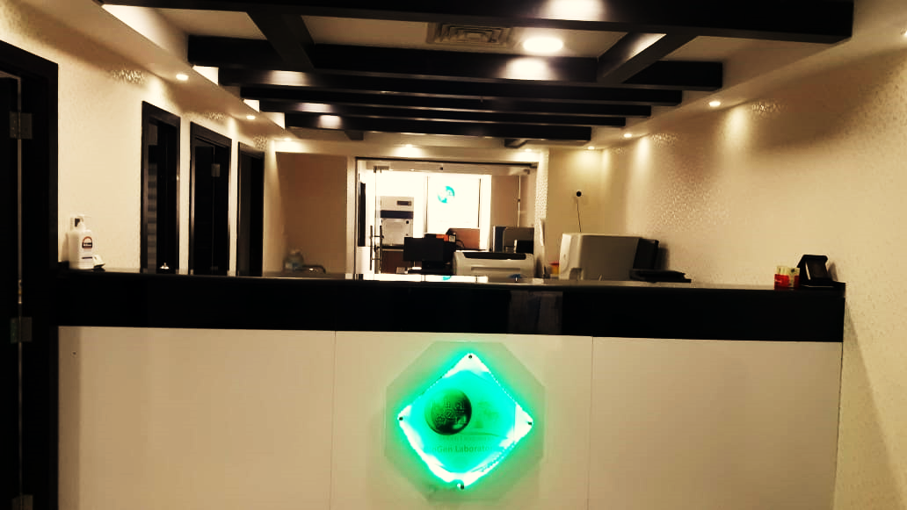
نبذة عن المختبر
تأسس المختبر عام 2014 ،واختار شعار بيوجين للتعبير عن قسمين رئيسيين في التحاليل الطبية:
Bio: from Biochemistry ( (كيمياء حيوية
Gen: from Genetics(وراثة)

Slide 11
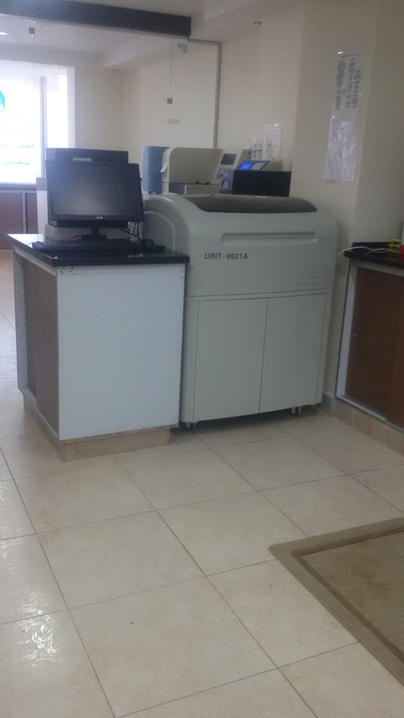
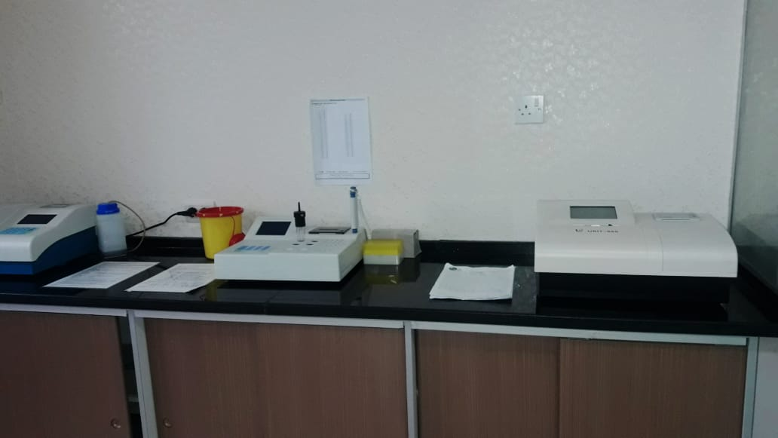
تضم مختبراتنا اقسام عديدة، وتقدم جميع الفحوصات المخبرية و مبنية على أجهزة حديثة ومتطورة، وتضم هذه الفحوصات ما يلي:
فحوصات الامراض الوراثية
الفحوصات الكيميائية لأنزيمات الكبد والقلب
فحوصات جميع الهرمونات والغدد وكاشفات الأورام
فحوصات البول وزراعة البكتيريا
فحوصات الأنسجة والخلايا السرطانية

Slide 12
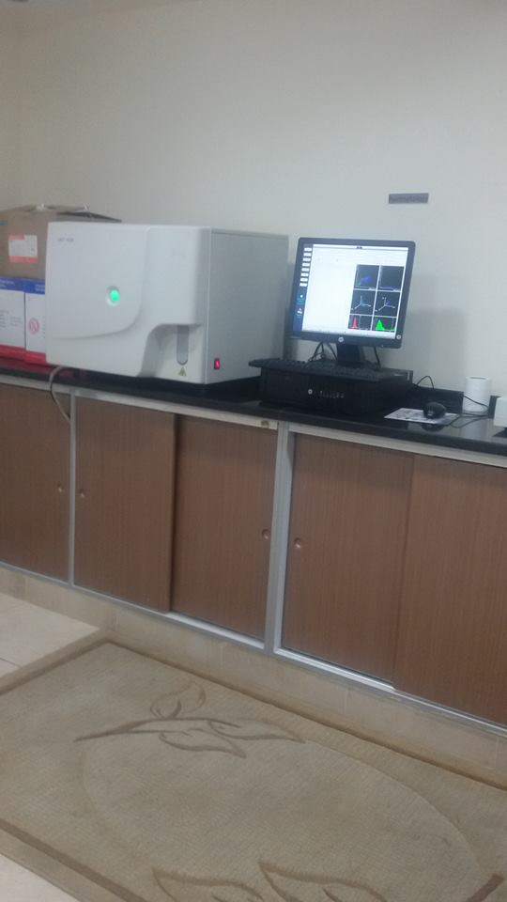
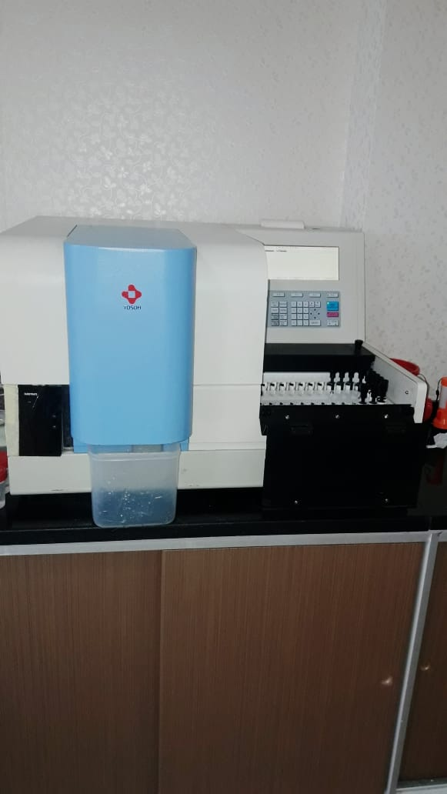
فحوصات السائل المنوي وهرمونات الخصوبة
فحوصات المناعة والروماتيزم والحساسية
فحوصات ما قبل الزواج
فحوصات الكبد الوبائي ونقص المناعة

Slide 13

لمزيد من المعلومات
Phone: (06)5510117, (077)5557117
Email: Info@biogen.dr-kanan.com
Web: Biogen.dr-kanan.com
Facebook: facebook.com/Biogenlabs
مختبرات الكنعان الطبية (بيوجين)
للتحاليل الطبية
عمارة 89 –شارع وصفي التل،
بجانب مستشفى الجاردنز
–

