Slide 1
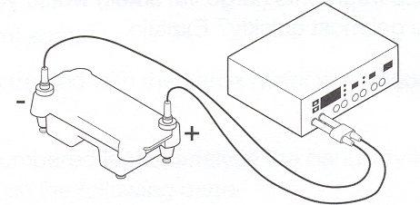
Electrophoresis
Introduction
  Principle of Electrophoresis
    Migration of charged particles in an electric field
    When electric field applied to medium with charged particles
      Neg charged particles (anions) migrate towards anode (+)
      Pos charged particles (cations) migrate towards cathode (-)

Slide 2
Electrophoresis
DNA (RNA) electrophoresis methods
  Based on type of matrix (i.e., support medium)
  Agarose electrophoresis
    Polysaccharide from seaweed (purified from agar)
    Migration of DNA is independent of charge
      At pH 7.0-8.0, DNA negatively charged
      Negative charge due to phosphate groups
      Mass to ratio is consistent (1 phosphate group/nucleotide)
      Charge has no effect
    Separation based on size (i.e., length) of nucleic acid (NA)
      Smaller fragments migrate faster
      Larger fragments move slower

Slide 3
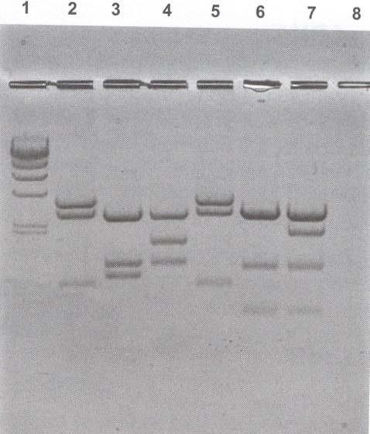
Electrophoresis

Slide 4
Electrophoresis
    Pros & cons
      Large range of separation (200 bp to 50,000 bp)
      Lower resolving power (sizes <100 bp hard to see)
      Easy to setup & perform
      Non-toxic
    Most commonly used in Clinical Lab
    Concentrations
      Most common 0.5% to 2.0%
      The higher the conc, the more dense the matrix & the smaller the pores, the slower DNA fragments migrate
        Higher concentrations for small fragments
        Lower concentrations for large fragment

Slide 5
Electrophoresis
Buffers
  Important Establish pH & provide ions for current conductivity
  Source of error
    If use only water, no ions in gel, conductivity lost & DNA won’t migrate
    If buffer not diluted properly, ion concentration too high, too much heat generated & gel melts
  Loading buffer (Sample buffer)
    Contents: 10-20% glycerol & tracking dyes
    Glycerol increases sample density, so sample “drops to bottom of well when loading gel
    Tracking dyes: Help visualize samples for
      Loading
      For tracking migration of samples through gel

Slide 6
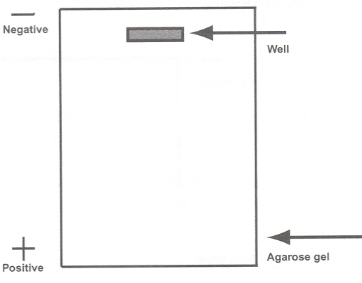
Electrophoresis
Visualizing DNA fragments
  Ethidium bromide
    Most common dye for DNA electrophoresis
    Fluorescent dye: Intercalates between bases of NA
    Under UV light, fluoresces & can visualize NA
    Usually included in gel & buffer
    Mutagen: Probably carcinogen (NASTY!!)
    Must use care when using
  Fast blast DNA stain
    Non-toxic & non-carcinogenic
    Wear gloves to protect hands from being stained
Website: http://learn.genetics.utah.edu/ → The Biotechniques Virtual Laboratory → Gel Electrophoresis

Slide 7
Electrophoresis
  Polyacrylamide gel electrophoresis (PAGE)
    Cross-linked polyacrylaminde polymer
    Pores more controlled and uniform
    Very high resolution
      Good for small fragment (5-500 bp)
      Can distinguish fragments with 1 bp difference
    Applications
      Traditional method for DNA sequencing
      Research
    Disadvantages
      Need large gel for DNA use
      Must be poured between glass plates
      Polyacrylamide: Neurotoxin

Slide 8
Electrophoresis
  Capillary electrophoresis
    Uses very small-bore, long capillary tube
    Newer technology for DNA sequencing
    Replacing PAGE
Analyzing results
  Depends on molecular technique
  Polymerase chain reaction (PCR) – Amplifies target
    Band present or not?
    Size appropriate?
      Can approximate size by visually comparing to DNA standards
      Qualitative result

Slide 9
Electrophoresis
  Restriction enzymes, Restriction Fragment Length Polymorphisms (RFLP) & “Fingerprinting”
    Uses include:
      Identity testing (old forensic test)
      Studying microorganisms involved in outbreaks
    Procedure
      Treat DNA with one or more RE
      Separate RFLPs with electrophoresis
      Include standard DNA ladder in 1 lane; standard contains several different DNA fragments of known size
      Measure distance known DNA fragments migrate

Slide 10
Electrophoresis
Standard
      Graph results
      Measure distance unknown fragments migrate, use graph to determine size of unknown
      Size determination (in base-pairs) for gel on
Size (bp) | Distance (mm)
23,000 | 11.0
9,400 | 13.0
6,500 | 15.0
4,400 | 18.0
2,300 | 23.0
2,000 | 24.0

Slide 11
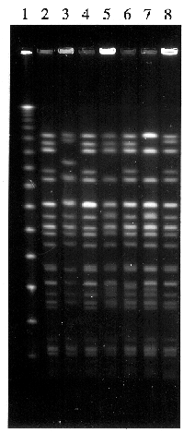
Electrophoresis
    Example: E. coli O157 outbreak: RFLP used to if determine isolates the same or different strain

Slide 12
Electrophoresis
  Pulse-Field Gel Electrophoresis (PFGE)
    Used to separate large DNA fragments (large RFLPs)
    Get better separation if precisely change direction of electrical current
    PulseNet
      Network of local, state, & federal agencies
      Foodborne disease-causing bacteria tested
        E. coli O157:H7 (4) Listeria
        Salmonella (5) Campylobacter
        Shigella (6) Vibrio cholerae
      Organism treated with restriction enzymes
      Pattern entered into data base
      Goal: Rapidly detect outbreaks & take preventive action

Slide 13
Electrophoresis Project
(8 Points)
Website: http://learn.genetics.utah.edu/ → The Biotech. Virtual Lab. → Gel Electrophor.
Name six items needed to make a gel.
How long does it usually take for a gel to solidify.
What is the purpose of the comb?
What type of pipette is used to transfer the DNA sample into a well in the gel?
Does the black cord/end generate a positive or negative charge? The red cord/end?
When examining the gel box, what tells you that the current is running?
In this exercise, what color is the tracking dye?
Which DNA stain was used in this exercise?
In this exercise what piece of equipment was used to examine the gel?
Report the size of the DNA fragments in the DNA sample.

Slide 14
Lessons
Briefly summarize the principle of electrophoresis.
Define the following terms: Cathode, Cation, Anode & Anion
State three functions of DNA electrophoresis.
Summarize the key aspects of DNA agarose gel electrophoresis including the:
  Effect charge has on migration
  Charge (positive or negative) of DNA at pH 7.0- 8.0.
  Separation principle
  Relative size of DNA fragments near the cathode; near the anode
  Effect of agarose concentration on DNA fragment migration
  Buffer concentration
  Composition of loading buffer & the functions of each component
  Methods for visualizing DNA fragments

Slide 15
Lessons
Compare agarose electrophoresis and polyacrylamide gel electrophoresis.
Compare ethidium bromide and fast blast DNA stains including:
  Uses
  Appearance
  Hazards
Very briefly summarize the use of capillary electrophoresis.
Briefly describe the use of Restriction Fragment Length Polymorphisms for characterizing bacterial strains.
Briefly describe the procedure for using a DNA ladder to determine fragment length.
Determine the length of a DNA fragment if given its migration distance and a graph depicting the migration distances of the components in a DNA ladder.
Analyze a gel and determine which organisms have identical fingerprints.
Very briefly describe:
  Pulse-Field Gel Electrophoresis (PFGE) procedure
  PulseNet (include the specific organisms monitored)

