Slide 1
Replication, Transcription, & Translation
Central Dogma of Molecular Biology
  Explains how proteins synthesized from DNA information
DNA (DNA Synthesis) → Replication
DNA (RNA Synthesis) →Transcription
RNA (Protein Synthesis) → Protein → Translation
  Proposed by Francis Crick (1955)
  Revised Central Dogma: Retroviruses transcribe RNA (their genome) into DNA with Reverse Transcriptase (an enzyme)
Transcription Translation
DNA (RNA Synthesis) → RNA (Protein Synthesis) → Protein
←←←←←←←←
Reverse
Transcriptase

Slide 2
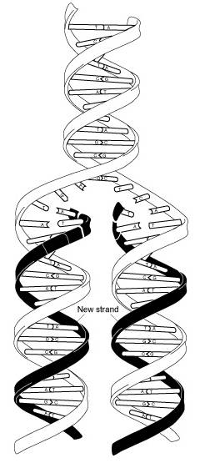
DNA Replication
DNA replication
  Cell division: Daughter cells have same genomic DNA (exact copies)
  General
    Process to make replica or identical copy of genomic DNA
    Involves DNA synthesis (biochemical creation of new strand of DNA)
    Semi-conservative: After replication each double strand (DS) of DNA composed of 1 “new” (daughter) & 1 “parent” DNA strand
    Base-pairing
      A-T; G-C
      Key aspect
      Assures DNA copied exactly

Slide 3
DNA Replication
  Enzymes & their actions (in sequential order)
    Helicase
      Unwinds & separates DNA double strand
      Special proteins prevent rejoining of double strands
    Topoisomerase: Reduces supercoiling (occurs during unwinding)
    Primase: Produces RNA primer
    DNA polymerase III
      Requires:
        Template: Parent DNA strand
        RNA primer: Complementary to DNA template
      Adds appropriate nucleotide to 3' end of new DNA strand

Slide 4
DNA Replication
  Strand replication
    Strands in DS DNA are anti-parallel (run in opposite directions)
    Newly synthesized DNA strands anti-parallel to parent strand
    Leading strand
      Replicated continuously from 3' end of the parent strand (template) with the newest end of the forming strand facing into the replication fork.
      New strand formed continuously going into replication fork
      Direction of strand formation 5' to 3' (see Lectures 2 & 3)
      New strand anti-parallel to parent strand

Slide 5
DNA Replication
    Lagging strand
      DNA polymerase replicates DNA only in 5' to 3' direction
      Parent strand in this case is in the 5' to 3' direction
      Parent & new strand must be anti-parallel
      Lagging strand formed in pieces (5' to 3'): Okazaki fragments
        5' to 3' synthesis occurs in direction opposite to fork movement
        Each fragment has its own RNA primer formed by primase
      After Okazaki fragment complete, DNA polymerase I removes RNA primer & replaces it with DNA
      Ligase (enzyme) links the fragments

Slide 6
DNA Replication
  Replication occurs at multiple sites on chromosome at the same time
  Website: www.dnai.org → Code → Copying the Code → Putting It Together → Replication

Slide 7
RNA synthesis
  Transcription: DNA information transferred (“transcribed”) to a newly assembled piece of RNA (i.e. DNA → RNA)
  Process - General
    DNA double helix unwinds
    RNA polymerase reads only one strand (template)
    Produces RNA (one stranded) which consists of A, U, C, G with ribose as the sugar
    RNA synthesized 5' to 3' direction
    Template for RNA : The 3' to 5' DNA strand (template strand)
    mRNA copy of the “non-template” DNA strand
      Except U instead of T
      mRNA travels to cytoplasm where it’s read to form protein

Slide 8
RNA polymerases
    Example
3' T-A-C-G-C-T-A-G-T-C-C-G-T-C 5' Template strand (Anti-sense)
5' A-T-G-C-G-A-T-C-A-G-G-C-A-G 3' Non-template strand (Message or Sense)
DNA 3’ T-A-C-G-C-T-A-G-T-C-C-G-T-C 5' Template strand
mRNA 5' A-U-G-C-G-A-U-C-A-G-G-C-A-G 3‘ Transcript
  RNA polymerases
    Eukaryotic cells
Enzyme Location Product
RNA polymerase I Nucleolus rRNA (ribosomal)
RNA polymerase II Nucleoplasm mRNA (messenger)
RNA polymerase III Nucleoplasm tRNA (transfer)
mt RNA polymerase Mitochondria mtRNA (mitochondria)
    Prokaryotic cells: Simpler system

Slide 9
  Transcription steps
    Transcription Steps
    Initiation
      Promoters: DNA regions that signal RNA polymerase starting point
      Factors (proteins) help RNA polymerase recognize promoter
      Short section of DNA helix unwinds
    Elongation
      RNA polymerase moves along DNA
      Synthesizes RNA 5' to 3'
    Termination (2 mechanisms)
      Terminator sequence: Stop RNA polymerase
      Termination factors (proteins)

Slide 10
  Post-transcriptional processing
  Post-transcriptional processing
    Occurs in nucleus
    Pre-mRNA: RNA first transcribed from DNA; contains
      Introns
        Noncoding
        Stay within nucleus
      Exons
        Coding
        Exit nucleus
    RNA splicing
      Noncoding introns removed from pre-mRNA
      Done by spliceosomes (special enzymes)

Slide 11
Post-transcriptional processing

Slide 12
Post-transcriptional processing
  mRNA additional processing
    5' Cap: Special modified nucleotide added to 5' end
    Poly(A) tail
      Added to 3' end; number of As in tail varies
      Can be used to help isolate mRNA; poly(T)s attached to column in solid phase extraction protocol; Poly(A) tail hybridizes to Poly T & mRNA attaches to column
  Websites
    www.dnai.org → Code → Copying the Code → Putting It Together → Transcription (Transcription animation)
    www.dnai.org → Code → Copying the Code → Putting It Together → Interactive (Student can transcribe DNA into RNA)

Slide 13
Translation
Translation
  General
    Translation: Synthesis of protein using mRNA as template
    mRNA transported to cytoplasm for protein synthesis
    Proteins (polypeptides): Linear sequences of amino acids joined by peptide bonds (See page 24, Clinical Biochemistry by S. Goldberg)
    20 Amino acids used to make proteins
    Proteins have directionality
      Encoded by mRNA 5' to 3'
      Amino terminus: 5'
      Carboxy terminus: 3'

Slide 14
Translation
  Triplet code (Codon)
    3 nucleotides encode for 1 amino acid
    64 codons: 4 nucleotides in a triplet code (4)³
      Genetic code is redundant (AKA degenerate)
      An amino acid may be encoded by more than 1 codon
    Genetic code

Slide 15
Translation
    Genetic code has punctuation
      UAA, UAG & UGA: Stop codons
      AUG:
        “Start” codon (AKA initiation codon)
        Codes for methionine
        All proteins start with methionine
    Codons do not overlap
      5'-GCCCAC-3'
      5'-GCC CAC-3'
    Mutations or errors in genomic DNA carry through to mRNA & may change protein composition (depending on the error)
    Example
5'-UUUAUGGUACUUAAAGGCCCCUAUUAGGGG-3' mRNA
5' UUU AUG GUA CUU AAA GGC CCC UAU UAG GGG 3' Codons
5' UUU AUG GUA CUU AAA GGC CCC UAU UAG GGG 3'
Met Val Leu Lys Gly Pro Tyr Stop Amino acids

Slide 16
Translation
  Role of transfer RNA (tRNA) in translation
    tRNA carries amino acids to ribosome for to be added to polypeptide
    Each tRNA molecule specific for only one amino acid
    Each tRNA molecule specific for specific mRNA codon
    tRNA anticodon complementary to mRNA codon
      Codon for Phe in mRNA: UUC
      Anticodon of tRNA^{Phe} : AAG

Slide 17
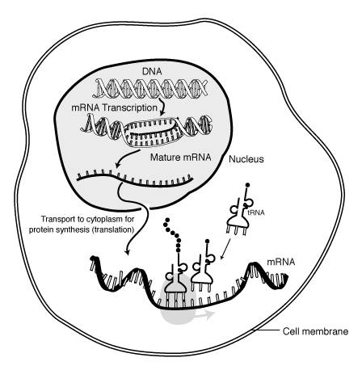
Translation
  Ribosome
    Protein-ribosomal RNA (rRNA) complex
    Ribosome binds to mRNA at initiation site to form initiation complex
    Codons on mRNA “read” by tRNA
    The appropriate tRNA base pairs with codon
    Ribosomal enzyme catalyzes formation of peptide bond
    Polyribosome: Multiple ribosomes on a strand of mRNA

Slide 18
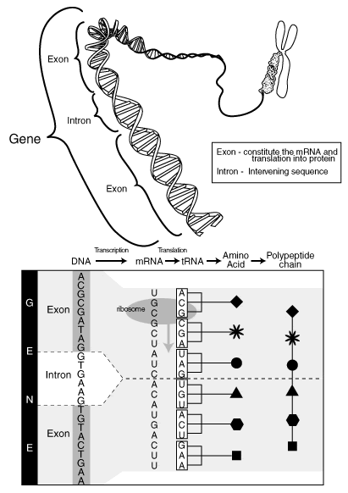
Translation

Slide 19
Replication, Transcription & Translation Project
(5 Points)
1- Website: http://www.dnai.org →Code → Copying the Code → Putting It Together → Replication
a. How fast is the helicase unwinding the double helix?
b. Is the “backwards” looping strand being copied continuously or one section at a time?
2- Website: http://www.dnai.org →Code → Copying the Code → Putting It Together → Transcription
a. The blue molecule is:
b. The yellow strand is:

Slide 20
Replication, Transcription & Translation Project
(5 Points)
3- Website: http://www.dnai.org →Code → Copying the Code → Putting It Together → Interactive
The first nucleotide in the RNA strand that you synthesized was:
The last nucleotide in the RNA strand that you synthesized was:
4. Website: http://learn.genetics.utah.edu→ The Basics and Beyond→ Transcribe & Translate a Gene
The start codon is:
The first amino acid is:
The last amino acid in the polypeptide you synthesized is:
The stop codon for this exercise is:

Slide 21
Lessons
Briefly summarize the following:
  Central dogma of molecular biology
  Revised central dogma of molecular biology
Outline the DNA replication cycle including the following aspects:
  Specific enzymes and their function f.Direction of replication
  Semi-conservative replication g.Okazaki fragments
  Base-pairing h.Multiple initiation sites
  Leading strand i.Process location
  Lagging strand
Outline the RNA synthesis cycle including the following aspects:
  Directionality of synthesis e.Initiation
  RNA polymerases f.Elongation
  Template (Anti-sense strand) g.Termination
  Non-template (Sense strand) h.Process location
Define the following terms:
  Transcription e.Intron
  Translation f.Exon
  Codon g.Spliceosome
  Anticodon h.Polyribosome

Slide 22
Lessons
Outline the process of translating mRNA into a protein. Include the following:
  Protein directionality
  Triplet code (codon)
  Functions of mRNA, tRNA, rRNA & ribosomes
  Stop & start codons
  Location of process
When give a strand of DNA determine the complementary:
  DNA strand
  RNA strand
When given a strand of mRNA determine the amino acid sequence using a “Genetic Code” table.
Summarize post-transcriptional mRNA processing including:
  Location of process
  Modifications at the 5' and 3' ends

