Slide 1
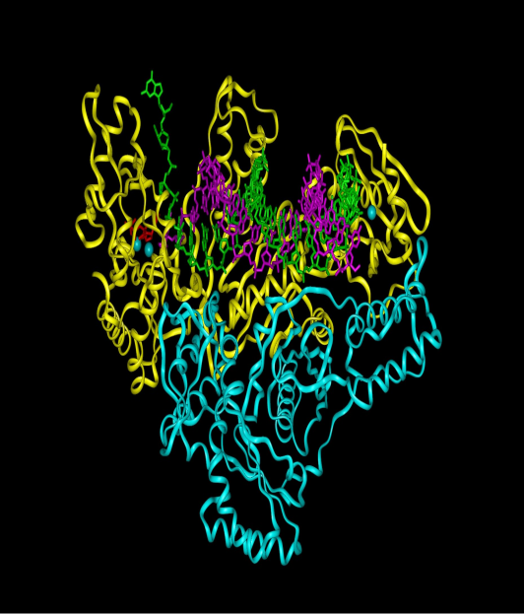
PCR Variations
Introduction - Several PCR variations
  Reverse Transcriptase - PCR
  Multiplex PCR
  Real Time - PCR
Reverse transcriptase - PCR
  Reverse transcriptase
    A DNA polymerase
    Isolated from retroviruses (RNA virus)
    Transcribes RNA into DNA
      Human mRNA
      Virus RNA
  “New” DNA = Complementary DNA (cDNA)
  cDNA used in PCR

Slide 2
Reverse Transcription

Slide 3
Reverse Transcription
Purpose: Detect RNA in patient specimens
  Detect RNA viruses
    Human Immunodeficiency Virus (HIV)
    Hepatitis C Virus (HCV)
  Determine gene “expression”
    Is a particular gene actively transcribed & translated?
    Sometimes mRNA better than DNA for diagnosing disease
Reverse transcription of mRNA into cDNA
  mRNA has poly(A) tail
  Reverse transcriptase needs primer: Use poly(T) primer
  Genomic Vs cDNA
    Genomic DNA: Introns & exons
    cDNA copy of mRNA (therefore NO introns)
    Amplifying gene from genomic DNA different from cDNA

Slide 4
Reverse Transcription

Slide 5
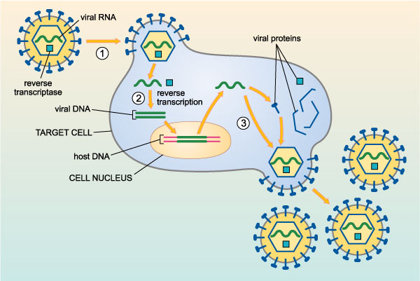
Reverse Transcription
Reverse transcription of Viral RNA into cDNA
  Different type of primers
  Sequence specific primers

Slide 6
Multiplex PCR
Multiplex PCR
  Amplification of 2 or more target sequences in one reaction
  Need primer set for each target
  Purpose: ID species & at same time detect target sequence
  Example: Methicillin-resistant Staphylococcus aureus (MRSA)
    Amplify staphylococcus & S. aureus specific gene
    Amplify methicillin-resistance gene

Slide 7
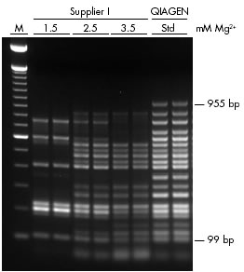
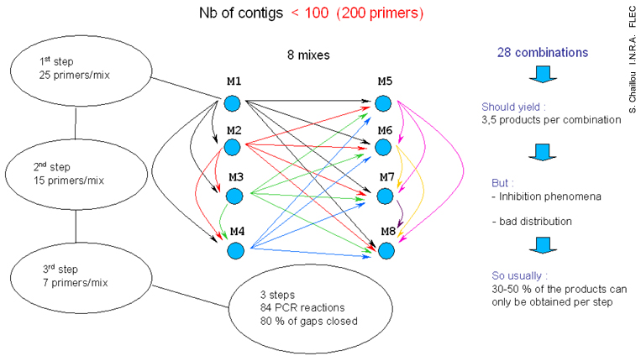
Multiplex PCR

Slide 8
Real-Time PCR
Introduction
  Traditional PCR = End-Point PCR
    Amplicon detected at end of series of reactions
    Semi-quantitative (how many copies?????)
    Distinguishes amplicons based on size
    Not automated
    Requires post-PCR processing (e.g., gel electrophoresis)
  Real-Time
    Uses chemicals to detect PCR amplification during early phase of reaction
    Can quantitate starting amount of nucleic acid
  Multiplex Real Time PCR also available

Slide 9
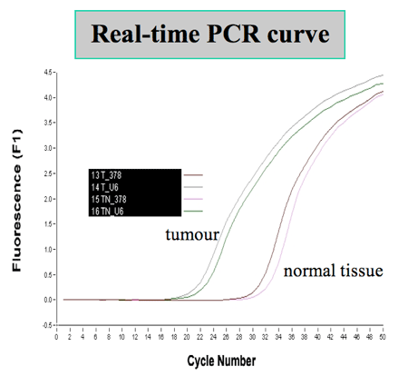
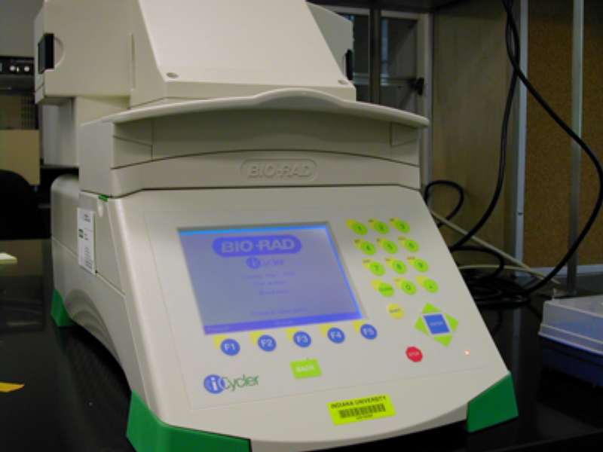

Slide 10
Real-Time PCR
PCR Phases
  Exponential (AKA Geometric)
    Reaction specific & precise
    Exact doubling of product every cycle
    Phase used in Real-Time PCR
  Linear
    High variability
    Reaction components being consumed
    Reaction slowing
    Products starting to degrade
  Plateau
    End-point for gel detection
    Reaction has stopped
    No more products being made
    PCR products will degrade if left too long

Slide 11

Plateau
Exponential
Linear

Slide 12
Real-Time PCR (TaqMan)
TaqMan® Method (Hydrolysis probe)
  2 types of fluorophores (fluorescent dyes)
    Reporter (R)
    Quencher (Q)
  Fluorescence Resonance Energy Transfer (FRET)
  One dye (Q) interferes with fluorescence of the other (R)

Slide 13
Real-Time PCR (TaqMan)
Principle/Process
  Target DNA denatured to single strands by heat
  Primer binds to template/target DNA
  TaqMan Probe binds to template/target DNA
  Taq polymerase synthesizes new DNA.

Slide 15
Real-Time PCR (TaqMan)
Principle/Process
  When it reaches TaqMan Probe it removes Reporter & then entire TaqMan Probe including Quencher
  Reporter is now free of Quencher & can fluoresce
  Fluorescence measured
    C_{T} = Cycle threshold = Number of PCR cycles to reach threshold where fluorescence detected
    High initial conc. needs fewer cycles to reach C_{T}
    Low initial conc. needs more cycles to reach C_{T}
  Standard curve
    Known concentrations of target (original DNA) plotted against C_{T} values
    Concentration in patient specimen then determined

Slide 16
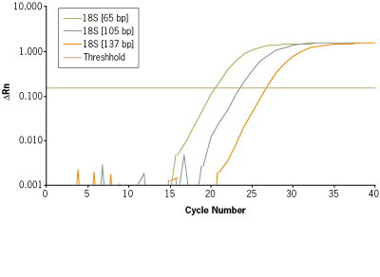
Real-Time PCR (TaqMan)

Slide 17
Real-Time PCR (TaqMan)
Molecular Beacon Method (Hybridization probe)
  FRET based technology
  Molecular beacons
    Short strands of single stranded DNA
    Nucleotide sequence of beacon customized for specific target
    Beacon forms a hairpin
      Ends are complementary
      “Loop” contains target specific nucleotides
    Fluorescent dyes at each end
      Reporter
      Quencher
    Quencher dye interferes with Reporter

Slide 18
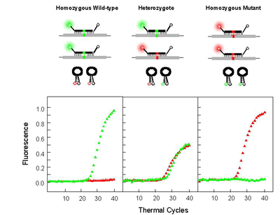

Slide 19
Real-Time PCR (TaqMan)
SYBR® Green Method
  Fluorescent probe
  SYBR Green probe binds to double-stranded DNA
  Non-specific binding; can bind to any double-stranded DNA
  Fluorescence increases as PCR increases amount of DNA

Slide 20
Real-Time PCR (TaqMan)

Slide 21
PCR Variations (Lessons)
Define the following terms:
  Reverse transcriptase e. FRET
  Complementary DNA f. Cycle threshold (CT)
  Gene expression g. Hydrolysis probe
  Oligo dT primer h. Hybridization probe
Summarize the Reverse Transcriptase – PCR technique including its:
  Principle
  Clinical uses
  Key components
Be able to draw a simple diagram of:
  Reverse transcriptase PCR
  TaqMan Real-Time PCR
  Beacon Real Time PCR

Slide 22
PCR Variations (Lessons)
Compare genomic DNA and complementary DNA made from mRNA.
Briefly describe Multiplex PCR and give an example of its use
Compare Real-Time and End-Point PCR including
  Amplicon detection methods
  Ability to quantitate amplicons
  Automation
Draw a PCR graph and label its three stages.
Compare the three stages of PCR including:
  Reaction speed
  Reaction specificity and precision
  Reaction components

Slide 23
PCR Variations (Lessons)
Outline the TaqMan PCR method including its:
  Principle
  Method for determining initial concentration of analyte
Summarize the principle of the:
  Molecular Beacon PCR method
  SYBR Green PCR method

