Slide 1



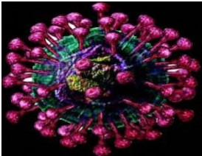

Nov
I
Coro
avirus
0LJtb
e

Slide 2
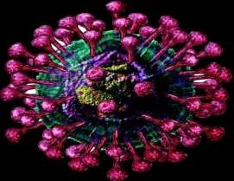
INTRODUCTION
○ Corona virus was first identified as a cause of
the common cold in 1960.
○ Until 2002, the virus was considered a
relatively simple, nonfatal virus.
○ An outbreak of severe acute respiratory syndrome coronavirus (SARS-CoV) in 2002 to 2003 in Guangdong province in China,
caused an eventual 8,098 confirmed cases,
resulting in 774 deaths reported in 17 countries.

Slide 3
○ Since then scientists became deeply concerned
about the pathogenesis of coronaviruses.
○ In 2012, again another coronavirus MERS-CoV
caused an outbreak in Saudi Arabia caused
1227 cases with fatality rate 37%.

Slide 4
○ Over the last three decades there have
been three attacks of three different
coronaviruses, SARS-CoV, MERS
CoV and
the recent one 2019 novel coronavirus
(2019-nCoV).

Slide 5
CHARACTERISTICS:
○ Family: Coronaviridae
○ Gender: Coronavirus
○ Genome: linear positive sense single-
stranded RNA, pleomorphic, 80
30 serotypes
○ Spherical or helical.
○ 60-200 nm. in diameter.
○ Total RNA without segmentation
to
220
nm,

Slide 6
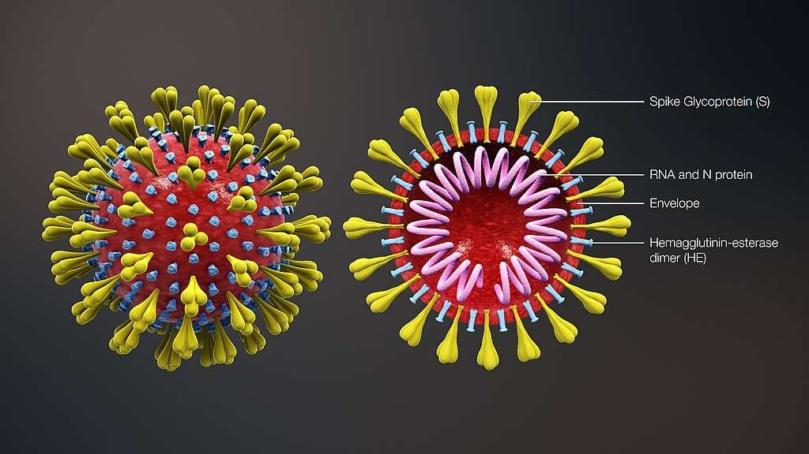
CORONAVIRUS

Slide 7
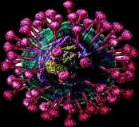
○ Surface antigens are glycoproteins and
nucleoproteins internally.
○ Glycoproteins were characterized:
E1. Transmembrane.
E2. Adhesion to the cell membrane.
○ Protein S. Form projected responsible for stimulating, neutralizing antibody and interaction with cellular receptors.

Slide 8
○ Bind to cells via specific receptors.
○ Enter through membrane fusion.
○ In the cytoplasm, the viral RNA is translated by the host machinery.
○ Viral proteins are synthesized, assembled,
are fused to the cell membrane.

Slide 9
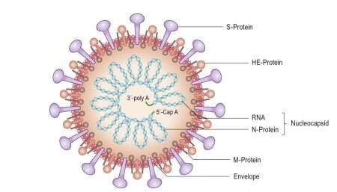
CORONAVIRUS

Slide 10
Major Proteins:
○ S – spike (receptor binding cell fusion).
○ E – envelope (small: envelope protein, not as abundant as S).
○ M – membrane protein (transmembrane budding and envelope formation)

Slide 11
2019 NOVEL CORONAVIRUS (2019-NCOV)
○ A new strain of coronavirus which differs
considerably in genetic structure from previously recognized coronavirus.
○ Othername: Wuhan CoronaVirus, Wuhan
seafood market pneumonia virus.

Slide 12
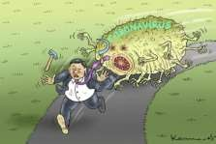
EPIDEMIOLOGY
The first known human infection occurred in early December 2019. An outbreak of 2019-
nCoV was first detected in Wuhan, China, in mid- December 2019, likely originating from a single infected animal. The virus subsequently spread
to other provinces of Mainland China and other countries, including Thailand, Japan, Taiwan, South Korea, Australia, France, Nepal, India and the United States and more.

Slide 13

○ On 30 January 2020, 2019-nCoV was
designated a global health emergency by the
World Health Organization (WHO).
○ First confirmed death was on 9 January 2020.
○ As of 5 February 2020, there were 24,604 confirmed cases of infection, of which 24,391 were within mainland China.

Slide 14

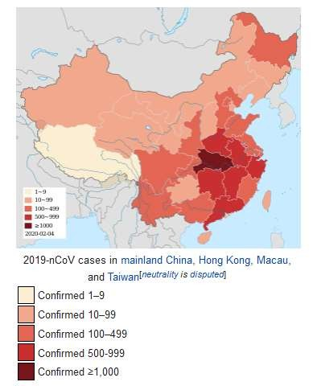
GEOGRAPHIC DISTRIBUTION

Slide 15
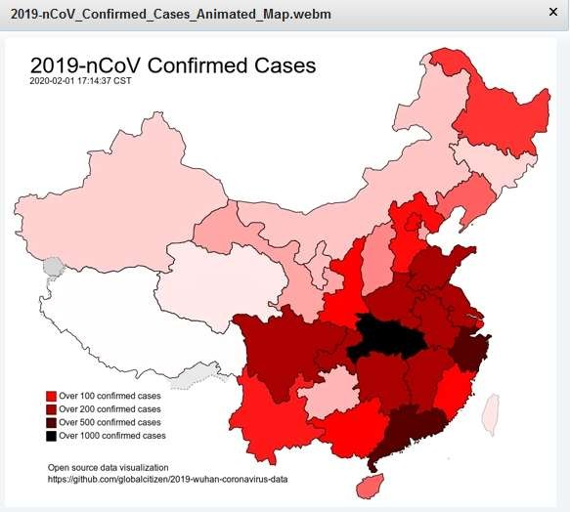
GEOGRAPHIC DISTRIBUTION

Slide 16
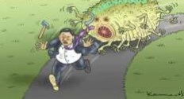


2019-20
Wuhan
coronavirus
outbreak
•
t
,.,,.._
~,.. .
)
' --
. ~
-
Arnrn
^{---.c}-^{m} ----------------
ate o map of confirmed 2019-nCo\/
cases spreading
from
12 .Janu arv 2020 to 5 February" 2020
Date
1 December
(2 months
2019-ongoing:
1 ::2:
and
4 day's}
in
China:-::::
Location
First identified
..,-._.ur1an. Hubei.
Casualties
.A.s of 5 February"
2020 :c: .:e .
Confirmed
cases: 24.588:-'-:
Deaths:
493:c::
Affected territories:
28

Slide 17
Co.rrrir rn
tJational
e d cases
Health
in rn atnf arrd
Con1n1ission
China
daily
according
reports:-=--
to the
· - · e }
4 .•
(.
2020-01-1 '3
2020-01-17
2020-01-18
2020-01-19
2020-01-20
2020-01-21
2c.12L.1-01-2: ..-
_{I} --------
6 2
I + 3
⁰u ^{c_.·:)}
1 ~^{•C}
1
I + ^{g} •.
I + t~i 4
c ··:)
1
^{g} 0'"
c,.:)
2 ^{g} 1
4 4 Cl
I + 4
7
C-:i
~
c . :i
I + 1
-
~
7
1
I +
^{--,} c, c,.:,
-
-
~'U~'U
U1 ., :·
ll 1 ~'-1
:.:~
< u
• -I
c
I
' '
~'U~'U
1
. • ,,
r
•
' '
·:,
u
I
~-'(l~'(I
ll1
~-'·
I • .: •
"
:20:20-01-:27
2020-01-2;3
2020-01-29
2020-01-30
2020-01-31
2020-02-01
2020-02-02
2020-02-03
2020-02-04
c:
97.j
I+ 32G·:)
7
9
11
711
':::,92
9 1
1+29r:.:i
I -+-2':::,c .. :)
I + 2 2 c.,
7
17
20~
l--+-2[1C_.-:J:
1+1 gc_.-:):
1+1gc.-:i:
20.438
24.-:::24

Slide 18
2019-20
nCoV
Confirmed
outbreak
by
countryf'";,·
Country
liiillllll
or
region
•
Deaths
•
Recoveries
•
Reference
re;•:
re,.:
re:c:
re:c:
rec:
re::::
re::::
lc ,, -
r,1a1nland
China
24
348
491
892
~
•
japan
Singapore
28
2:5
1
s
Thailand
111::111
:-:
^{i}-^{alll}
Hong
l<ong
21
1
South
l<orea
19
--
Australia
14
2
Gerr11ar1y
12
r,,1 a I av s I a
12
I c .;
11111
-
Ta1·~var~
1 1
i
united
r, 1 a c a u
V I t_• t 11 d
States
1 1
r
r r I'
.:::::II
11:111
••
• ,._.
m::::
10
111
1 ()
f rdllCt•
c : ,-Hl
I'
iHld
l
l ir ut
e ·fl Ar dt)
E
111,r
,--11c-,.c.
I'
Incl 1,·--1
'>
I'
~
Ph1l1pp1nes
:?,
r
r I,.
re;•
re;•:
re,.:
rec:
re:-:
rec:
rec:
•
•
ltalv
2
2
2
-
Russia
-,-:: United
-
•
•
l<1ngdon1
Belg1un1
1
11:!1 ^{Can1bod1a}
1
~
E3:::
-
-^{I !C}-^{l}
Finland
1
rJepal
1
Spain
1
Sn Lanka
1
1
1
S•.veden
28 territories
24,589
493
907
i;..::::. of-=- Fe:::.ruar·.
2020
H1::::.tor, ·=--t-11,-1.3
::::::tt-1'='1 =·

Slide 19
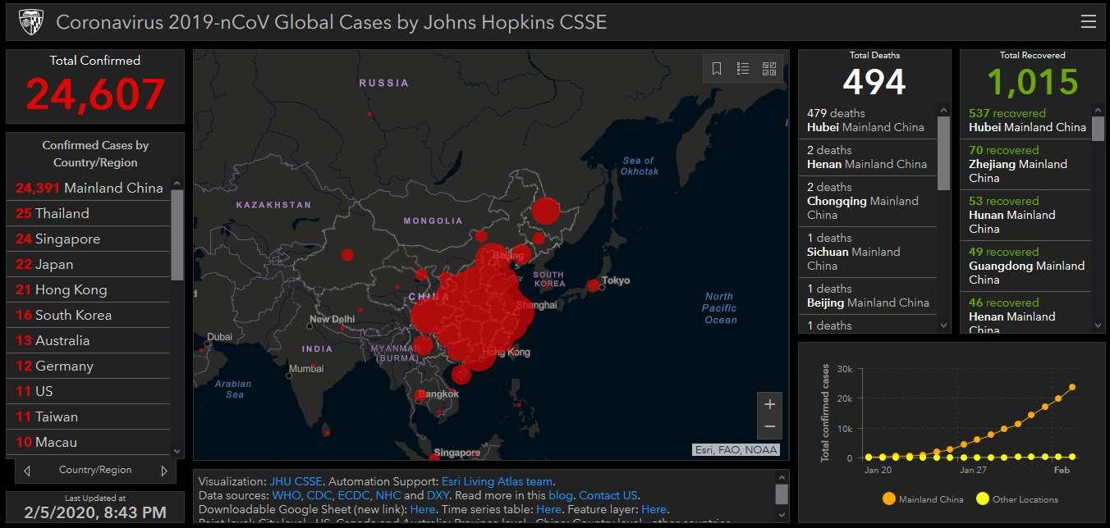

Slide 20
○ The suspicion of emergence of new virus
arose when a cluster of people in a sea-food market at Wuhan City, China developed pneumonia without any clear cause.
○ The virus isolated from the sample is in the same family of viruses SARS-CoV and MERS- CoV
○ Genetic homology is about 75-80% with
SARS-CoV.

Slide 21
RESERVOIR
○
Animals sold for food are suspected to be the
reservoir or the intermediary because many of the first identified infected individuals were workers at the Huanan Sea food Market, Hubei, Wuhan,China.
A market selling live animals for food was also blamed in the SARS epidemic in 2003
Researchers confirmed by genomic study,
○
○
○
2019-CoV
have 96% homology with Bat
corona viruses.

Slide 22
FIRST TRANSMISSION OF 2019-NCOV WAS
ZOONOTIC
○ 2019-nCoV is thought to be a zoonotic virus,
as most
workers seafood
of the first group of patients were
or customers of a local whole sale market which also sold live
consumable animals, including poultry,
donkey, sheep, pig, camels, hedgehogs, snakes etc

Slide 23
○ 2019-nCoV might have jumped from host
species bats to snakes and then to humans.
○ Snake is the intermediate host between human and bat.
○ In the animal host viruses undergo repeated mutations to get allowed to transmit to the human
○ After reaching the human, person to person
transmission is possible.

Slide 24
MODE OF TRANSMISSION
○ Human-to-human transmission of the virus has
been confirmed. Coronaviruses are primarily spread through close contact, in particular through respiratory droplets from coughs and sneezes within a range of about 6 feet (1.8 m).
○ When a person touches a surface or object contaminated with infectious droplets and then touches his or her mouth, nose or eye(s)

Slide 25
○ Incubation period 02-14 days
○ Viral RNA has also been found in stool
samples from infected patients.
○ It is possible that the virus can be infectious even during the incubation period but this has not been proven and the WHO states that "transmission from asymptomatic cases is likely not a major driver of transmission" at this time.

Slide 26

From animalsto humans: the emergenceof a new virus
~IA(,t • SIA(,t j ') ' AC, t 4
• • • • •
Viru1 Animal d11ea1e reservoir Intermediate ho1t1 Tran1mi111on to humaM, D111em1nat1on
.','t , r \. I+, i" . r ,, , 11 ill, 1,1: I·, then between humans ,'.1 • I •.-• .J _{• I} 1··1 '. i•• ··;•,, n ¹¹
Corona·mus :1·,'t". ~.JI',, hr,: 1.)'l1pi•. theovet 1 hf.', ,r,.. ; ,.,;:, .,;•JJ~·: n¹:>h1;,. pr:p,,l.11101~.
le· Ebol• ,i:d SARS' 1d 1~·¹1'.J!•
. - ... ' ',
•
•
_',I/

Slide 27
○ The basic reproduction number has been
estimated to be 3.11, which means on average an infected person will infect 3 others.

Slide 28
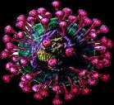
SIGNS AND SYMPTOMS
Those infected may be asymptomatic or have
mild to severe symptoms like fever, cough, shortness of breath, and diarrhoea. The time from exposure to onset of symptoms is estimated at 2 to 10 days by the World Health Organization and 2 to 14 days by the US Centers for Disease Control and Prevention (CDC). Upper respiratory symptoms such as sneezing, a runny nose or sore throat are less frequent.

Slide 29
Cases of severe infection can result in
pneumonia, kidney failure and death. Many of those who died had other conditions such as hypertension, diabetes, or cardiovascular disease that impaired their immune systems.

Slide 30
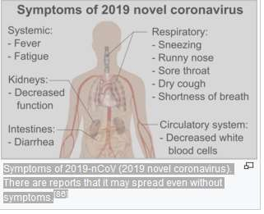

Slide 31
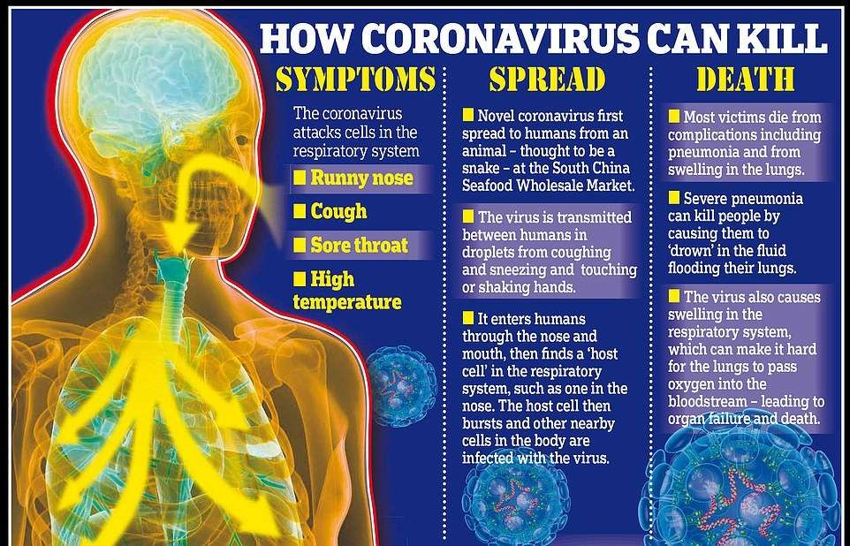

Slide 32
ESTIMATES
○ Researchers at Northeastern University and
Imperial College London estimated that the number of actual infections maybe 10 times higher than those confirmed .

Slide 33
DIAGNOSIS
The WHO has published several testing protocols for 2019-nCoV. Testing uses real time reverse transcription-polymerase chain reaction (rRT-PCR).The test can be done on respiratory or blood samples. Results are generally available within a few hours to days.

Slide 34
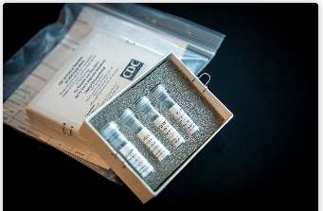
PICTURE OF CDC’S LABORATORY TEST KIT FOR
THE 2019 NOVEL CORONAVIRUS (2019-NCOV)

Slide 35
MANAGEMENT
There were no effective medications or vaccines
against 2019-nCoV, though development efforts were underway. Attempts to relieve the symptoms include taking regular (over-the- counter) flu medications, drinking fluids and resting. Oxygen therapy, intravenous fluids and breathing support may be required.

Slide 36
EXPERIMENTAL TREATMENT
The NHC, recommends patients be
given two lopinavir & ritonavir
twice a
day & a dose of alpha interpheron
through nebulization twice daily.

Slide 37
In China treatment are given as follows :
✓ Tamiflu ( Oseltamivir ) antiviral therapy:
it may help to reduce symptoms. It must be
taken within 48 hours of onset
otherwise it does not work.
✓ Antibiotic
✓ Corticosteroid
✓ O2 support
of
symptom

Slide 38
COMPLICATION
○ Acute respiratory distress
○ Anaemia
○ Acute cardiac injury
○ Acute kidney injury
○ Secondary infection
syndrome

Slide 39

PREVENTION

Slide 40
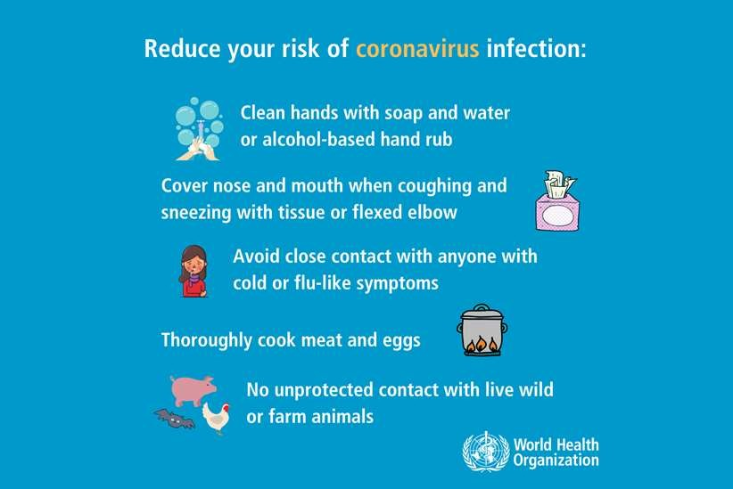

Slide 41
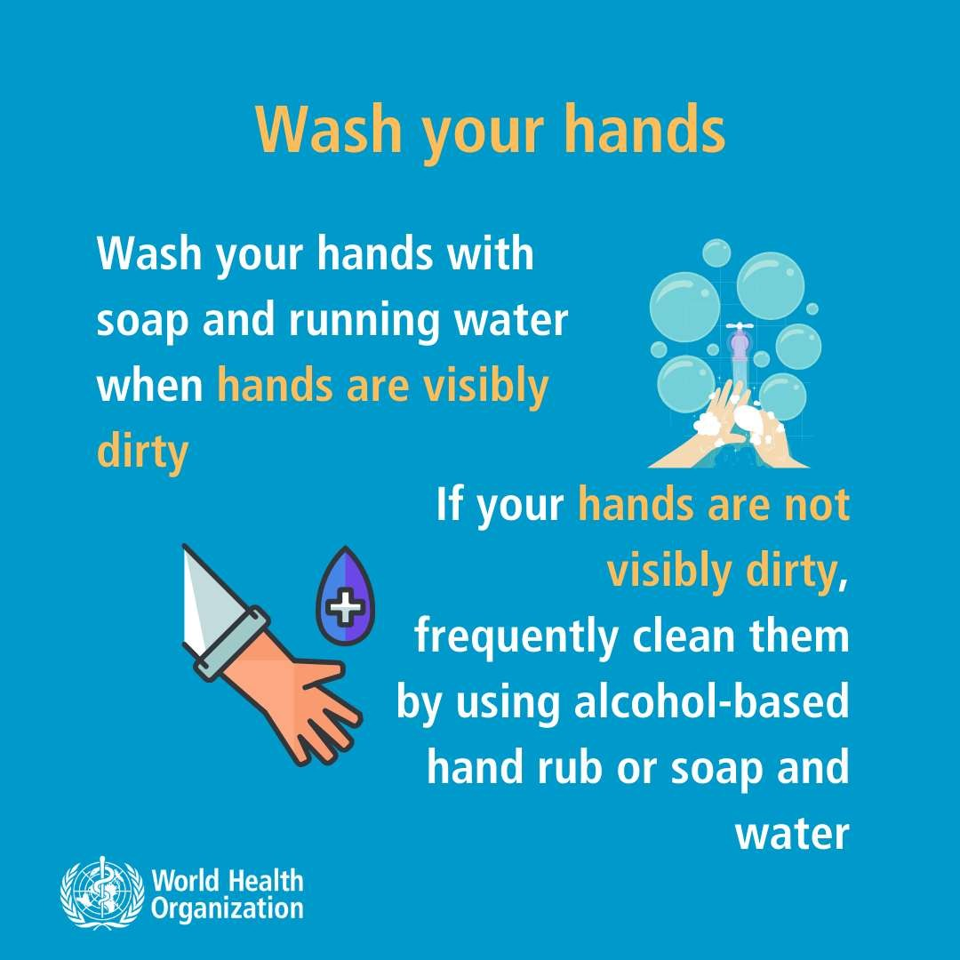

Slide 42
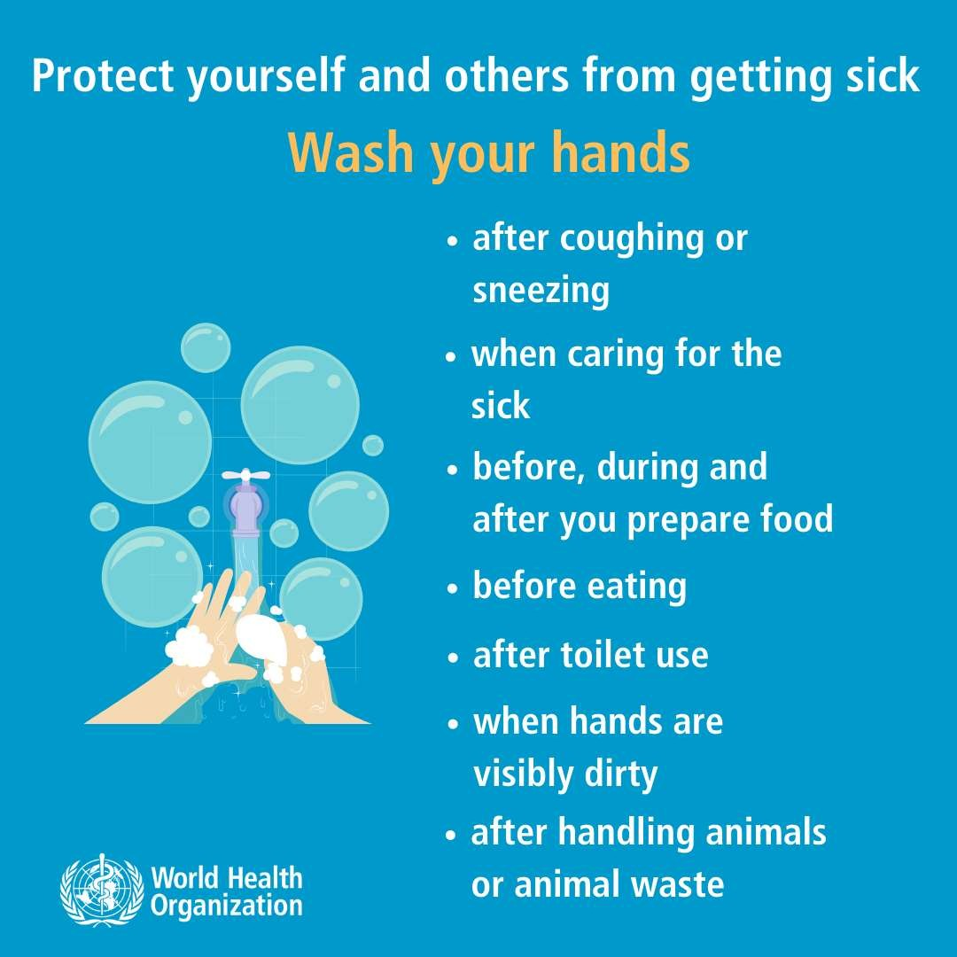

Slide 43
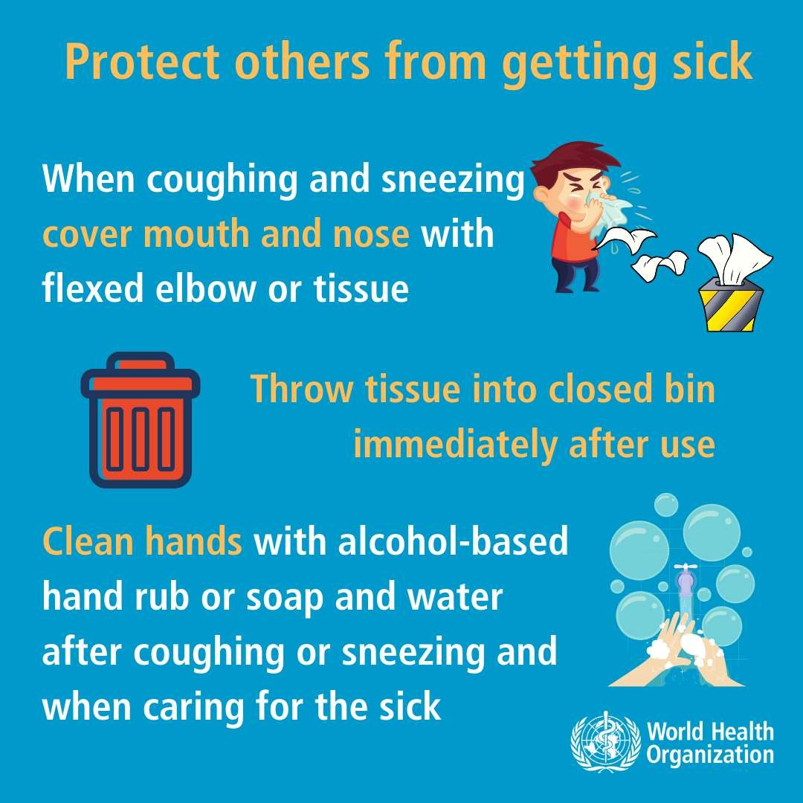

Slide 44
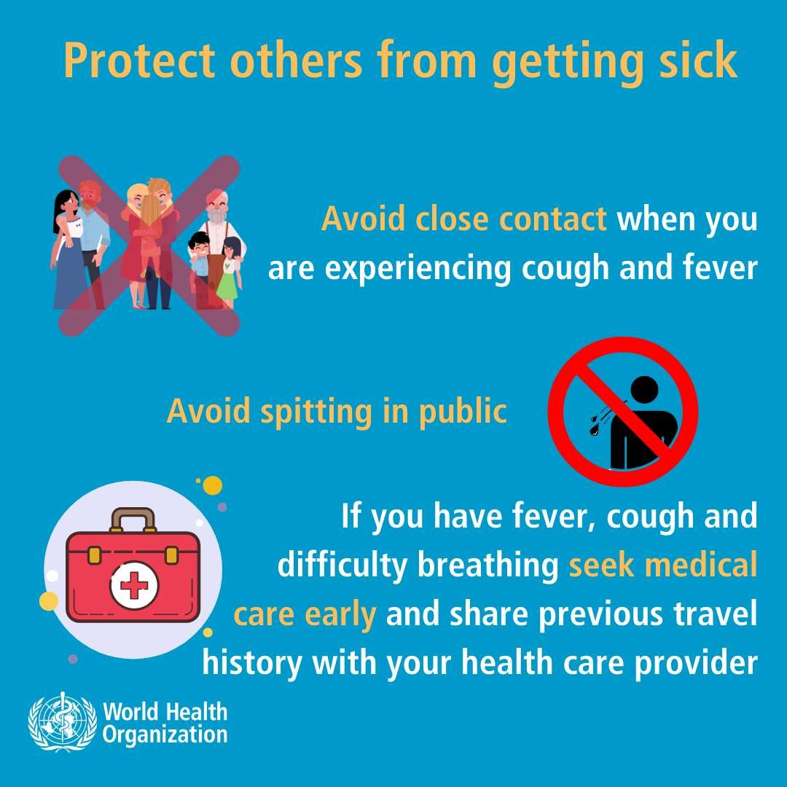

Slide 45
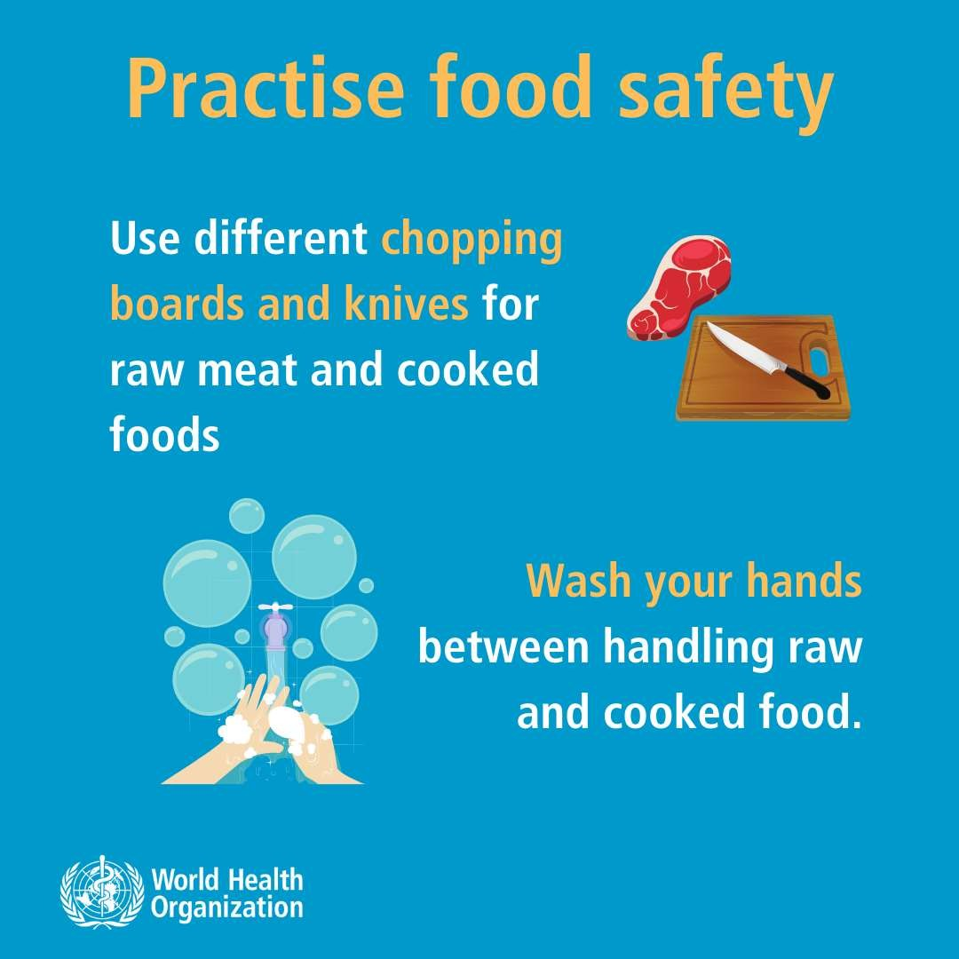

Slide 46
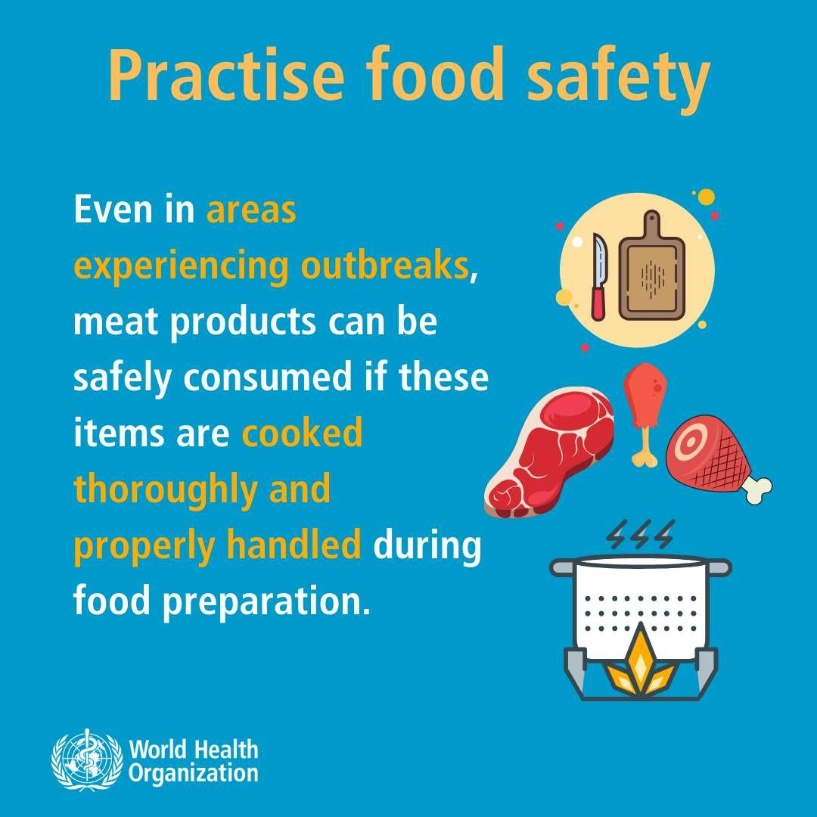

Slide 47
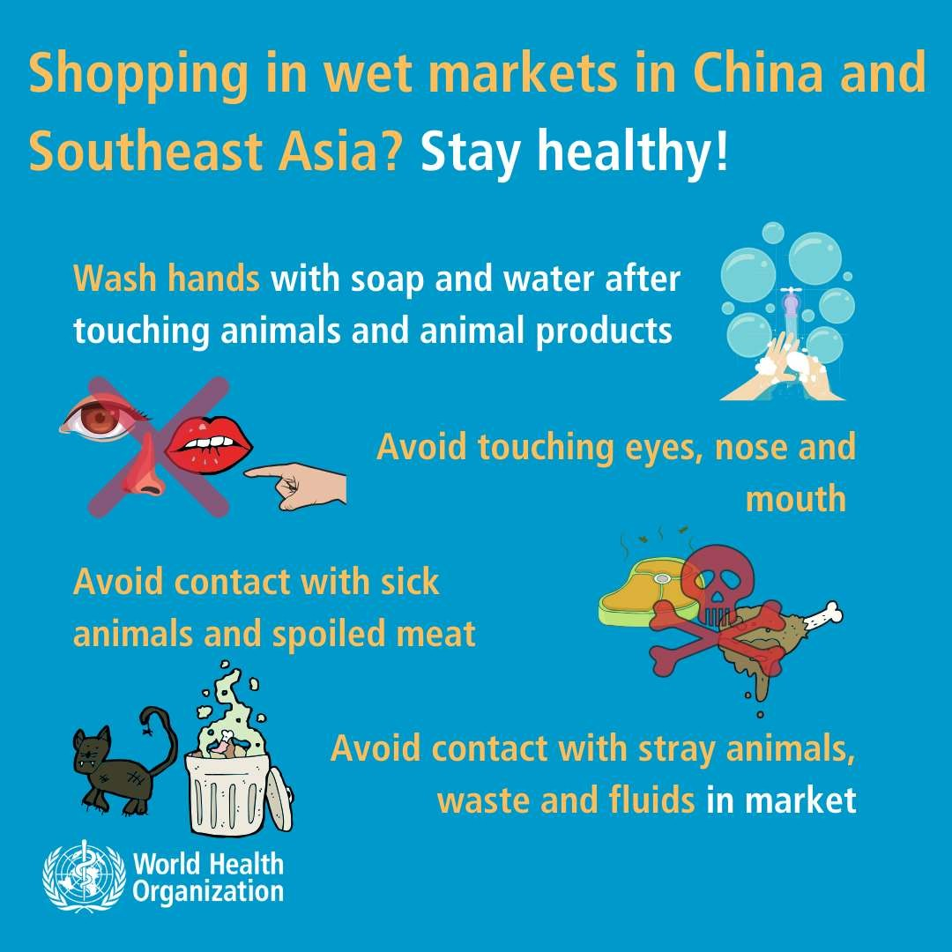

Slide 48
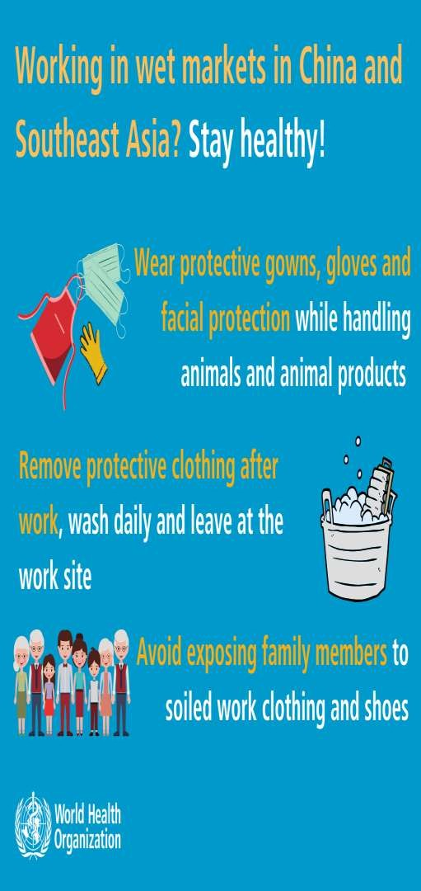
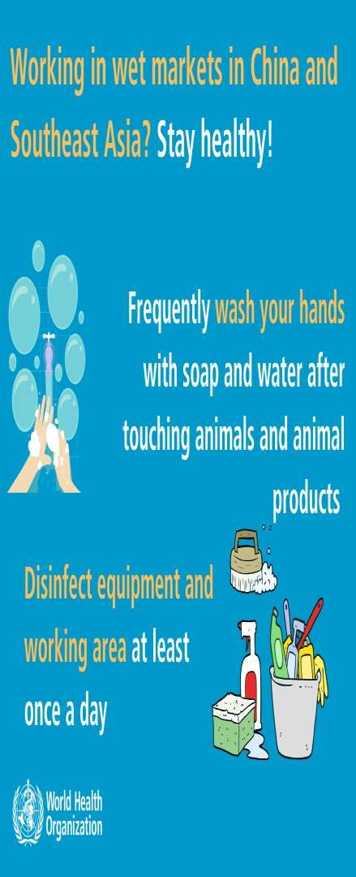

Slide 49








WHILE
TRAVELLING
WHILE
TRAVELLIN
Avoid travel if you have
Avoid close contact
with people suffering from a fever and cough
a
fever
and
cough
Frequently clean hands
If you have
a fever, cough and
using alcohol-based
difficulty breathing seek medical
care early and share previous travel history with your health care provider
hand rub or soap and III
Avoid touching eyes,
nose or mouth

Slide 50

WHILE TRAVELLING
When coughing and sneezing cover mouth and nose with flexed elbow or tissue - throw
WHILE TRAVELLING
If you become sick
~
A
·~~:a
while
travelling,
~,,
inform crew and
tissue away
immediately and
seek medical
early
care
wash
hands
If you choose to wear
a face mask, be
sure to cover mouth and nose·
avoid touching mask once it's on
If you seek medical
attention, share travel history with your health care provider
I I
•••
00~
0
Immediately discard single-use mask
after each use and wash hands after removing masks

Slide 51



WHILE
TRAVELLING
Eat
only
well•
food
cooked
Avoid
spitting
in
public
Avoid
close
contact
with
and
travel
animals
that
are
sick

Slide 52
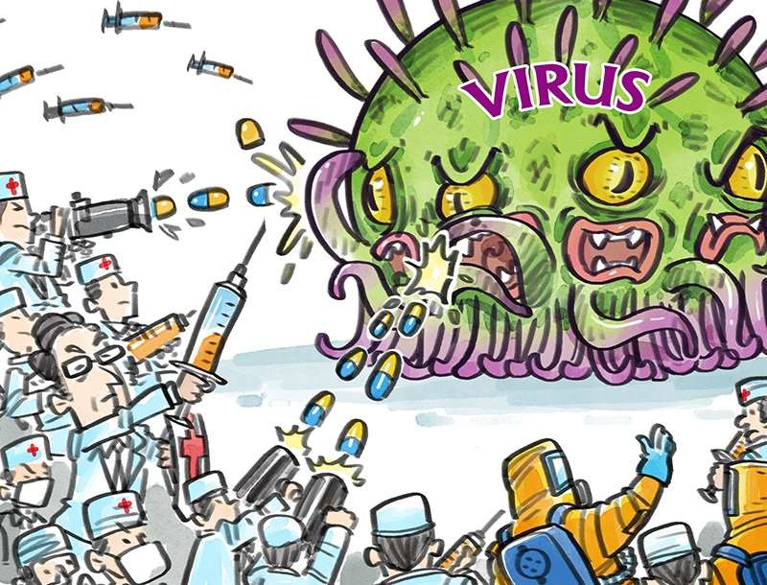
VACCINE RESEARCH

Slide 53
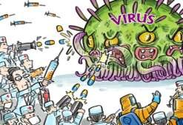
○ In China, the Chinese Center for Disease
Control and Prevention is developing a vaccine against the novel coronavirus.
○ University of Hong Kong, which previously participated in work on the SARS coronavirus during its 2003 outbreak, has also announced that a vaccine is under development there but has yet to proceed to animal testing.

Slide 54
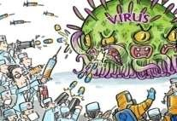
○
The United States National Institutes of
Health (NIH) is cooperating with Moderna to create an RNA vaccine matching a spike of the coronavirus surface, and is hoping to start production by May 2020.
In Australia, the University of Queensland is investigating the potential of a molecular clamp vaccine that would genetically modify viral proteins to make them mimic the coronavirus and stimulate an immune reaction.
○

Slide 55
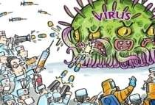
○ The International Vaccine Centre (VIDO-
InterVac) at the University of Saskatchewan to begin work on a vaccine. VIDO-InterVac aims to start production and animal testing in March
2020, and human testing in 2021.
○ The Imperial College Faculty of Medicine in London has funding to develop a vaccine and take it to animal testing, a phase of research it expects to complete by mid-February 2020.

Slide 56
PROGNOSIS
The overall case fatality rate appears to
approximately 3% based on initial case reports; however, the true number of infections and disease course are still unknown at this time. Most of those who died were older and/or had underlying
be
health conditions. Case fatality rates were
approximately 37% for MERS and 10% for
SARS.

Slide 57

WHAT CHINA
NCOV
IS DOING TO CONTAIN 2019-
○ The country
has put 16 cities on lockdown,
keeping about 46 million people quarantine.
○ Extension of new year holidays
○ Educational institutes kept suspended up to
mid February
○ More provinces and cities outside the most contaminated Hubei started to restrict travel.

Slide 58
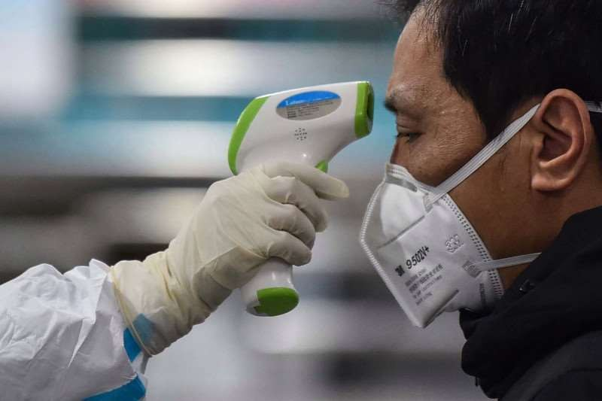
A MEDICAL STAFF MEMBER TAKES THE
TEMPERATURE OF A MAN AT THE WUHAN

Slide 59
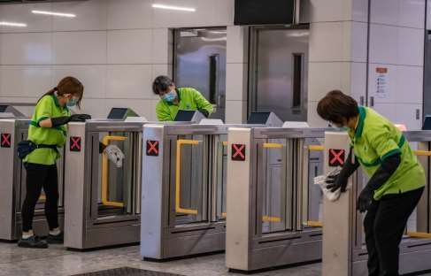
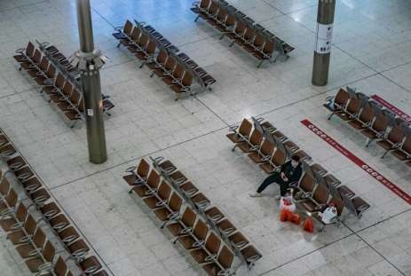
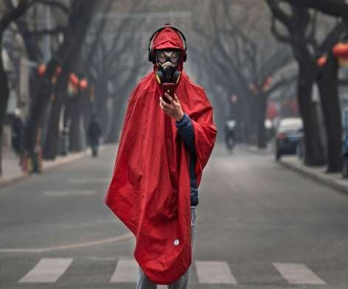
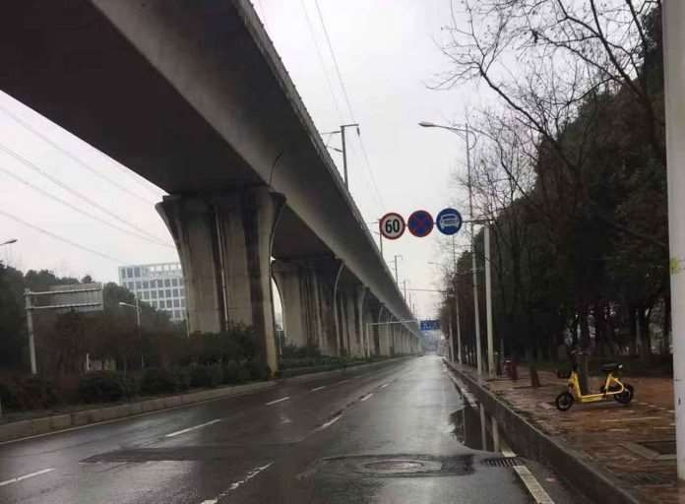

Slide 60
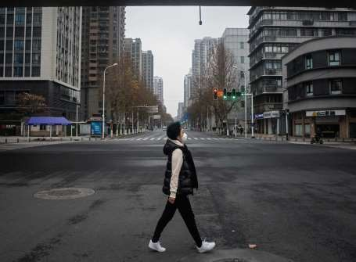
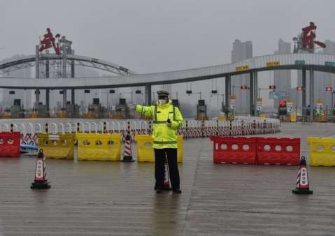
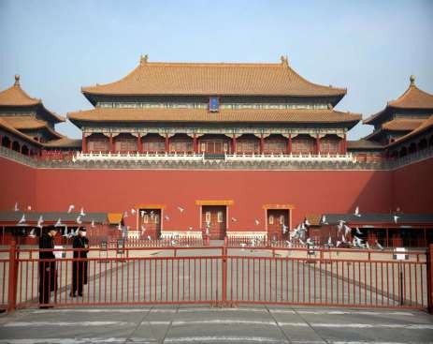
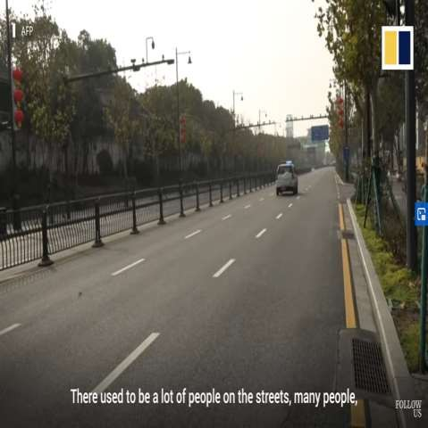

Slide 61
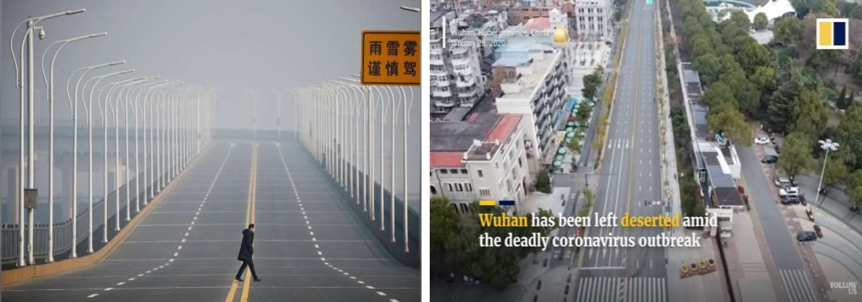
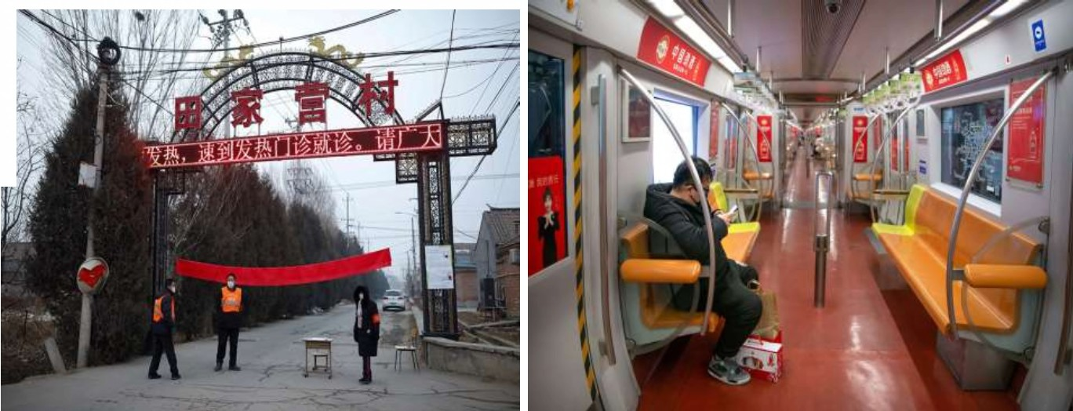
I
'
^{I}i

Slide 62
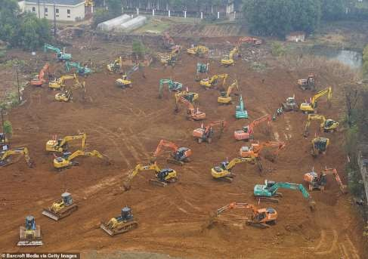
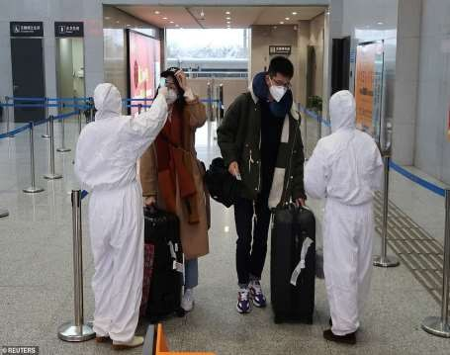
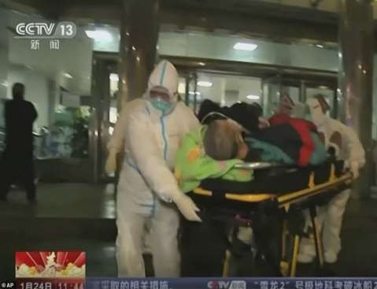
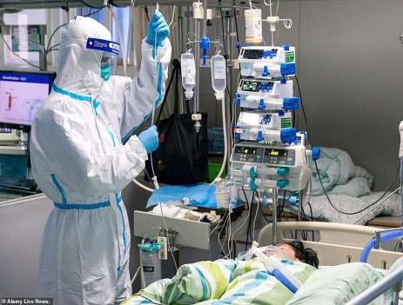

Slide 63
○ Since 31 December 2019, some regions and
countries near China tightened their screening of selected travellers.
○ People with fevers are subsequently taken to medical institutions after being registered and given masks.
○ Real time Reverse Transcription-Polymerase Chain Reaction (rRT-PCR) test was used to confirm new cases.

Slide 64
SITUATION IN BANGLADESH
○ No confirmed cases are found in Bangladesh.
○ Still, we are in vulnerable situation
○ Emergence of 2019-nCoV will cause an ultimate
massacre in our densely populated country
○ The IEDCR has launched four hotlines for creating awareness among people about the epidemic. The numbers are: 01937110011,
01937000011, 01927711784 and 01927711785.

Slide 65
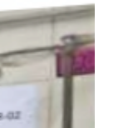
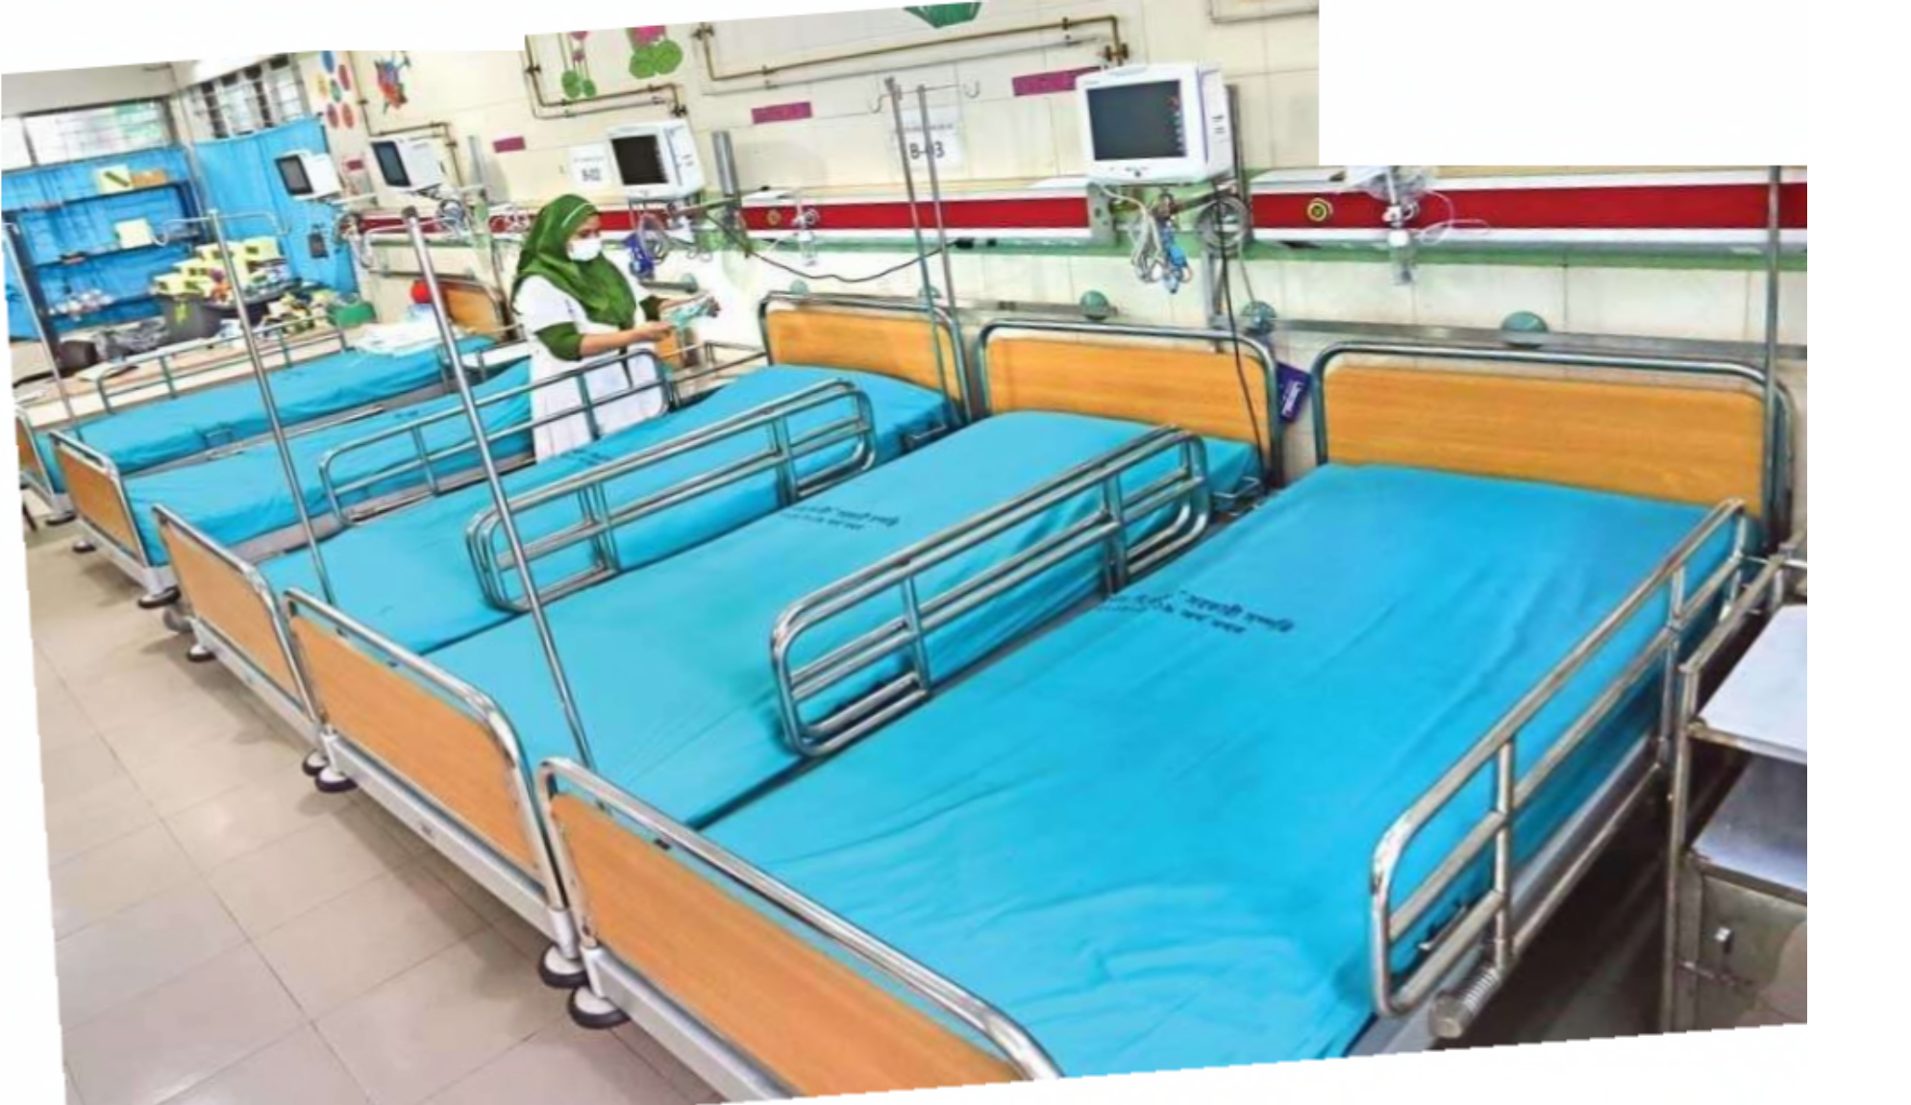
An isolated unit was opened on the ground floor of unit -2 of
DMCH for handling any possible coronavirus outbreak
;... l
B-04

Slide 66


. - '
Between
Sat and Sun,
Barn
From January 21 till
now
302
150
127
6
5631
468
253
28
0
34
Source:
IEDCR

Slide 67
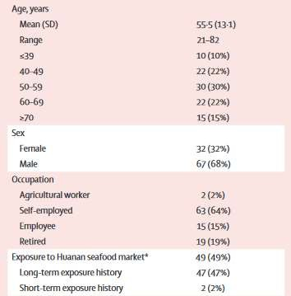
STUDY ON CORONA VIRUS OUTBREAK

Slide 68
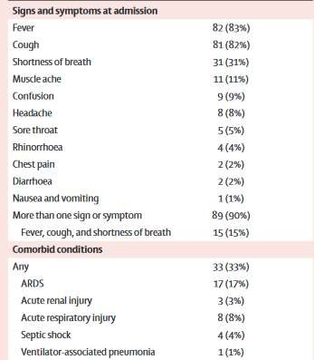

Slide 69
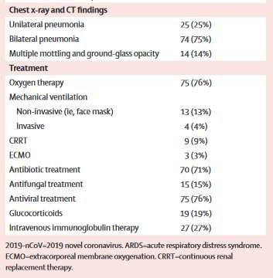

Slide 70
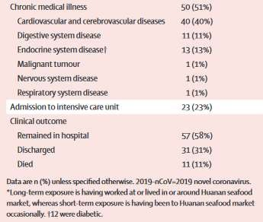

Slide 71


Slide 72
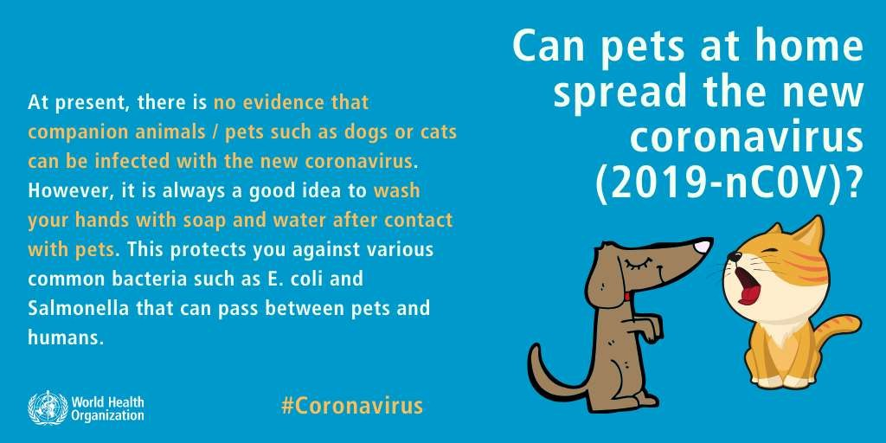

Slide 73


Slide 74


Slide 75


Slide 76


Slide 77


Slide 78
TAKE HOME MESSAGE
○ Preventive measures is only protective
approach of population to avoid 2019-nCoV.
○ No specific treatment yet available, Vaccine
under animal trial.
○ Don’t panic! Get informed. Be prepared.

Slide 79



