Slide 1
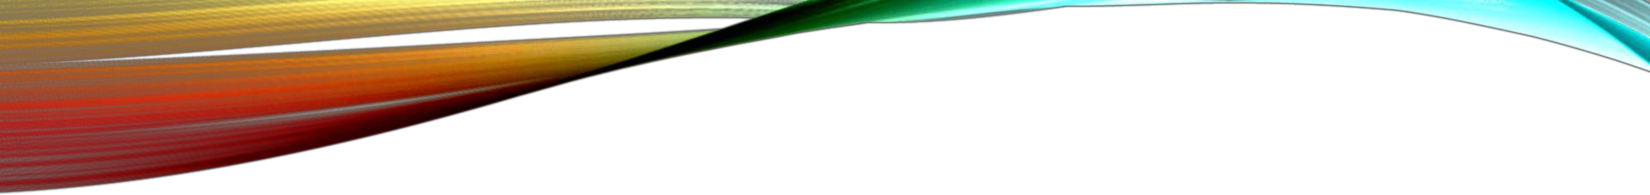
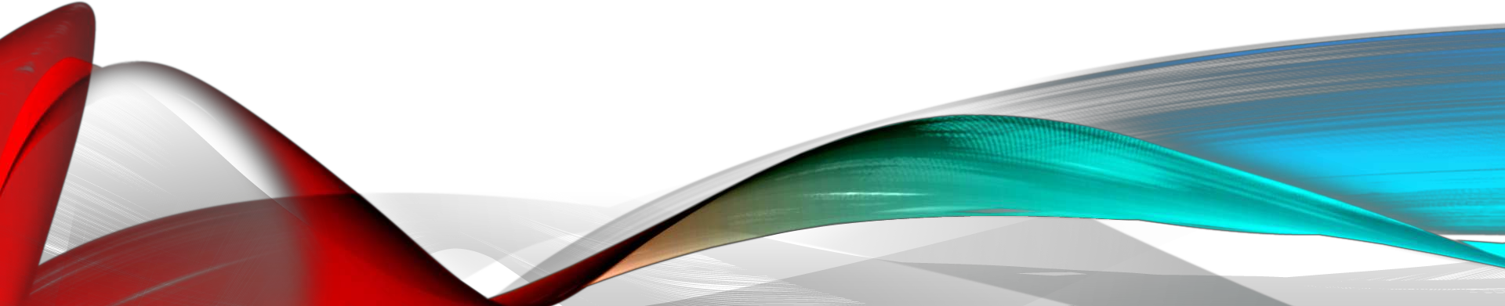
CORONAVIRUS
BY : SRUSHTI SHINDE

Slide 2
CONTENT
What is Corona Virus?
Where did it come from?
^{1.}
^{2.}
^{3.}
^{4.}
^{5.}
^{6.}
^{7.}
^{8.}
^{9.}
^{Effect of Corona}
^{Transmission}
^{Death Count}
^{Symptoms}
^{Prevention}
^{Treatment}
^{Conclusion}
Virus

Slide 3
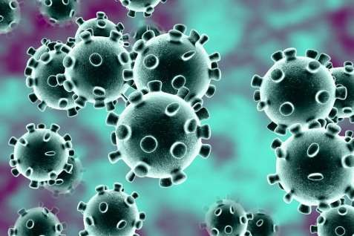
WHAT
IS
CORONA
VIRUS?
It is a Family of viruses which
^{include:-}
^{➢Common Cold}
^{➢MERS(Middle East Respiratory}
^{Syndrome)}
^{➢SAR(Severe acute respiratory}
^{syndrome )}

Slide 4
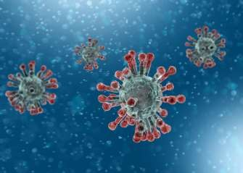
WHERE
DID
IT
COME
FROM?
•
➢
Origin-
It was first detected
in Wuhan, a city in
China.
Because of the
disease being a
viral one, it started
spreading within
the city in no time
and killing people
in large numbers.
• Circulating among animals
• Capability of transmitting between animals and humans.
• Source of coronavirus – Wide
Range of animals.
• MERS - CAMELS
• SARS - CIVET CATS
➢

Slide 5
EFFECT
IMPACT ON CHINA
OF
CORONA
VIRUS
GLOBAL IMPACT
• Large swathes of the public
transportation, tourism, leisure, and
retailing networks have shut down.
• Many factories, shops, places of work,
banks, and schools and universities
have been disrupted.
has been badly
affected, with many global airlines
cancelling flights to and from China.
in and out of China have
therefore been disrupted,

Slide 6
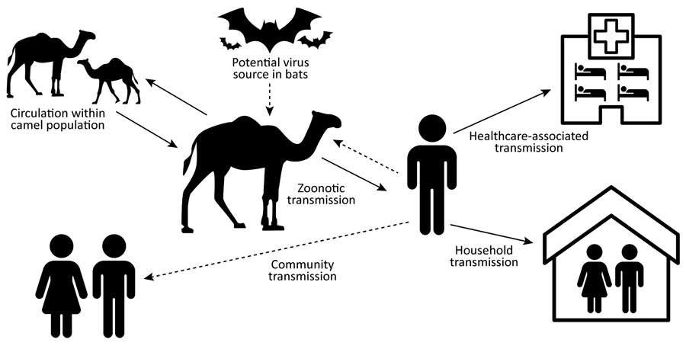
TRANSMISSION
• close contact with an infectious person
• contact with droplets from an infected person’s cough or sneeze
• touching objects or surfaces (like doorknobs or tables) that have cough or sneeze
droplets from an infected person, and then touching your mouth or face

Slide 7


DEATH CO
UNT
Australia
23
Country.
Other
Total
Cases
New
Cases
Total
Deaths
Malaysia
22
78.514
+450
2.747
TOTAL DEATH
COUNT:-
2814
TOTAL CASES
DETECTED:-
82585
France
18
2
China
1.766
+505
13
Vietnam
16
S. Korea
Spain
15
+2
705
4
U.K.
15
+2
Italy
528
+58
14
U.A.E.
13
Iran
245
+106
26
Canada
12
Japan
207
+35
4
Macao
10
Singapore
93
Iraq
6
+1
Hong Kong
92
+3
2
Oman
4
USA
60
Switzerland
4
+3
Kuwait
43
+17
Philippines
3
1
Thailand
40
Austria
3
+1
Bahrain
33
Croatia
3
Taiwan
32
1
Greece
3
+2
India
3

Slide 8
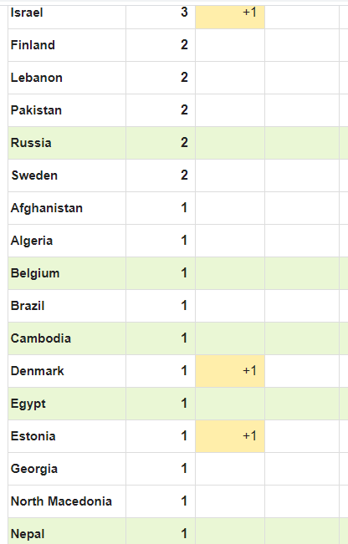
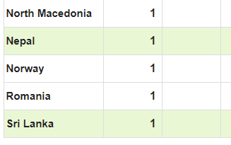
^{DATA}
^{COLLECTED TILL}
^{27TH}
^{FEBRUARY,2020}

Slide 9
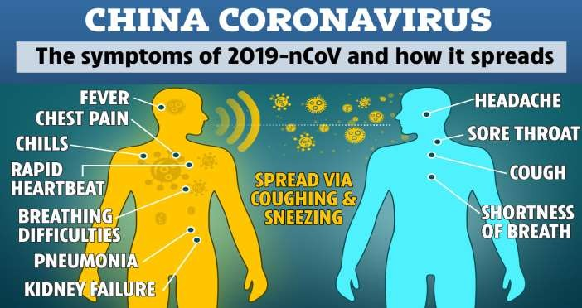
SYMPTOMS
• Fever
• flu-like symptoms such as coughing, sore throat and fatigue
• shortness of breath

Slide 10
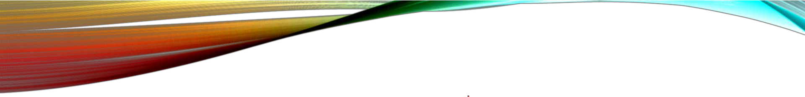
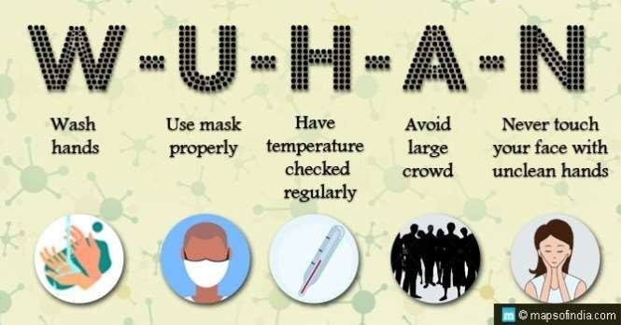
PREVENTION
WE DO NOT RECOMMEND
SURGICAL MASKS for healthy
members of the public. A surgical
mask will not protect you against the
virus.

Slide 11
TREATMENT
• THERE IS NO TREATMENT FOR CORONAVIRUS
TILL NOW, but medical care can treat most of the
symptoms. Antibiotics do not work on viruses.

Slide 12
CONCLUSION
Government is working on the prevention of this virus but the speed at which it is
spreading is making humans difficult to catch it up.
The major prevention lies in the hands of an individual which is mentioned in the
earlier slides.
Be Safe and have a healthy day!

