Slide 1


Biogen Laboratory Educational Series
CoronaVirus
Dr Raed Kanan

Slide 2
Objectives
Biogen Laboratory Educational Series
Brief Outbreak Background
What are Coronaviruses?
Family Members and Migration
Structure of Coronaviruses
How does the virus attack the Cells?
How it is Transmitted
Symptoms of the disease
Diagnosis of the disease
Treatment of the disease
Prevention of Transmission
Notes:
In December 2019, there was a cluster of pneumonia cases in China. Investigations found that it was caused by a previously unknown virus, now named the 2019 Novel Coronavirus. In this video we'll take a quick look at what is currently known about the virus. Keep in mind this is a new virus, and what's known about the virus now might change in the future.
Coronaviruses are a large group of viruses; they consist of a core of genetic material surrounded by an envelope of proteins spikes. This gives it the appearance of a crown. Crown in Latin is called 'Corona' and that's how these viruses get their name. There are different types of coronaviruses that causes respiratory and sometimes gastrointestinal symptoms. Respiratory symptoms can range from the common cold to pneumonia and in most people the symptoms tend to be mild. However, there are some types of coronaviruses that can cause severe disease, these include SARS - Coronavirus, identified in China 2003, and MERS - Coronavirus, that was first identified in Saudi Arabia in 2012. The 2019 Coronavirus was first identified in China 2019.
It initially occurred in a group of people with pneumonia, who'd been associated with seafood and animal markets in Wuhan. The disease has since spread from the sick to others including family members and healthcare staff. There are many cases at present and has spread within China and other countries.
So, where did the virus come from? It's known that the coronaviruses circulate in a range of animals. Sometimes these viruses can make the jump from animals to humans. This is called a spillover and could be due to a range of factors, such as mutations in the virus or increased between humans and animals. For example, MERS from Camels and SARS from civet cats. The animal reservoir of the 2019 coronavirus is not known yet.
How is it transmitted? The exact dynamic of how the virus is transmitted is yet to be determined, in general respiratory is usually transmitted through droplets created when an infected person coughs or sneezes or through something that has been contaminated with the virus. People most at risk of infection from a novel coronavirus are those in close contact with animals, such as animal workers and those who are caring for people who are infected with the virus, such as family members or healthcare workers.
So. How does the disease present? (Symptoms) Well, from what is known so far there could be a number of symptoms ranging from mild to severe. There can be fever and respiratory symptoms such as cough and shortness of breath. In more severe cases there's been pneumonia, kidney failure and death. The mortality rate is not known yet.
How can we tell if someone is infected? (Diagnosis) The infection can be diagnosed with a test known as PCR or Polymerase Chain Reaction. This test identifies the virus based off its genetic fingerprint. There's currently no known medication for the virus and treatment is supportive care. There is currently no vaccine to protect from the virus. Treatments and vaccines are in development.
How do we prevent transmission of the virus? This new virus currently has a limited geographic spread, however there are a number of standard hygiene practices that have been recommended to protect against infection and further spread. These include covering your mouth and nose with a medical mask, tissue or flexed elbow. Avoid close contact with those who are unwell. The appropriate use of masks and personal protective equipment, especially in the health care setting, washing hands regularly with soap and water or alcohol-based hand rub. Actions that can be taken to prevent infection from an animal source include: Avoiding unnecessary contact with animals, washing hands after contact with animals or animal products and ensuring animal products are cooked thoroughly before they're consumed. It's important to stay home if you're feeling unwell, but if you have a fever, cough or difficulty of breathing seek medical care early and share your previous travel history with your health care provider.

Slide 3
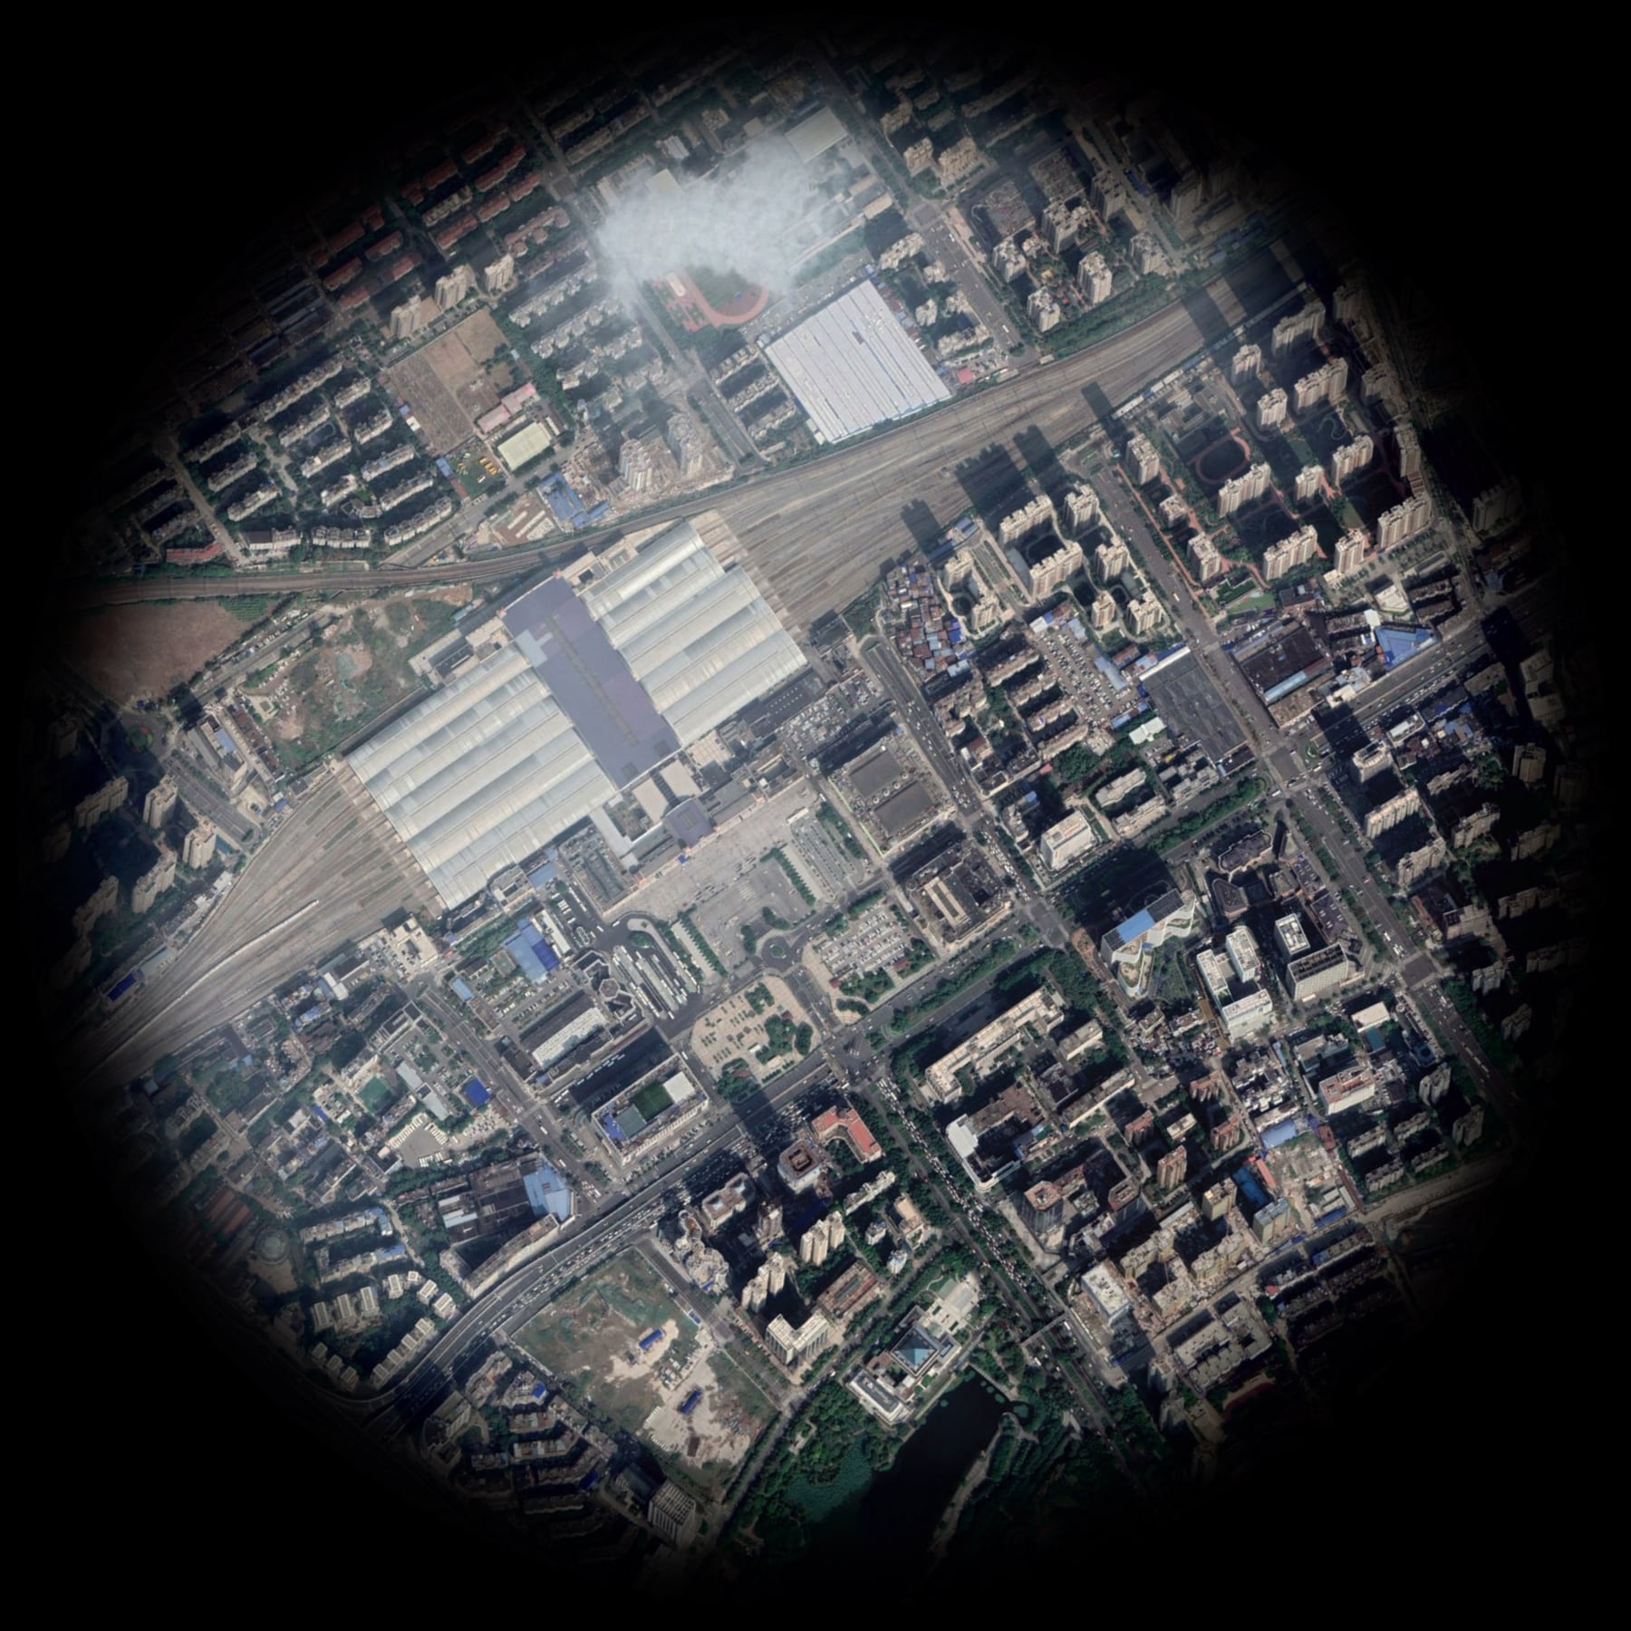
Biogen Laboratory Educational Series
Outbreak
WUHAN
Cluster of Pneumonia
December 2019
Notes:
Coronaviruses (CoV) are a family of viruses that cause sicknesses like the common cold, as well as more severe diseases, such as Middle East Respiratory Syndrome and Severe Acute Respiratory Syndrome. A novel coronavirus (nCoV) is a new strain – one that hasn’t previously been recognized in humans.
Coronaviruses cause diseases in mammals and birds. A zoonotic virus is one that is transmitted between animals and people. When a virus circulating in animal populations infects people, this is termed a “spillover event”.
How does CoVID-19 affect the body? The virus is fitted with protein spikes sticking out of the envelope that forms the surface and houses a core of genetic material. Any virus that enters your body looks for cells with compatible receptors – ones that allow it to invade the cell. Once they find the right cell, they enter and use the cell’s replication machinery to create copies of themselves. It is likely that COVID-19 uses the same receptor as SARS – found in both lungs and small intestines.
It is thought that CoVID-19 shares many similarities with SARS, which has three phases of attack: viral replication, hyper-reactivity of the immune system, and finally pulmonary destruction. Early on in infection, the coronavirus invades two types of cells in the lungs – mucus and cilia cells. Mucus keeps your lungs from drying out and protects them from pathogens. Cilia beat the mucus towards the exterior of your body, clearing debris – including viruses! – out of your lungs. Cilia cells were the preferred hosts of SARS-CoV, and are likely the preferred hosts of the new coronavirus. When these cells die, they slough off into your airways, filling them with debris and fluid. Symptoms include a fever, cough, and breathing difficulties. Many of those infected get pneumonia in both their lungs.
Enter the immune system. Immune cells recognize the virus and flood into the lungs. The lung tissue becomes inflamed. During normal immune function, the inflammatory process is highly regulated and is confined to infected areas. However, sometimes the immune system overreacts, and this results in damage to healthy tissue. More cells die and slough off into the lungs, further clogging them and worsening the pneumonia.
As damage to the lungs increases, stage three begins, potentially resulting in respiratory failure. Patients that reach this stage of infection can incur permanent lung damage or even die. We see the same lesions in the lungs of those infected by the novel coronavirus as those with SARS. SARS creates holes in the lungs, so they look honeycomb-like. This is probably due to the aforementioned over-reactive immune response, which affects tissue both infected and healthy and creates scars that stiffen the lungs. As such, some patients may require ventilators to aid breathing.
The inflammation also results in more permeable alveoli. This is the location of the thin interface of gas exchange, where your lungs replace carbon dioxide in your blood with fresh oxygen you just inhaled. Increased permeability causes fluid to leak into the lungs. This decreases the lungs’ ability to oxygenate blood, and in severe cases, floods them so that you become unable to breathe. Sometimes, this can be fatal.
The immune system’s over-reaction can also cause another kind of damage. Proteins called cytokines are the immune system’s alarm system, recruiting immune cells to the infection site. Over-production of cytokines can result in a cytokine storm, where there is large-scale inflammation in the body. Blood vessels become more permeable and fluid seeps out. This makes it difficult for blood and oxygen to reach the rest of the body and can result in multi-organ failure. This has happened in the most severe cases of CoVid-19. Although there are no specific treatments for coronaviruses, symptoms can be treated through supportive care. Also, vaccines are currently in development.
What can you do to protect yourself from CoVid-19? Basic protocol comes down to regular hand washing, avoiding close contact with anyone coughing or sneezing, avoiding unnecessary contact with animals, washing hands after contact with animals, thoroughly cooking meat and eggs prior to consumption, and covering your mouth and nose while coughing or sneezing. Respiratory viruses are typically transmitted via droplets in sneezes or coughs of those infected, so preventing their travel stops the spread of disease.

Slide 4
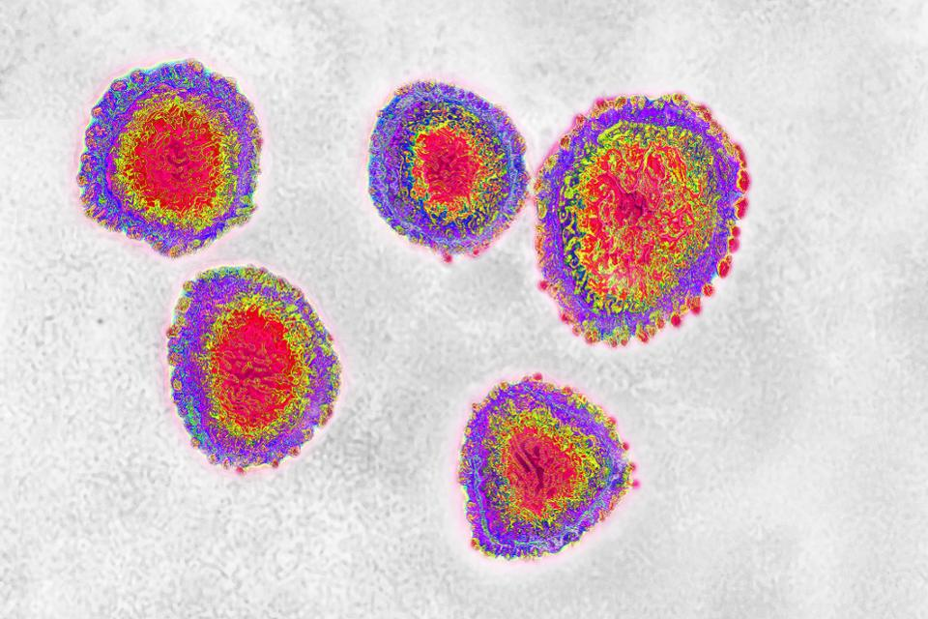
Biogen Laboratory Educational Series
Coronaviruses
Family of viruses
  Common Cold
  Respiratory diseases
Notes:
Coronaviruses (CoV) are a family of viruses that cause sicknesses like the common cold, as well as more severe diseases, such as Middle East Respiratory Syndrome and Severe Acute Respiratory Syndrome. A novel coronavirus (nCoV) is a new strain – one that hasn’t previously been recognized in humans.
Coronaviruses cause diseases in mammals and birds. A zoonotic virus is one that is transmitted between animals and people. When a virus circulating in animal populations infects people, this is termed a “spillover event”.
How does CoVID-19 affect the body? The virus is fitted with protein spikes sticking out of the envelope that forms the surface and houses a core of genetic material. Any virus that enters your body looks for cells with compatible receptors – ones that allow it to invade the cell. Once they find the right cell, they enter and use the cell’s replication machinery to create copies of themselves. It is likely that COVID-19 uses the same receptor as SARS – found in both lungs and small intestines.
It is thought that CoVID-19 shares many similarities with SARS, which has three phases of attack: viral replication, hyper-reactivity of the immune system, and finally pulmonary destruction. Early on in infection, the coronavirus invades two types of cells in the lungs – mucus and cilia cells. Mucus keeps your lungs from drying out and protects them from pathogens. Cilia beat the mucus towards the exterior of your body, clearing debris – including viruses! – out of your lungs. Cilia cells were the preferred hosts of SARS-CoV, and are likely the preferred hosts of the new coronavirus. When these cells die, they slough off into your airways, filling them with debris and fluid. Symptoms include a fever, cough, and breathing difficulties. Many of those infected get pneumonia in both their lungs.
Enter the immune system. Immune cells recognize the virus and flood into the lungs. The lung tissue becomes inflamed. During normal immune function, the inflammatory process is highly regulated and is confined to infected areas. However, sometimes the immune system overreacts, and this results in damage to healthy tissue. More cells die and slough off into the lungs, further clogging them and worsening the pneumonia.
As damage to the lungs increases, stage three begins, potentially resulting in respiratory failure. Patients that reach this stage of infection can incur permanent lung damage or even die. We see the same lesions in the lungs of those infected by the novel coronavirus as those with SARS. SARS creates holes in the lungs, so they look honeycomb-like. This is probably due to the aforementioned over-reactive immune response, which affects tissue both infected and healthy and creates scars that stiffen the lungs. As such, some patients may require ventilators to aid breathing.
The inflammation also results in more permeable alveoli. This is the location of the thin interface of gas exchange, where your lungs replace carbon dioxide in your blood with fresh oxygen you just inhaled. Increased permeability causes fluid to leak into the lungs. This decreases the lungs’ ability to oxygenate blood, and in severe cases, floods them so that you become unable to breathe. Sometimes, this can be fatal.
The immune system’s over-reaction can also cause another kind of damage. Proteins called cytokines are the immune system’s alarm system, recruiting immune cells to the infection site. Over-production of cytokines can result in a cytokine storm, where there is large-scale inflammation in the body. Blood vessels become more permeable and fluid seeps out. This makes it difficult for blood and oxygen to reach the rest of the body and can result in multi-organ failure. This has happened in the most severe cases of CoVid-19. Although there are no specific treatments for coronaviruses, symptoms can be treated through supportive care. Also, vaccines are currently in development.
What can you do to protect yourself from CoVid-19? Basic protocol comes down to regular hand washing, avoiding close contact with anyone coughing or sneezing, avoiding unnecessary contact with animals, washing hands after contact with animals, thoroughly cooking meat and eggs prior to consumption, and covering your mouth and nose while coughing or sneezing. Respiratory viruses are typically transmitted via droplets in sneezes or coughs of those infected, so preventing their travel stops the spread of disease.

Slide 5

Biogen Laboratory Educational Series
Coronaviruses
2019-nCOV
2019
novel
Corona Virus Disease
COVID-19
Notes:
Coronaviruses (CoV) are a family of viruses that cause sicknesses like the common cold, as well as more severe diseases, such as Middle East Respiratory Syndrome and Severe Acute Respiratory Syndrome. A novel coronavirus (nCoV) is a new strain – one that hasn’t previously been recognized in humans.
Coronaviruses cause diseases in mammals and birds. A zoonotic virus is one that is transmitted between animals and people. When a virus circulating in animal populations infects people, this is termed a “spillover event”.
How does CoVID-19 affect the body? The virus is fitted with protein spikes sticking out of the envelope that forms the surface and houses a core of genetic material. Any virus that enters your body looks for cells with compatible receptors – ones that allow it to invade the cell. Once they find the right cell, they enter and use the cell’s replication machinery to create copies of themselves. It is likely that COVID-19 uses the same receptor as SARS – found in both lungs and small intestines.
It is thought that CoVID-19 shares many similarities with SARS, which has three phases of attack: viral replication, hyper-reactivity of the immune system, and finally pulmonary destruction. Early on in infection, the coronavirus invades two types of cells in the lungs – mucus and cilia cells. Mucus keeps your lungs from drying out and protects them from pathogens. Cilia beat the mucus towards the exterior of your body, clearing debris – including viruses! – out of your lungs. Cilia cells were the preferred hosts of SARS-CoV, and are likely the preferred hosts of the new coronavirus. When these cells die, they slough off into your airways, filling them with debris and fluid. Symptoms include a fever, cough, and breathing difficulties. Many of those infected get pneumonia in both their lungs.
Enter the immune system. Immune cells recognize the virus and flood into the lungs. The lung tissue becomes inflamed. During normal immune function, the inflammatory process is highly regulated and is confined to infected areas. However, sometimes the immune system overreacts, and this results in damage to healthy tissue. More cells die and slough off into the lungs, further clogging them and worsening the pneumonia.
As damage to the lungs increases, stage three begins, potentially resulting in respiratory failure. Patients that reach this stage of infection can incur permanent lung damage or even die. We see the same lesions in the lungs of those infected by the novel coronavirus as those with SARS. SARS creates holes in the lungs, so they look honeycomb-like. This is probably due to the aforementioned over-reactive immune response, which affects tissue both infected and healthy and creates scars that stiffen the lungs. As such, some patients may require ventilators to aid breathing.
The inflammation also results in more permeable alveoli. This is the location of the thin interface of gas exchange, where your lungs replace carbon dioxide in your blood with fresh oxygen you just inhaled. Increased permeability causes fluid to leak into the lungs. This decreases the lungs’ ability to oxygenate blood, and in severe cases, floods them so that you become unable to breathe. Sometimes, this can be fatal.
The immune system’s over-reaction can also cause another kind of damage. Proteins called cytokines are the immune system’s alarm system, recruiting immune cells to the infection site. Over-production of cytokines can result in a cytokine storm, where there is large-scale inflammation in the body. Blood vessels become more permeable and fluid seeps out. This makes it difficult for blood and oxygen to reach the rest of the body and can result in multi-organ failure. This has happened in the most severe cases of CoVid-19. Although there are no specific treatments for coronaviruses, symptoms can be treated through supportive care. Also, vaccines are currently in development.
What can you do to protect yourself from CoVid-19? Basic protocol comes down to regular hand washing, avoiding close contact with anyone coughing or sneezing, avoiding unnecessary contact with animals, washing hands after contact with animals, thoroughly cooking meat and eggs prior to consumption, and covering your mouth and nose while coughing or sneezing. Respiratory viruses are typically transmitted via droplets in sneezes or coughs of those infected, so preventing their travel stops the spread of disease.

Slide 6
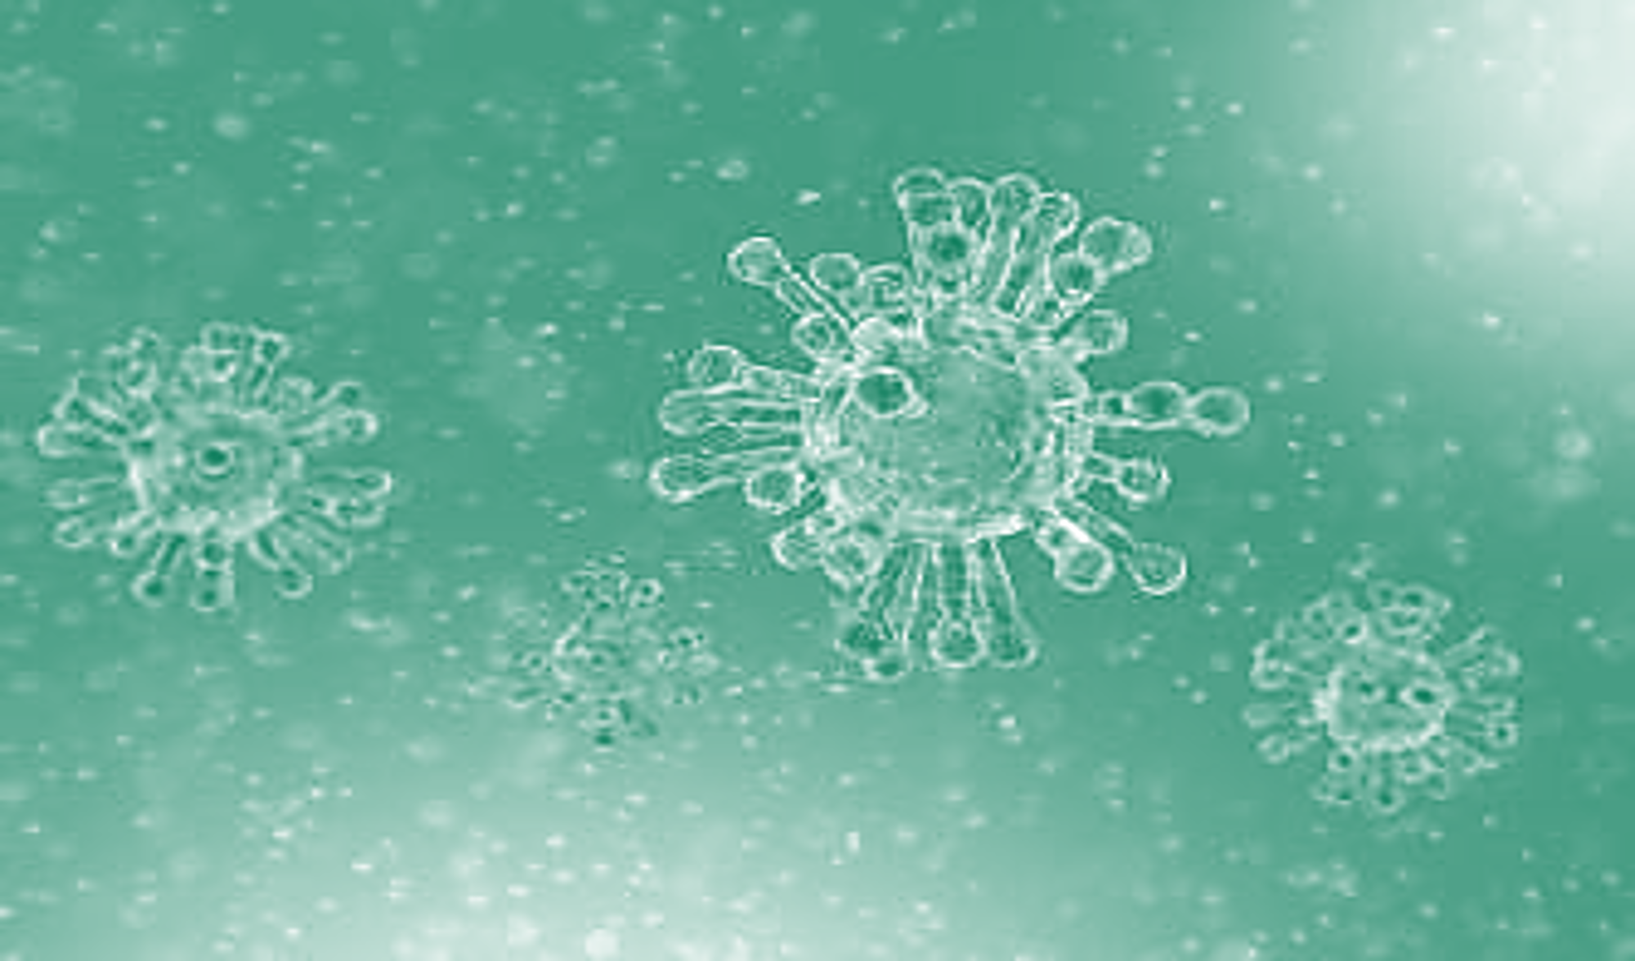
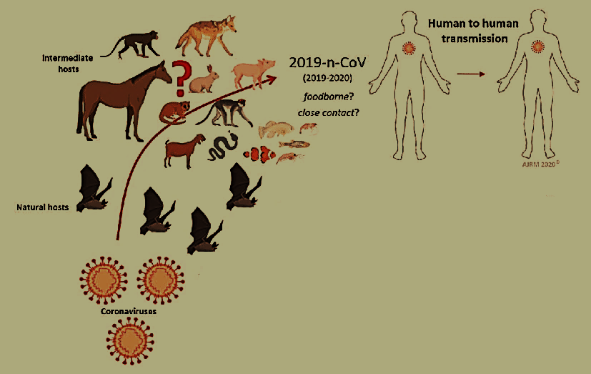
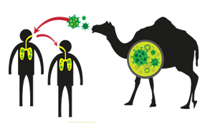
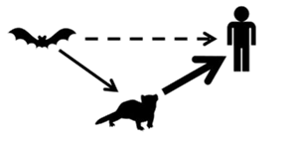
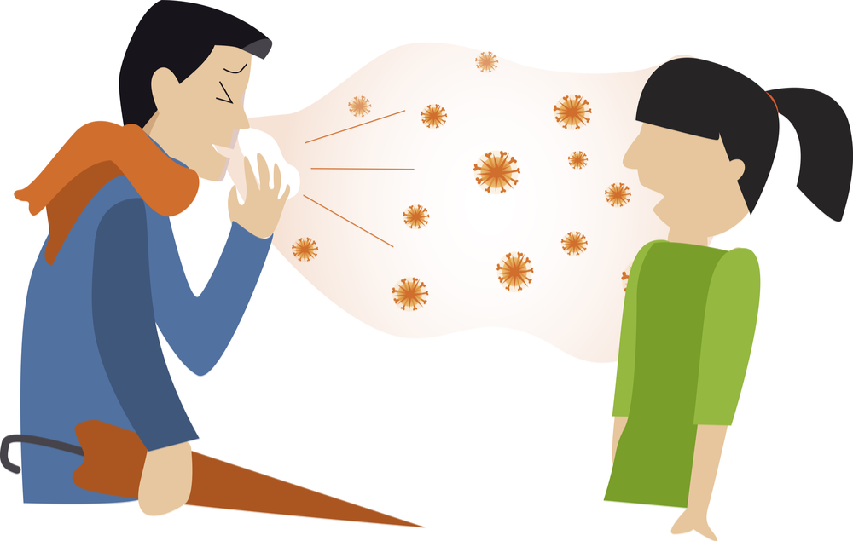
Biogen Laboratory Educational Series
Coronaviruses Family
عائلة الكورونا
2019 COVID
2012 MERS
1960 Common Cold
2002 SARS
Notes:
Coronaviruses (CoV) are a family of viruses that cause sicknesses like the common cold, as well as more severe diseases, such as Middle East Respiratory Syndrome and Severe Acute Respiratory Syndrome. A novel coronavirus (nCoV) is a new strain – one that hasn’t previously been recognized in humans.
Coronaviruses cause diseases in mammals and birds. A zoonotic virus is one that is transmitted between animals and people. When a virus circulating in animal populations infects people, this is termed a “spillover event”.
How does CoVID-19 affect the body? The virus is fitted with protein spikes sticking out of the envelope that forms the surface and houses a core of genetic material. Any virus that enters your body looks for cells with compatible receptors – ones that allow it to invade the cell. Once they find the right cell, they enter and use the cell’s replication machinery to create copies of themselves. It is likely that COVID-19 uses the same receptor as SARS – found in both lungs and small intestines.
It is thought that CoVID-19 shares many similarities with SARS, which has three phases of attack: viral replication, hyper-reactivity of the immune system, and finally pulmonary destruction. Early on in infection, the coronavirus invades two types of cells in the lungs – mucus and cilia cells. Mucus keeps your lungs from drying out and protects them from pathogens. Cilia beat the mucus towards the exterior of your body, clearing debris – including viruses! – out of your lungs. Cilia cells were the preferred hosts of SARS-CoV, and are likely the preferred hosts of the new coronavirus. When these cells die, they slough off into your airways, filling them with debris and fluid. Symptoms include a fever, cough, and breathing difficulties. Many of those infected get pneumonia in both their lungs.
Enter the immune system. Immune cells recognize the virus and flood into the lungs. The lung tissue becomes inflamed. During normal immune function, the inflammatory process is highly regulated and is confined to infected areas. However, sometimes the immune system overreacts, and this results in damage to healthy tissue. More cells die and slough off into the lungs, further clogging them and worsening the pneumonia.
As damage to the lungs increases, stage three begins, potentially resulting in respiratory failure. Patients that reach this stage of infection can incur permanent lung damage or even die. We see the same lesions in the lungs of those infected by the novel coronavirus as those with SARS. SARS creates holes in the lungs, so they look honeycomb-like. This is probably due to the aforementioned over-reactive immune response, which affects tissue both infected and healthy and creates scars that stiffen the lungs. As such, some patients may require ventilators to aid breathing.
The inflammation also results in more permeable alveoli. This is the location of the thin interface of gas exchange, where your lungs replace carbon dioxide in your blood with fresh oxygen you just inhaled. Increased permeability causes fluid to leak into the lungs. This decreases the lungs’ ability to oxygenate blood, and in severe cases, floods them so that you become unable to breathe. Sometimes, this can be fatal.
The immune system’s over-reaction can also cause another kind of damage. Proteins called cytokines are the immune system’s alarm system, recruiting immune cells to the infection site. Over-production of cytokines can result in a cytokine storm, where there is large-scale inflammation in the body. Blood vessels become more permeable and fluid seeps out. This makes it difficult for blood and oxygen to reach the rest of the body and can result in multi-organ failure. This has happened in the most severe cases of CoVid-19. Although there are no specific treatments for coronaviruses, symptoms can be treated through supportive care. Also, vaccines are currently in development.
What can you do to protect yourself from CoVid-19? Basic protocol comes down to regular hand washing, avoiding close contact with anyone coughing or sneezing, avoiding unnecessary contact with animals, washing hands after contact with animals, thoroughly cooking meat and eggs prior to consumption, and covering your mouth and nose while coughing or sneezing. Respiratory viruses are typically transmitted via droplets in sneezes or coughs of those infected, so preventing their travel stops the spread of disease.

Slide 7
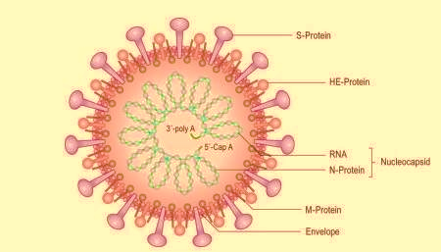
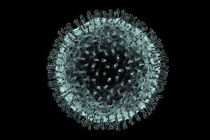

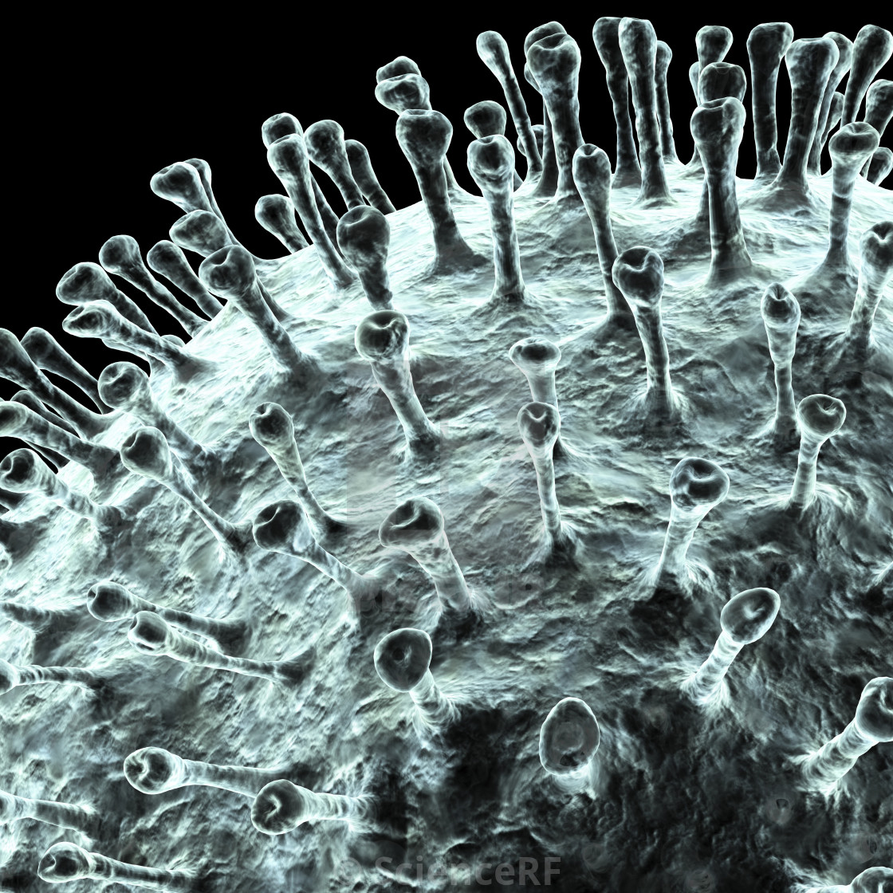
Biogen Laboratory Educational Series
Coronaviruses
Crown
Corona
Notes:
Coronaviruses (CoV) are a family of viruses that cause sicknesses like the common cold, as well as more severe diseases, such as Middle East Respiratory Syndrome and Severe Acute Respiratory Syndrome. A novel coronavirus (nCoV) is a new strain – one that hasn’t previously been recognized in humans.
Coronaviruses cause diseases in mammals and birds. A zoonotic virus is one that is transmitted between animals and people. When a virus circulating in animal populations infects people, this is termed a “spillover event”.
How does CoVID-19 affect the body? The virus is fitted with protein spikes sticking out of the envelope that forms the surface and houses a core of genetic material. Any virus that enters your body looks for cells with compatible receptors – ones that allow it to invade the cell. Once they find the right cell, they enter and use the cell’s replication machinery to create copies of themselves. It is likely that COVID-19 uses the same receptor as SARS – found in both lungs and small intestines.
It is thought that CoVID-19 shares many similarities with SARS, which has three phases of attack: viral replication, hyper-reactivity of the immune system, and finally pulmonary destruction. Early on in infection, the coronavirus invades two types of cells in the lungs – mucus and cilia cells. Mucus keeps your lungs from drying out and protects them from pathogens. Cilia beat the mucus towards the exterior of your body, clearing debris – including viruses! – out of your lungs. Cilia cells were the preferred hosts of SARS-CoV, and are likely the preferred hosts of the new coronavirus. When these cells die, they slough off into your airways, filling them with debris and fluid. Symptoms include a fever, cough, and breathing difficulties. Many of those infected get pneumonia in both their lungs.
Enter the immune system. Immune cells recognize the virus and flood into the lungs. The lung tissue becomes inflamed. During normal immune function, the inflammatory process is highly regulated and is confined to infected areas. However, sometimes the immune system overreacts, and this results in damage to healthy tissue. More cells die and slough off into the lungs, further clogging them and worsening the pneumonia.
As damage to the lungs increases, stage three begins, potentially resulting in respiratory failure. Patients that reach this stage of infection can incur permanent lung damage or even die. We see the same lesions in the lungs of those infected by the novel coronavirus as those with SARS. SARS creates holes in the lungs, so they look honeycomb-like. This is probably due to the aforementioned over-reactive immune response, which affects tissue both infected and healthy and creates scars that stiffen the lungs. As such, some patients may require ventilators to aid breathing.
The inflammation also results in more permeable alveoli. This is the location of the thin interface of gas exchange, where your lungs replace carbon dioxide in your blood with fresh oxygen you just inhaled. Increased permeability causes fluid to leak into the lungs. This decreases the lungs’ ability to oxygenate blood, and in severe cases, floods them so that you become unable to breathe. Sometimes, this can be fatal.
The immune system’s over-reaction can also cause another kind of damage. Proteins called cytokines are the immune system’s alarm system, recruiting immune cells to the infection site. Over-production of cytokines can result in a cytokine storm, where there is large-scale inflammation in the body. Blood vessels become more permeable and fluid seeps out. This makes it difficult for blood and oxygen to reach the rest of the body and can result in multi-organ failure. This has happened in the most severe cases of CoVid-19. Although there are no specific treatments for coronaviruses, symptoms can be treated through supportive care. Also, vaccines are currently in development.
What can you do to protect yourself from CoVid-19? Basic protocol comes down to regular hand washing, avoiding close contact with anyone coughing or sneezing, avoiding unnecessary contact with animals, washing hands after contact with animals, thoroughly cooking meat and eggs prior to consumption, and covering your mouth and nose while coughing or sneezing. Respiratory viruses are typically transmitted via droplets in sneezes or coughs of those infected, so preventing their travel stops the spread of disease.

Slide 8
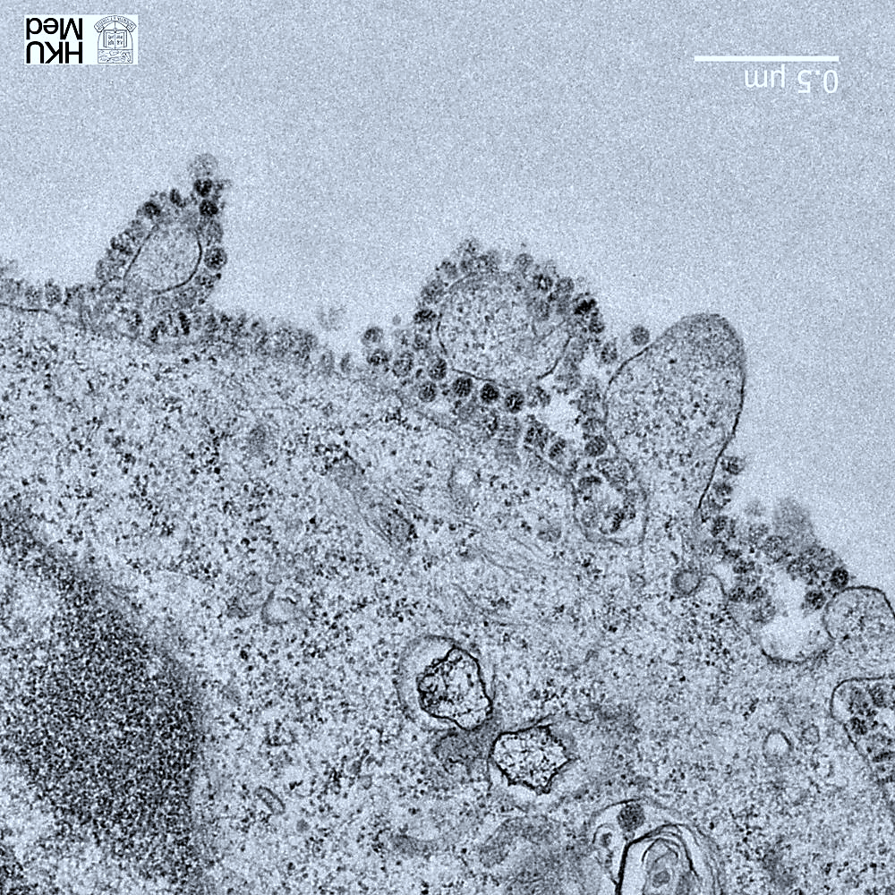
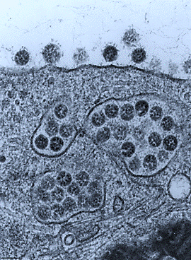
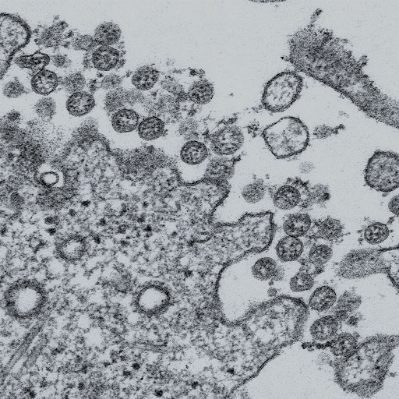
Biogen Laboratory Educational Series
Coronavirus Attack
عملية اقتحام الخلايا
Notes:
Coronaviruses (CoV) are a family of viruses that cause sicknesses like the common cold, as well as more severe diseases, such as Middle East Respiratory Syndrome and Severe Acute Respiratory Syndrome. A novel coronavirus (nCoV) is a new strain – one that hasn’t previously been recognized in humans.
Coronaviruses cause diseases in mammals and birds. A zoonotic virus is one that is transmitted between animals and people. When a virus circulating in animal populations infects people, this is termed a “spillover event”.
How does CoVID-19 affect the body? The virus is fitted with protein spikes sticking out of the envelope that forms the surface and houses a core of genetic material. Any virus that enters your body looks for cells with compatible receptors – ones that allow it to invade the cell. Once they find the right cell, they enter and use the cell’s replication machinery to create copies of themselves. It is likely that COVID-19 uses the same receptor as SARS – found in both lungs and small intestines.
It is thought that CoVID-19 shares many similarities with SARS, which has three phases of attack: viral replication, hyper-reactivity of the immune system, and finally pulmonary destruction. Early on in infection, the coronavirus invades two types of cells in the lungs – mucus and cilia cells. Mucus keeps your lungs from drying out and protects them from pathogens. Cilia beat the mucus towards the exterior of your body, clearing debris – including viruses! – out of your lungs. Cilia cells were the preferred hosts of SARS-CoV, and are likely the preferred hosts of the new coronavirus. When these cells die, they slough off into your airways, filling them with debris and fluid. Symptoms include a fever, cough, and breathing difficulties. Many of those infected get pneumonia in both their lungs.
Enter the immune system. Immune cells recognize the virus and flood into the lungs. The lung tissue becomes inflamed. During normal immune function, the inflammatory process is highly regulated and is confined to infected areas. However, sometimes the immune system overreacts, and this results in damage to healthy tissue. More cells die and slough off into the lungs, further clogging them and worsening the pneumonia.
As damage to the lungs increases, stage three begins, potentially resulting in respiratory failure. Patients that reach this stage of infection can incur permanent lung damage or even die. We see the same lesions in the lungs of those infected by the novel coronavirus as those with SARS. SARS creates holes in the lungs, so they look honeycomb-like. This is probably due to the aforementioned over-reactive immune response, which affects tissue both infected and healthy and creates scars that stiffen the lungs. As such, some patients may require ventilators to aid breathing.
The inflammation also results in more permeable alveoli. This is the location of the thin interface of gas exchange, where your lungs replace carbon dioxide in your blood with fresh oxygen you just inhaled. Increased permeability causes fluid to leak into the lungs. This decreases the lungs’ ability to oxygenate blood, and in severe cases, floods them so that you become unable to breathe. Sometimes, this can be fatal.
The immune system’s over-reaction can also cause another kind of damage. Proteins called cytokines are the immune system’s alarm system, recruiting immune cells to the infection site. Over-production of cytokines can result in a cytokine storm, where there is large-scale inflammation in the body. Blood vessels become more permeable and fluid seeps out. This makes it difficult for blood and oxygen to reach the rest of the body and can result in multi-organ failure. This has happened in the most severe cases of CoVid-19. Although there are no specific treatments for coronaviruses, symptoms can be treated through supportive care. Also, vaccines are currently in development.
What can you do to protect yourself from CoVid-19? Basic protocol comes down to regular hand washing, avoiding close contact with anyone coughing or sneezing, avoiding unnecessary contact with animals, washing hands after contact with animals, thoroughly cooking meat and eggs prior to consumption, and covering your mouth and nose while coughing or sneezing. Respiratory viruses are typically transmitted via droplets in sneezes or coughs of those infected, so preventing their travel stops the spread of disease.

Slide 9
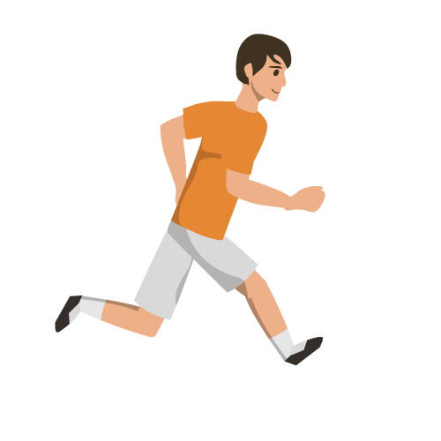

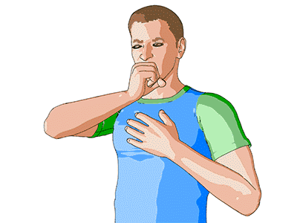
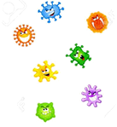
Biogen Laboratory Educational Series
Transmission
Notes:
Coronaviruses (CoV) are a family of viruses that cause sicknesses like the common cold, as well as more severe diseases, such as Middle East Respiratory Syndrome and Severe Acute Respiratory Syndrome. A novel coronavirus (nCoV) is a new strain – one that hasn’t previously been recognized in humans.
Coronaviruses cause diseases in mammals and birds. A zoonotic virus is one that is transmitted between animals and people. When a virus circulating in animal populations infects people, this is termed a “spillover event”.
How does CoVID-19 affect the body? The virus is fitted with protein spikes sticking out of the envelope that forms the surface and houses a core of genetic material. Any virus that enters your body looks for cells with compatible receptors – ones that allow it to invade the cell. Once they find the right cell, they enter and use the cell’s replication machinery to create copies of themselves. It is likely that COVID-19 uses the same receptor as SARS – found in both lungs and small intestines.
It is thought that CoVID-19 shares many similarities with SARS, which has three phases of attack: viral replication, hyper-reactivity of the immune system, and finally pulmonary destruction. Early on in infection, the coronavirus invades two types of cells in the lungs – mucus and cilia cells. Mucus keeps your lungs from drying out and protects them from pathogens. Cilia beat the mucus towards the exterior of your body, clearing debris – including viruses! – out of your lungs. Cilia cells were the preferred hosts of SARS-CoV, and are likely the preferred hosts of the new coronavirus. When these cells die, they slough off into your airways, filling them with debris and fluid. Symptoms include a fever, cough, and breathing difficulties. Many of those infected get pneumonia in both their lungs.
Enter the immune system. Immune cells recognize the virus and flood into the lungs. The lung tissue becomes inflamed. During normal immune function, the inflammatory process is highly regulated and is confined to infected areas. However, sometimes the immune system overreacts, and this results in damage to healthy tissue. More cells die and slough off into the lungs, further clogging them and worsening the pneumonia.
As damage to the lungs increases, stage three begins, potentially resulting in respiratory failure. Patients that reach this stage of infection can incur permanent lung damage or even die. We see the same lesions in the lungs of those infected by the novel coronavirus as those with SARS. SARS creates holes in the lungs, so they look honeycomb-like. This is probably due to the aforementioned over-reactive immune response, which affects tissue both infected and healthy and creates scars that stiffen the lungs. As such, some patients may require ventilators to aid breathing.
The inflammation also results in more permeable alveoli. This is the location of the thin interface of gas exchange, where your lungs replace carbon dioxide in your blood with fresh oxygen you just inhaled. Increased permeability causes fluid to leak into the lungs. This decreases the lungs’ ability to oxygenate blood, and in severe cases, floods them so that you become unable to breathe. Sometimes, this can be fatal.
The immune system’s over-reaction can also cause another kind of damage. Proteins called cytokines are the immune system’s alarm system, recruiting immune cells to the infection site. Over-production of cytokines can result in a cytokine storm, where there is large-scale inflammation in the body. Blood vessels become more permeable and fluid seeps out. This makes it difficult for blood and oxygen to reach the rest of the body and can result in multi-organ failure. This has happened in the most severe cases of CoVid-19. Although there are no specific treatments for coronaviruses, symptoms can be treated through supportive care. Also, vaccines are currently in development.
What can you do to protect yourself from CoVid-19? Basic protocol comes down to regular hand washing, avoiding close contact with anyone coughing or sneezing, avoiding unnecessary contact with animals, washing hands after contact with animals, thoroughly cooking meat and eggs prior to consumption, and covering your mouth and nose while coughing or sneezing. Respiratory viruses are typically transmitted via droplets in sneezes or coughs of those infected, so preventing their travel stops the spread of disease.

Slide 10
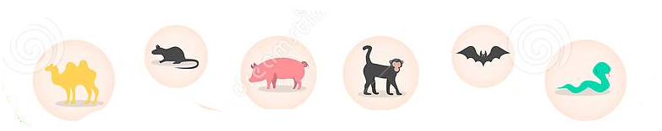

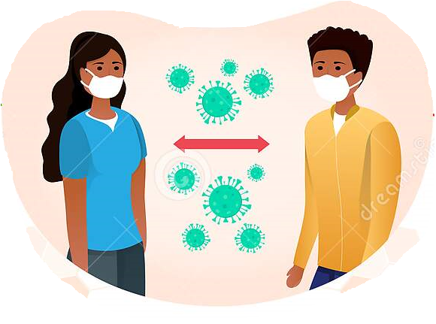

Biogen Laboratory Educational Series
Transmission
??
Animals
مخالطة وأكل الحيوانات
??
Direct Contact
الاتصال المباشر
Crowded places
الأماكن المزدحمة
Notes:
Coronaviruses (CoV) are a family of viruses that cause sicknesses like the common cold, as well as more severe diseases, such as Middle East Respiratory Syndrome and Severe Acute Respiratory Syndrome. A novel coronavirus (nCoV) is a new strain – one that hasn’t previously been recognized in humans.
Coronaviruses cause diseases in mammals and birds. A zoonotic virus is one that is transmitted between animals and people. When a virus circulating in animal populations infects people, this is termed a “spillover event”.
How does CoVID-19 affect the body? The virus is fitted with protein spikes sticking out of the envelope that forms the surface and houses a core of genetic material. Any virus that enters your body looks for cells with compatible receptors – ones that allow it to invade the cell. Once they find the right cell, they enter and use the cell’s replication machinery to create copies of themselves. It is likely that COVID-19 uses the same receptor as SARS – found in both lungs and small intestines.
It is thought that CoVID-19 shares many similarities with SARS, which has three phases of attack: viral replication, hyper-reactivity of the immune system, and finally pulmonary destruction. Early on in infection, the coronavirus invades two types of cells in the lungs – mucus and cilia cells. Mucus keeps your lungs from drying out and protects them from pathogens. Cilia beat the mucus towards the exterior of your body, clearing debris – including viruses! – out of your lungs. Cilia cells were the preferred hosts of SARS-CoV, and are likely the preferred hosts of the new coronavirus. When these cells die, they slough off into your airways, filling them with debris and fluid. Symptoms include a fever, cough, and breathing difficulties. Many of those infected get pneumonia in both their lungs.
Enter the immune system. Immune cells recognize the virus and flood into the lungs. The lung tissue becomes inflamed. During normal immune function, the inflammatory process is highly regulated and is confined to infected areas. However, sometimes the immune system overreacts, and this results in damage to healthy tissue. More cells die and slough off into the lungs, further clogging them and worsening the pneumonia.
As damage to the lungs increases, stage three begins, potentially resulting in respiratory failure. Patients that reach this stage of infection can incur permanent lung damage or even die. We see the same lesions in the lungs of those infected by the novel coronavirus as those with SARS. SARS creates holes in the lungs, so they look honeycomb-like. This is probably due to the aforementioned over-reactive immune response, which affects tissue both infected and healthy and creates scars that stiffen the lungs. As such, some patients may require ventilators to aid breathing.
The inflammation also results in more permeable alveoli. This is the location of the thin interface of gas exchange, where your lungs replace carbon dioxide in your blood with fresh oxygen you just inhaled. Increased permeability causes fluid to leak into the lungs. This decreases the lungs’ ability to oxygenate blood, and in severe cases, floods them so that you become unable to breathe. Sometimes, this can be fatal.
The immune system’s over-reaction can also cause another kind of damage. Proteins called cytokines are the immune system’s alarm system, recruiting immune cells to the infection site. Over-production of cytokines can result in a cytokine storm, where there is large-scale inflammation in the body. Blood vessels become more permeable and fluid seeps out. This makes it difficult for blood and oxygen to reach the rest of the body and can result in multi-organ failure. This has happened in the most severe cases of CoVid-19. Although there are no specific treatments for coronaviruses, symptoms can be treated through supportive care. Also, vaccines are currently in development.
What can you do to protect yourself from CoVid-19? Basic protocol comes down to regular hand washing, avoiding close contact with anyone coughing or sneezing, avoiding unnecessary contact with animals, washing hands after contact with animals, thoroughly cooking meat and eggs prior to consumption, and covering your mouth and nose while coughing or sneezing. Respiratory viruses are typically transmitted via droplets in sneezes or coughs of those infected, so preventing their travel stops the spread of disease.

Slide 11

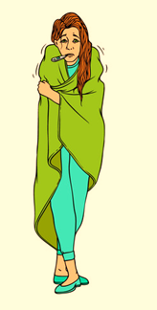
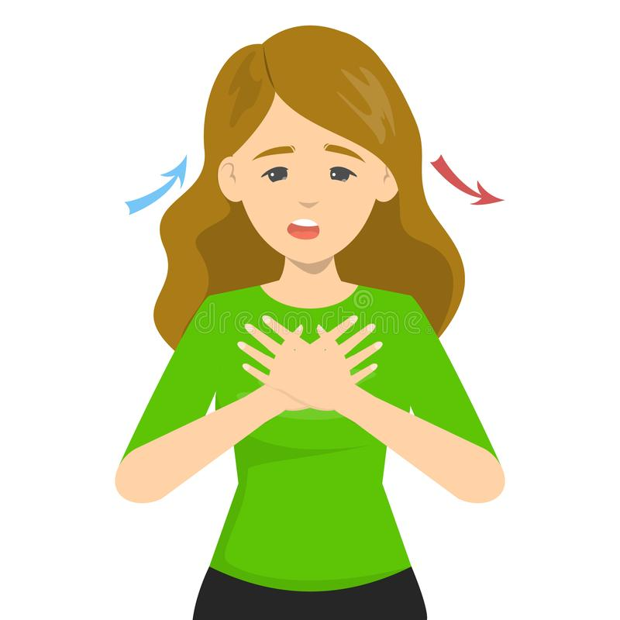
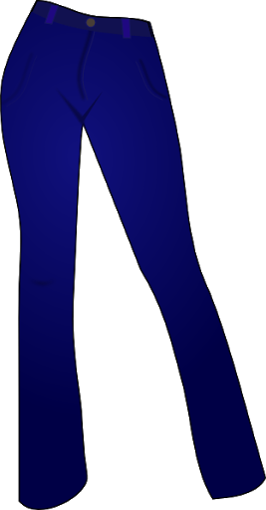

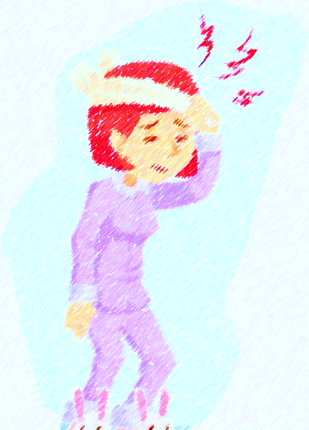
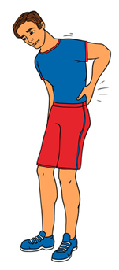
Biogen Laboratory Educational Series
Symptoms
Typical ((الشائعة
Rare (النادرة)
Dry Cough
كجة جافة
Fever
حرارة مرتفعة
Shortness of breath
ضيق في التنفس
Headache
صداع
Dizziness
دوخة
Fatigue
تعب
Notes:
Coronaviruses (CoV) are a family of viruses that cause sicknesses like the common cold, as well as more severe diseases, such as Middle East Respiratory Syndrome and Severe Acute Respiratory Syndrome. A novel coronavirus (nCoV) is a new strain – one that hasn’t previously been recognized in humans.
Coronaviruses cause diseases in mammals and birds. A zoonotic virus is one that is transmitted between animals and people. When a virus circulating in animal populations infects people, this is termed a “spillover event”.
How does CoVID-19 affect the body? The virus is fitted with protein spikes sticking out of the envelope that forms the surface and houses a core of genetic material. Any virus that enters your body looks for cells with compatible receptors – ones that allow it to invade the cell. Once they find the right cell, they enter and use the cell’s replication machinery to create copies of themselves. It is likely that COVID-19 uses the same receptor as SARS – found in both lungs and small intestines.
It is thought that CoVID-19 shares many similarities with SARS, which has three phases of attack: viral replication, hyper-reactivity of the immune system, and finally pulmonary destruction. Early on in infection, the coronavirus invades two types of cells in the lungs – mucus and cilia cells. Mucus keeps your lungs from drying out and protects them from pathogens. Cilia beat the mucus towards the exterior of your body, clearing debris – including viruses! – out of your lungs. Cilia cells were the preferred hosts of SARS-CoV, and are likely the preferred hosts of the new coronavirus. When these cells die, they slough off into your airways, filling them with debris and fluid. Symptoms include a fever, cough, and breathing difficulties. Many of those infected get pneumonia in both their lungs.
Enter the immune system. Immune cells recognize the virus and flood into the lungs. The lung tissue becomes inflamed. During normal immune function, the inflammatory process is highly regulated and is confined to infected areas. However, sometimes the immune system overreacts, and this results in damage to healthy tissue. More cells die and slough off into the lungs, further clogging them and worsening the pneumonia.
As damage to the lungs increases, stage three begins, potentially resulting in respiratory failure. Patients that reach this stage of infection can incur permanent lung damage or even die. We see the same lesions in the lungs of those infected by the novel coronavirus as those with SARS. SARS creates holes in the lungs, so they look honeycomb-like. This is probably due to the aforementioned over-reactive immune response, which affects tissue both infected and healthy and creates scars that stiffen the lungs. As such, some patients may require ventilators to aid breathing.
The inflammation also results in more permeable alveoli. This is the location of the thin interface of gas exchange, where your lungs replace carbon dioxide in your blood with fresh oxygen you just inhaled. Increased permeability causes fluid to leak into the lungs. This decreases the lungs’ ability to oxygenate blood, and in severe cases, floods them so that you become unable to breathe. Sometimes, this can be fatal.
The immune system’s over-reaction can also cause another kind of damage. Proteins called cytokines are the immune system’s alarm system, recruiting immune cells to the infection site. Over-production of cytokines can result in a cytokine storm, where there is large-scale inflammation in the body. Blood vessels become more permeable and fluid seeps out. This makes it difficult for blood and oxygen to reach the rest of the body and can result in multi-organ failure. This has happened in the most severe cases of CoVid-19. Although there are no specific treatments for coronaviruses, symptoms can be treated through supportive care. Also, vaccines are currently in development.
What can you do to protect yourself from CoVid-19? Basic protocol comes down to regular hand washing, avoiding close contact with anyone coughing or sneezing, avoiding unnecessary contact with animals, washing hands after contact with animals, thoroughly cooking meat and eggs prior to consumption, and covering your mouth and nose while coughing or sneezing. Respiratory viruses are typically transmitted via droplets in sneezes or coughs of those infected, so preventing their travel stops the spread of disease.

Slide 12
Typical Symptoms
Biogen Laboratory Educational Series
Symptoms
COVID-19 typically causes flu-like symptoms including a fever and cough.
( أعراض مشابهة للأنفلونزا العادية كالحمى والكحة)
It seems to start with a fever, followed by a dry cough.
After a week, it can lead to shortness of breath, with about 20% of patients requiring hospital treatment.
( بمكن أن تؤدي الى ضيق بالتنفس)
Notably, the COVID-19 infection rarely seems to cause a runny nose, sneezing, or sore throat (these symptoms have been observed in only about 5% of patients). Sore throat, sneezing, and stuffy nose are most often signs of a cold.
((في حالات نادرة جدا يسبب العطاس والرشح و التهاب الحلق
Notes:
Coronaviruses (CoV) are a family of viruses that cause sicknesses like the common cold, as well as more severe diseases, such as Middle East Respiratory Syndrome and Severe Acute Respiratory Syndrome. A novel coronavirus (nCoV) is a new strain – one that hasn’t previously been recognized in humans.
Coronaviruses cause diseases in mammals and birds. A zoonotic virus is one that is transmitted between animals and people. When a virus circulating in animal populations infects people, this is termed a “spillover event”.
How does CoVID-19 affect the body? The virus is fitted with protein spikes sticking out of the envelope that forms the surface and houses a core of genetic material. Any virus that enters your body looks for cells with compatible receptors – ones that allow it to invade the cell. Once they find the right cell, they enter and use the cell’s replication machinery to create copies of themselves. It is likely that COVID-19 uses the same receptor as SARS – found in both lungs and small intestines.
It is thought that CoVID-19 shares many similarities with SARS, which has three phases of attack: viral replication, hyper-reactivity of the immune system, and finally pulmonary destruction. Early on in infection, the coronavirus invades two types of cells in the lungs – mucus and cilia cells. Mucus keeps your lungs from drying out and protects them from pathogens. Cilia beat the mucus towards the exterior of your body, clearing debris – including viruses! – out of your lungs. Cilia cells were the preferred hosts of SARS-CoV, and are likely the preferred hosts of the new coronavirus. When these cells die, they slough off into your airways, filling them with debris and fluid. Symptoms include a fever, cough, and breathing difficulties. Many of those infected get pneumonia in both their lungs.
Enter the immune system. Immune cells recognize the virus and flood into the lungs. The lung tissue becomes inflamed. During normal immune function, the inflammatory process is highly regulated and is confined to infected areas. However, sometimes the immune system overreacts, and this results in damage to healthy tissue. More cells die and slough off into the lungs, further clogging them and worsening the pneumonia.
As damage to the lungs increases, stage three begins, potentially resulting in respiratory failure. Patients that reach this stage of infection can incur permanent lung damage or even die. We see the same lesions in the lungs of those infected by the novel coronavirus as those with SARS. SARS creates holes in the lungs, so they look honeycomb-like. This is probably due to the aforementioned over-reactive immune response, which affects tissue both infected and healthy and creates scars that stiffen the lungs. As such, some patients may require ventilators to aid breathing.
The inflammation also results in more permeable alveoli. This is the location of the thin interface of gas exchange, where your lungs replace carbon dioxide in your blood with fresh oxygen you just inhaled. Increased permeability causes fluid to leak into the lungs. This decreases the lungs’ ability to oxygenate blood, and in severe cases, floods them so that you become unable to breathe. Sometimes, this can be fatal.
The immune system’s over-reaction can also cause another kind of damage. Proteins called cytokines are the immune system’s alarm system, recruiting immune cells to the infection site. Over-production of cytokines can result in a cytokine storm, where there is large-scale inflammation in the body. Blood vessels become more permeable and fluid seeps out. This makes it difficult for blood and oxygen to reach the rest of the body and can result in multi-organ failure. This has happened in the most severe cases of CoVid-19. Although there are no specific treatments for coronaviruses, symptoms can be treated through supportive care. Also, vaccines are currently in development.
What can you do to protect yourself from CoVid-19? Basic protocol comes down to regular hand washing, avoiding close contact with anyone coughing or sneezing, avoiding unnecessary contact with animals, washing hands after contact with animals, thoroughly cooking meat and eggs prior to consumption, and covering your mouth and nose while coughing or sneezing. Respiratory viruses are typically transmitted via droplets in sneezes or coughs of those infected, so preventing their travel stops the spread of disease.

Slide 13
80% of cases are mild
Biogen Laboratory Educational Series
Symptoms
80.9% of infections are mild (with flu-like symptoms) and can recover at home.
13.8% are severe, developing severe diseases including pneumonia and shortness of breath.
4.7% as critical and can include: respiratory failure, septic shock, and multi-organ failure.
in about 3% of reported cases the virus is fatal.
Risk of death increases the older you are.
Relatively few cases are seen among children.
Notes:
Coronaviruses (CoV) are a family of viruses that cause sicknesses like the common cold, as well as more severe diseases, such as Middle East Respiratory Syndrome and Severe Acute Respiratory Syndrome. A novel coronavirus (nCoV) is a new strain – one that hasn’t previously been recognized in humans.
Coronaviruses cause diseases in mammals and birds. A zoonotic virus is one that is transmitted between animals and people. When a virus circulating in animal populations infects people, this is termed a “spillover event”.
How does CoVID-19 affect the body? The virus is fitted with protein spikes sticking out of the envelope that forms the surface and houses a core of genetic material. Any virus that enters your body looks for cells with compatible receptors – ones that allow it to invade the cell. Once they find the right cell, they enter and use the cell’s replication machinery to create copies of themselves. It is likely that COVID-19 uses the same receptor as SARS – found in both lungs and small intestines.
It is thought that CoVID-19 shares many similarities with SARS, which has three phases of attack: viral replication, hyper-reactivity of the immune system, and finally pulmonary destruction. Early on in infection, the coronavirus invades two types of cells in the lungs – mucus and cilia cells. Mucus keeps your lungs from drying out and protects them from pathogens. Cilia beat the mucus towards the exterior of your body, clearing debris – including viruses! – out of your lungs. Cilia cells were the preferred hosts of SARS-CoV, and are likely the preferred hosts of the new coronavirus. When these cells die, they slough off into your airways, filling them with debris and fluid. Symptoms include a fever, cough, and breathing difficulties. Many of those infected get pneumonia in both their lungs.
Enter the immune system. Immune cells recognize the virus and flood into the lungs. The lung tissue becomes inflamed. During normal immune function, the inflammatory process is highly regulated and is confined to infected areas. However, sometimes the immune system overreacts, and this results in damage to healthy tissue. More cells die and slough off into the lungs, further clogging them and worsening the pneumonia.
As damage to the lungs increases, stage three begins, potentially resulting in respiratory failure. Patients that reach this stage of infection can incur permanent lung damage or even die. We see the same lesions in the lungs of those infected by the novel coronavirus as those with SARS. SARS creates holes in the lungs, so they look honeycomb-like. This is probably due to the aforementioned over-reactive immune response, which affects tissue both infected and healthy and creates scars that stiffen the lungs. As such, some patients may require ventilators to aid breathing.
The inflammation also results in more permeable alveoli. This is the location of the thin interface of gas exchange, where your lungs replace carbon dioxide in your blood with fresh oxygen you just inhaled. Increased permeability causes fluid to leak into the lungs. This decreases the lungs’ ability to oxygenate blood, and in severe cases, floods them so that you become unable to breathe. Sometimes, this can be fatal.
The immune system’s over-reaction can also cause another kind of damage. Proteins called cytokines are the immune system’s alarm system, recruiting immune cells to the infection site. Over-production of cytokines can result in a cytokine storm, where there is large-scale inflammation in the body. Blood vessels become more permeable and fluid seeps out. This makes it difficult for blood and oxygen to reach the rest of the body and can result in multi-organ failure. This has happened in the most severe cases of CoVid-19. Although there are no specific treatments for coronaviruses, symptoms can be treated through supportive care. Also, vaccines are currently in development.
What can you do to protect yourself from CoVid-19? Basic protocol comes down to regular hand washing, avoiding close contact with anyone coughing or sneezing, avoiding unnecessary contact with animals, washing hands after contact with animals, thoroughly cooking meat and eggs prior to consumption, and covering your mouth and nose while coughing or sneezing. Respiratory viruses are typically transmitted via droplets in sneezes or coughs of those infected, so preventing their travel stops the spread of disease.

Slide 14
Age of Death
Biogen Laboratory Educational Series
Death Rate
AGE | DEATH RATE confirmed cases | DEATH RATE all cases
80+ years old | 21.9% | 14.8%
70-79 years old |  | 8.0%
60-69 years old |  | 3.6%
50-59 years old |  | 1.3%
40-49 years old |  | 0.4%
30-39 years old |  | 0.2%
20-29 years old |  | 0.2%
10-19 years old |  | 0.2%
0-9 years old |  | no fatalities
Notes:
Coronaviruses (CoV) are a family of viruses that cause sicknesses like the common cold, as well as more severe diseases, such as Middle East Respiratory Syndrome and Severe Acute Respiratory Syndrome. A novel coronavirus (nCoV) is a new strain – one that hasn’t previously been recognized in humans.
Coronaviruses cause diseases in mammals and birds. A zoonotic virus is one that is transmitted between animals and people. When a virus circulating in animal populations infects people, this is termed a “spillover event”.
How does CoVID-19 affect the body? The virus is fitted with protein spikes sticking out of the envelope that forms the surface and houses a core of genetic material. Any virus that enters your body looks for cells with compatible receptors – ones that allow it to invade the cell. Once they find the right cell, they enter and use the cell’s replication machinery to create copies of themselves. It is likely that COVID-19 uses the same receptor as SARS – found in both lungs and small intestines.
It is thought that CoVID-19 shares many similarities with SARS, which has three phases of attack: viral replication, hyper-reactivity of the immune system, and finally pulmonary destruction. Early on in infection, the coronavirus invades two types of cells in the lungs – mucus and cilia cells. Mucus keeps your lungs from drying out and protects them from pathogens. Cilia beat the mucus towards the exterior of your body, clearing debris – including viruses! – out of your lungs. Cilia cells were the preferred hosts of SARS-CoV, and are likely the preferred hosts of the new coronavirus. When these cells die, they slough off into your airways, filling them with debris and fluid. Symptoms include a fever, cough, and breathing difficulties. Many of those infected get pneumonia in both their lungs.
Enter the immune system. Immune cells recognize the virus and flood into the lungs. The lung tissue becomes inflamed. During normal immune function, the inflammatory process is highly regulated and is confined to infected areas. However, sometimes the immune system overreacts, and this results in damage to healthy tissue. More cells die and slough off into the lungs, further clogging them and worsening the pneumonia.
As damage to the lungs increases, stage three begins, potentially resulting in respiratory failure. Patients that reach this stage of infection can incur permanent lung damage or even die. We see the same lesions in the lungs of those infected by the novel coronavirus as those with SARS. SARS creates holes in the lungs, so they look honeycomb-like. This is probably due to the aforementioned over-reactive immune response, which affects tissue both infected and healthy and creates scars that stiffen the lungs. As such, some patients may require ventilators to aid breathing.
The inflammation also results in more permeable alveoli. This is the location of the thin interface of gas exchange, where your lungs replace carbon dioxide in your blood with fresh oxygen you just inhaled. Increased permeability causes fluid to leak into the lungs. This decreases the lungs’ ability to oxygenate blood, and in severe cases, floods them so that you become unable to breathe. Sometimes, this can be fatal.
The immune system’s over-reaction can also cause another kind of damage. Proteins called cytokines are the immune system’s alarm system, recruiting immune cells to the infection site. Over-production of cytokines can result in a cytokine storm, where there is large-scale inflammation in the body. Blood vessels become more permeable and fluid seeps out. This makes it difficult for blood and oxygen to reach the rest of the body and can result in multi-organ failure. This has happened in the most severe cases of CoVid-19. Although there are no specific treatments for coronaviruses, symptoms can be treated through supportive care. Also, vaccines are currently in development.
What can you do to protect yourself from CoVid-19? Basic protocol comes down to regular hand washing, avoiding close contact with anyone coughing or sneezing, avoiding unnecessary contact with animals, washing hands after contact with animals, thoroughly cooking meat and eggs prior to consumption, and covering your mouth and nose while coughing or sneezing. Respiratory viruses are typically transmitted via droplets in sneezes or coughs of those infected, so preventing their travel stops the spread of disease.

Slide 15

Gender
Biogen Laboratory Educational Series
Death Rate
SEX | DEATH RATE confirmed cases | DEATH RATE all cases
Male | 4.7% | 2.8%
Female | 2.8% | 1.7%
Notes:
Coronaviruses (CoV) are a family of viruses that cause sicknesses like the common cold, as well as more severe diseases, such as Middle East Respiratory Syndrome and Severe Acute Respiratory Syndrome. A novel coronavirus (nCoV) is a new strain – one that hasn’t previously been recognized in humans.
Coronaviruses cause diseases in mammals and birds. A zoonotic virus is one that is transmitted between animals and people. When a virus circulating in animal populations infects people, this is termed a “spillover event”.
How does CoVID-19 affect the body? The virus is fitted with protein spikes sticking out of the envelope that forms the surface and houses a core of genetic material. Any virus that enters your body looks for cells with compatible receptors – ones that allow it to invade the cell. Once they find the right cell, they enter and use the cell’s replication machinery to create copies of themselves. It is likely that COVID-19 uses the same receptor as SARS – found in both lungs and small intestines.
It is thought that CoVID-19 shares many similarities with SARS, which has three phases of attack: viral replication, hyper-reactivity of the immune system, and finally pulmonary destruction. Early on in infection, the coronavirus invades two types of cells in the lungs – mucus and cilia cells. Mucus keeps your lungs from drying out and protects them from pathogens. Cilia beat the mucus towards the exterior of your body, clearing debris – including viruses! – out of your lungs. Cilia cells were the preferred hosts of SARS-CoV, and are likely the preferred hosts of the new coronavirus. When these cells die, they slough off into your airways, filling them with debris and fluid. Symptoms include a fever, cough, and breathing difficulties. Many of those infected get pneumonia in both their lungs.
Enter the immune system. Immune cells recognize the virus and flood into the lungs. The lung tissue becomes inflamed. During normal immune function, the inflammatory process is highly regulated and is confined to infected areas. However, sometimes the immune system overreacts, and this results in damage to healthy tissue. More cells die and slough off into the lungs, further clogging them and worsening the pneumonia.
As damage to the lungs increases, stage three begins, potentially resulting in respiratory failure. Patients that reach this stage of infection can incur permanent lung damage or even die. We see the same lesions in the lungs of those infected by the novel coronavirus as those with SARS. SARS creates holes in the lungs, so they look honeycomb-like. This is probably due to the aforementioned over-reactive immune response, which affects tissue both infected and healthy and creates scars that stiffen the lungs. As such, some patients may require ventilators to aid breathing.
The inflammation also results in more permeable alveoli. This is the location of the thin interface of gas exchange, where your lungs replace carbon dioxide in your blood with fresh oxygen you just inhaled. Increased permeability causes fluid to leak into the lungs. This decreases the lungs’ ability to oxygenate blood, and in severe cases, floods them so that you become unable to breathe. Sometimes, this can be fatal.
The immune system’s over-reaction can also cause another kind of damage. Proteins called cytokines are the immune system’s alarm system, recruiting immune cells to the infection site. Over-production of cytokines can result in a cytokine storm, where there is large-scale inflammation in the body. Blood vessels become more permeable and fluid seeps out. This makes it difficult for blood and oxygen to reach the rest of the body and can result in multi-organ failure. This has happened in the most severe cases of CoVid-19. Although there are no specific treatments for coronaviruses, symptoms can be treated through supportive care. Also, vaccines are currently in development.
What can you do to protect yourself from CoVid-19? Basic protocol comes down to regular hand washing, avoiding close contact with anyone coughing or sneezing, avoiding unnecessary contact with animals, washing hands after contact with animals, thoroughly cooking meat and eggs prior to consumption, and covering your mouth and nose while coughing or sneezing. Respiratory viruses are typically transmitted via droplets in sneezes or coughs of those infected, so preventing their travel stops the spread of disease.

Slide 16
Pre-existing conditions
Biogen Laboratory Educational Series
Death Rate
Cardiovascular disease
Diabetes
Chronic respiratory disease
Hypertension
Notes:
Coronaviruses (CoV) are a family of viruses that cause sicknesses like the common cold, as well as more severe diseases, such as Middle East Respiratory Syndrome and Severe Acute Respiratory Syndrome. A novel coronavirus (nCoV) is a new strain – one that hasn’t previously been recognized in humans.
Coronaviruses cause diseases in mammals and birds. A zoonotic virus is one that is transmitted between animals and people. When a virus circulating in animal populations infects people, this is termed a “spillover event”.
How does CoVID-19 affect the body? The virus is fitted with protein spikes sticking out of the envelope that forms the surface and houses a core of genetic material. Any virus that enters your body looks for cells with compatible receptors – ones that allow it to invade the cell. Once they find the right cell, they enter and use the cell’s replication machinery to create copies of themselves. It is likely that COVID-19 uses the same receptor as SARS – found in both lungs and small intestines.
It is thought that CoVID-19 shares many similarities with SARS, which has three phases of attack: viral replication, hyper-reactivity of the immune system, and finally pulmonary destruction. Early on in infection, the coronavirus invades two types of cells in the lungs – mucus and cilia cells. Mucus keeps your lungs from drying out and protects them from pathogens. Cilia beat the mucus towards the exterior of your body, clearing debris – including viruses! – out of your lungs. Cilia cells were the preferred hosts of SARS-CoV, and are likely the preferred hosts of the new coronavirus. When these cells die, they slough off into your airways, filling them with debris and fluid. Symptoms include a fever, cough, and breathing difficulties. Many of those infected get pneumonia in both their lungs.
Enter the immune system. Immune cells recognize the virus and flood into the lungs. The lung tissue becomes inflamed. During normal immune function, the inflammatory process is highly regulated and is confined to infected areas. However, sometimes the immune system overreacts, and this results in damage to healthy tissue. More cells die and slough off into the lungs, further clogging them and worsening the pneumonia.
As damage to the lungs increases, stage three begins, potentially resulting in respiratory failure. Patients that reach this stage of infection can incur permanent lung damage or even die. We see the same lesions in the lungs of those infected by the novel coronavirus as those with SARS. SARS creates holes in the lungs, so they look honeycomb-like. This is probably due to the aforementioned over-reactive immune response, which affects tissue both infected and healthy and creates scars that stiffen the lungs. As such, some patients may require ventilators to aid breathing.
The inflammation also results in more permeable alveoli. This is the location of the thin interface of gas exchange, where your lungs replace carbon dioxide in your blood with fresh oxygen you just inhaled. Increased permeability causes fluid to leak into the lungs. This decreases the lungs’ ability to oxygenate blood, and in severe cases, floods them so that you become unable to breathe. Sometimes, this can be fatal.
The immune system’s over-reaction can also cause another kind of damage. Proteins called cytokines are the immune system’s alarm system, recruiting immune cells to the infection site. Over-production of cytokines can result in a cytokine storm, where there is large-scale inflammation in the body. Blood vessels become more permeable and fluid seeps out. This makes it difficult for blood and oxygen to reach the rest of the body and can result in multi-organ failure. This has happened in the most severe cases of CoVid-19. Although there are no specific treatments for coronaviruses, symptoms can be treated through supportive care. Also, vaccines are currently in development.
What can you do to protect yourself from CoVid-19? Basic protocol comes down to regular hand washing, avoiding close contact with anyone coughing or sneezing, avoiding unnecessary contact with animals, washing hands after contact with animals, thoroughly cooking meat and eggs prior to consumption, and covering your mouth and nose while coughing or sneezing. Respiratory viruses are typically transmitted via droplets in sneezes or coughs of those infected, so preventing their travel stops the spread of disease.

Slide 17
Pre-existing conditions
Biogen Laboratory Educational Series
Death Rate
PRE-EXISTING CONDITION | DEATH RATE confirmed cases | DEATH RATE all cases
Cardiovascular disease (أمراض القلب) | 13.2% | 10.5%
Diabetes (مرض السكري) | 9.2% | 7.3%
Chronic respiratory disease (أمراض في الجهاز التنفسي) | 8.0% | 6.3%
Hypertension (مرض الضغط) | 8.4% | 6.0%
Cancer (مرض السرطان) | 7.6% | 5.6%
no pre-existing conditions |  | 0.9%
Notes:
Coronaviruses (CoV) are a family of viruses that cause sicknesses like the common cold, as well as more severe diseases, such as Middle East Respiratory Syndrome and Severe Acute Respiratory Syndrome. A novel coronavirus (nCoV) is a new strain – one that hasn’t previously been recognized in humans.
Coronaviruses cause diseases in mammals and birds. A zoonotic virus is one that is transmitted between animals and people. When a virus circulating in animal populations infects people, this is termed a “spillover event”.
How does CoVID-19 affect the body? The virus is fitted with protein spikes sticking out of the envelope that forms the surface and houses a core of genetic material. Any virus that enters your body looks for cells with compatible receptors – ones that allow it to invade the cell. Once they find the right cell, they enter and use the cell’s replication machinery to create copies of themselves. It is likely that COVID-19 uses the same receptor as SARS – found in both lungs and small intestines.
It is thought that CoVID-19 shares many similarities with SARS, which has three phases of attack: viral replication, hyper-reactivity of the immune system, and finally pulmonary destruction. Early on in infection, the coronavirus invades two types of cells in the lungs – mucus and cilia cells. Mucus keeps your lungs from drying out and protects them from pathogens. Cilia beat the mucus towards the exterior of your body, clearing debris – including viruses! – out of your lungs. Cilia cells were the preferred hosts of SARS-CoV, and are likely the preferred hosts of the new coronavirus. When these cells die, they slough off into your airways, filling them with debris and fluid. Symptoms include a fever, cough, and breathing difficulties. Many of those infected get pneumonia in both their lungs.
Enter the immune system. Immune cells recognize the virus and flood into the lungs. The lung tissue becomes inflamed. During normal immune function, the inflammatory process is highly regulated and is confined to infected areas. However, sometimes the immune system overreacts, and this results in damage to healthy tissue. More cells die and slough off into the lungs, further clogging them and worsening the pneumonia.
As damage to the lungs increases, stage three begins, potentially resulting in respiratory failure. Patients that reach this stage of infection can incur permanent lung damage or even die. We see the same lesions in the lungs of those infected by the novel coronavirus as those with SARS. SARS creates holes in the lungs, so they look honeycomb-like. This is probably due to the aforementioned over-reactive immune response, which affects tissue both infected and healthy and creates scars that stiffen the lungs. As such, some patients may require ventilators to aid breathing.
The inflammation also results in more permeable alveoli. This is the location of the thin interface of gas exchange, where your lungs replace carbon dioxide in your blood with fresh oxygen you just inhaled. Increased permeability causes fluid to leak into the lungs. This decreases the lungs’ ability to oxygenate blood, and in severe cases, floods them so that you become unable to breathe. Sometimes, this can be fatal.
The immune system’s over-reaction can also cause another kind of damage. Proteins called cytokines are the immune system’s alarm system, recruiting immune cells to the infection site. Over-production of cytokines can result in a cytokine storm, where there is large-scale inflammation in the body. Blood vessels become more permeable and fluid seeps out. This makes it difficult for blood and oxygen to reach the rest of the body and can result in multi-organ failure. This has happened in the most severe cases of CoVid-19. Although there are no specific treatments for coronaviruses, symptoms can be treated through supportive care. Also, vaccines are currently in development.
What can you do to protect yourself from CoVid-19? Basic protocol comes down to regular hand washing, avoiding close contact with anyone coughing or sneezing, avoiding unnecessary contact with animals, washing hands after contact with animals, thoroughly cooking meat and eggs prior to consumption, and covering your mouth and nose while coughing or sneezing. Respiratory viruses are typically transmitted via droplets in sneezes or coughs of those infected, so preventing their travel stops the spread of disease.

Slide 18
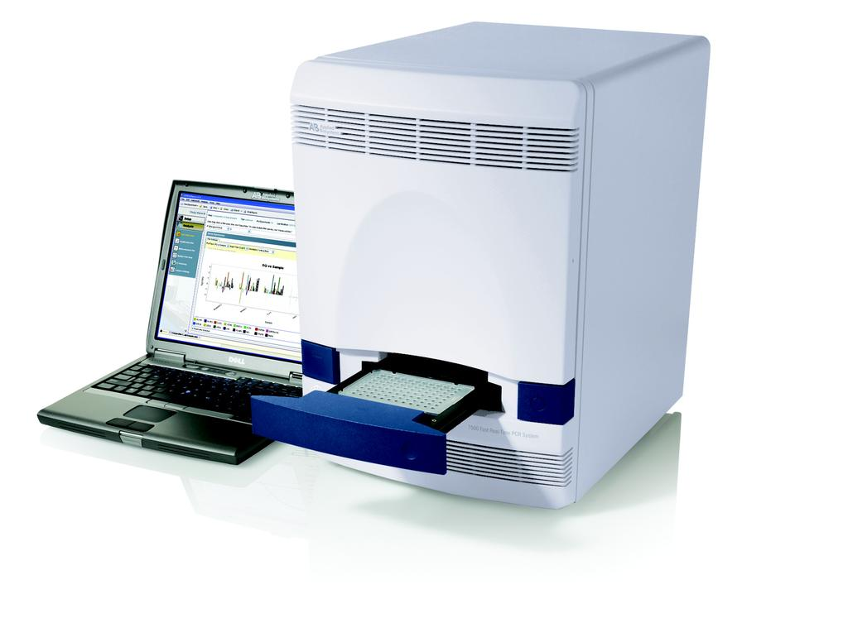
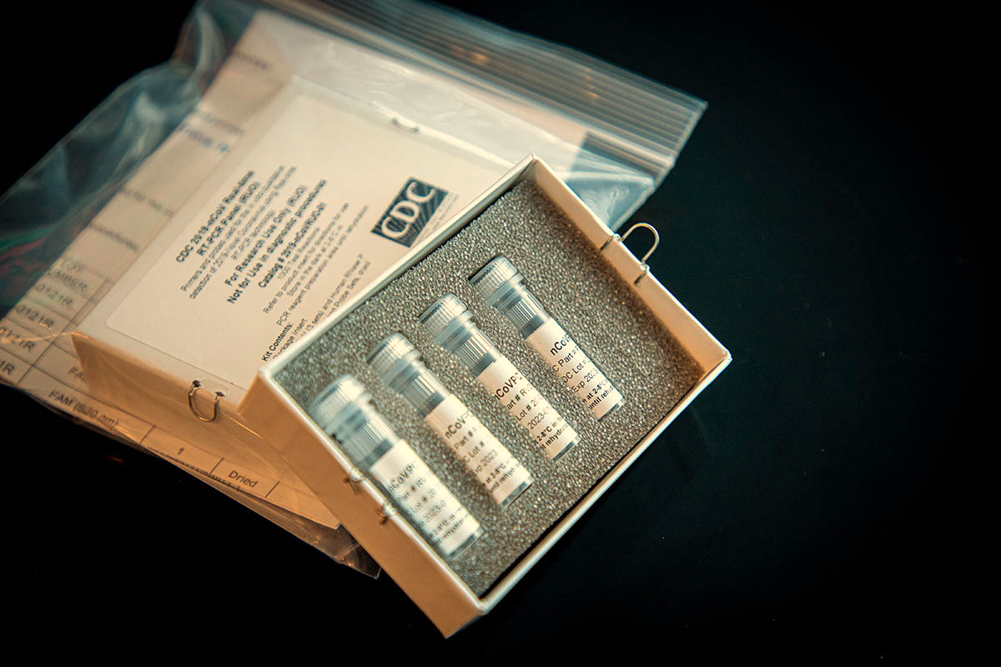
Biogen Laboratory Educational Series
Diagnosis
Real-Time PCR Instrument
COVID-19 test Kit
Notes:
Coronaviruses (CoV) are a family of viruses that cause sicknesses like the common cold, as well as more severe diseases, such as Middle East Respiratory Syndrome and Severe Acute Respiratory Syndrome. A novel coronavirus (nCoV) is a new strain – one that hasn’t previously been recognized in humans.
Coronaviruses cause diseases in mammals and birds. A zoonotic virus is one that is transmitted between animals and people. When a virus circulating in animal populations infects people, this is termed a “spillover event”.
How does CoVID-19 affect the body? The virus is fitted with protein spikes sticking out of the envelope that forms the surface and houses a core of genetic material. Any virus that enters your body looks for cells with compatible receptors – ones that allow it to invade the cell. Once they find the right cell, they enter and use the cell’s replication machinery to create copies of themselves. It is likely that COVID-19 uses the same receptor as SARS – found in both lungs and small intestines.
It is thought that CoVID-19 shares many similarities with SARS, which has three phases of attack: viral replication, hyper-reactivity of the immune system, and finally pulmonary destruction. Early on in infection, the coronavirus invades two types of cells in the lungs – mucus and cilia cells. Mucus keeps your lungs from drying out and protects them from pathogens. Cilia beat the mucus towards the exterior of your body, clearing debris – including viruses! – out of your lungs. Cilia cells were the preferred hosts of SARS-CoV, and are likely the preferred hosts of the new coronavirus. When these cells die, they slough off into your airways, filling them with debris and fluid. Symptoms include a fever, cough, and breathing difficulties. Many of those infected get pneumonia in both their lungs.
Enter the immune system. Immune cells recognize the virus and flood into the lungs. The lung tissue becomes inflamed. During normal immune function, the inflammatory process is highly regulated and is confined to infected areas. However, sometimes the immune system overreacts, and this results in damage to healthy tissue. More cells die and slough off into the lungs, further clogging them and worsening the pneumonia.
As damage to the lungs increases, stage three begins, potentially resulting in respiratory failure. Patients that reach this stage of infection can incur permanent lung damage or even die. We see the same lesions in the lungs of those infected by the novel coronavirus as those with SARS. SARS creates holes in the lungs, so they look honeycomb-like. This is probably due to the aforementioned over-reactive immune response, which affects tissue both infected and healthy and creates scars that stiffen the lungs. As such, some patients may require ventilators to aid breathing.
The inflammation also results in more permeable alveoli. This is the location of the thin interface of gas exchange, where your lungs replace carbon dioxide in your blood with fresh oxygen you just inhaled. Increased permeability causes fluid to leak into the lungs. This decreases the lungs’ ability to oxygenate blood, and in severe cases, floods them so that you become unable to breathe. Sometimes, this can be fatal.
The immune system’s over-reaction can also cause another kind of damage. Proteins called cytokines are the immune system’s alarm system, recruiting immune cells to the infection site. Over-production of cytokines can result in a cytokine storm, where there is large-scale inflammation in the body. Blood vessels become more permeable and fluid seeps out. This makes it difficult for blood and oxygen to reach the rest of the body and can result in multi-organ failure. This has happened in the most severe cases of CoVid-19. Although there are no specific treatments for coronaviruses, symptoms can be treated through supportive care. Also, vaccines are currently in development.
What can you do to protect yourself from CoVid-19? Basic protocol comes down to regular hand washing, avoiding close contact with anyone coughing or sneezing, avoiding unnecessary contact with animals, washing hands after contact with animals, thoroughly cooking meat and eggs prior to consumption, and covering your mouth and nose while coughing or sneezing. Respiratory viruses are typically transmitted via droplets in sneezes or coughs of those infected, so preventing their travel stops the spread of disease.

Slide 19
Biogen Laboratory Educational Series
Incubation Period
Virus | Incubation Period (typical cases)
2019-nCoV | 2-14 or 0-24 days (very rare cases)
SARS | 2-7 days, as long as 10 days
MERS | 5 days (range: 2-14)
Swine Flu | 1-4 days, as long as 7 days
Seasonal Flu | 2 days (1-4 range)
Notes:
Coronaviruses (CoV) are a family of viruses that cause sicknesses like the common cold, as well as more severe diseases, such as Middle East Respiratory Syndrome and Severe Acute Respiratory Syndrome. A novel coronavirus (nCoV) is a new strain – one that hasn’t previously been recognized in humans.
Coronaviruses cause diseases in mammals and birds. A zoonotic virus is one that is transmitted between animals and people. When a virus circulating in animal populations infects people, this is termed a “spillover event”.
How does CoVID-19 affect the body? The virus is fitted with protein spikes sticking out of the envelope that forms the surface and houses a core of genetic material. Any virus that enters your body looks for cells with compatible receptors – ones that allow it to invade the cell. Once they find the right cell, they enter and use the cell’s replication machinery to create copies of themselves. It is likely that COVID-19 uses the same receptor as SARS – found in both lungs and small intestines.
It is thought that CoVID-19 shares many similarities with SARS, which has three phases of attack: viral replication, hyper-reactivity of the immune system, and finally pulmonary destruction. Early on in infection, the coronavirus invades two types of cells in the lungs – mucus and cilia cells. Mucus keeps your lungs from drying out and protects them from pathogens. Cilia beat the mucus towards the exterior of your body, clearing debris – including viruses! – out of your lungs. Cilia cells were the preferred hosts of SARS-CoV, and are likely the preferred hosts of the new coronavirus. When these cells die, they slough off into your airways, filling them with debris and fluid. Symptoms include a fever, cough, and breathing difficulties. Many of those infected get pneumonia in both their lungs.
Enter the immune system. Immune cells recognize the virus and flood into the lungs. The lung tissue becomes inflamed. During normal immune function, the inflammatory process is highly regulated and is confined to infected areas. However, sometimes the immune system overreacts, and this results in damage to healthy tissue. More cells die and slough off into the lungs, further clogging them and worsening the pneumonia.
As damage to the lungs increases, stage three begins, potentially resulting in respiratory failure. Patients that reach this stage of infection can incur permanent lung damage or even die. We see the same lesions in the lungs of those infected by the novel coronavirus as those with SARS. SARS creates holes in the lungs, so they look honeycomb-like. This is probably due to the aforementioned over-reactive immune response, which affects tissue both infected and healthy and creates scars that stiffen the lungs. As such, some patients may require ventilators to aid breathing.
The inflammation also results in more permeable alveoli. This is the location of the thin interface of gas exchange, where your lungs replace carbon dioxide in your blood with fresh oxygen you just inhaled. Increased permeability causes fluid to leak into the lungs. This decreases the lungs’ ability to oxygenate blood, and in severe cases, floods them so that you become unable to breathe. Sometimes, this can be fatal.
The immune system’s over-reaction can also cause another kind of damage. Proteins called cytokines are the immune system’s alarm system, recruiting immune cells to the infection site. Over-production of cytokines can result in a cytokine storm, where there is large-scale inflammation in the body. Blood vessels become more permeable and fluid seeps out. This makes it difficult for blood and oxygen to reach the rest of the body and can result in multi-organ failure. This has happened in the most severe cases of CoVid-19. Although there are no specific treatments for coronaviruses, symptoms can be treated through supportive care. Also, vaccines are currently in development.
What can you do to protect yourself from CoVid-19? Basic protocol comes down to regular hand washing, avoiding close contact with anyone coughing or sneezing, avoiding unnecessary contact with animals, washing hands after contact with animals, thoroughly cooking meat and eggs prior to consumption, and covering your mouth and nose while coughing or sneezing. Respiratory viruses are typically transmitted via droplets in sneezes or coughs of those infected, so preventing their travel stops the spread of disease.

Slide 20
Biogen Laboratory Educational Series
Mortality Rate
Virus | Death Rate
2019-nCoV | 3-4%
SARS-CoV | 9.6%
MERS-CoV | 34%
Swine Flu | 0.02%
Notes:
Coronaviruses (CoV) are a family of viruses that cause sicknesses like the common cold, as well as more severe diseases, such as Middle East Respiratory Syndrome and Severe Acute Respiratory Syndrome. A novel coronavirus (nCoV) is a new strain – one that hasn’t previously been recognized in humans.
Coronaviruses cause diseases in mammals and birds. A zoonotic virus is one that is transmitted between animals and people. When a virus circulating in animal populations infects people, this is termed a “spillover event”.
How does CoVID-19 affect the body? The virus is fitted with protein spikes sticking out of the envelope that forms the surface and houses a core of genetic material. Any virus that enters your body looks for cells with compatible receptors – ones that allow it to invade the cell. Once they find the right cell, they enter and use the cell’s replication machinery to create copies of themselves. It is likely that COVID-19 uses the same receptor as SARS – found in both lungs and small intestines.
It is thought that CoVID-19 shares many similarities with SARS, which has three phases of attack: viral replication, hyper-reactivity of the immune system, and finally pulmonary destruction. Early on in infection, the coronavirus invades two types of cells in the lungs – mucus and cilia cells. Mucus keeps your lungs from drying out and protects them from pathogens. Cilia beat the mucus towards the exterior of your body, clearing debris – including viruses! – out of your lungs. Cilia cells were the preferred hosts of SARS-CoV, and are likely the preferred hosts of the new coronavirus. When these cells die, they slough off into your airways, filling them with debris and fluid. Symptoms include a fever, cough, and breathing difficulties. Many of those infected get pneumonia in both their lungs.
Enter the immune system. Immune cells recognize the virus and flood into the lungs. The lung tissue becomes inflamed. During normal immune function, the inflammatory process is highly regulated and is confined to infected areas. However, sometimes the immune system overreacts, and this results in damage to healthy tissue. More cells die and slough off into the lungs, further clogging them and worsening the pneumonia.
As damage to the lungs increases, stage three begins, potentially resulting in respiratory failure. Patients that reach this stage of infection can incur permanent lung damage or even die. We see the same lesions in the lungs of those infected by the novel coronavirus as those with SARS. SARS creates holes in the lungs, so they look honeycomb-like. This is probably due to the aforementioned over-reactive immune response, which affects tissue both infected and healthy and creates scars that stiffen the lungs. As such, some patients may require ventilators to aid breathing.
The inflammation also results in more permeable alveoli. This is the location of the thin interface of gas exchange, where your lungs replace carbon dioxide in your blood with fresh oxygen you just inhaled. Increased permeability causes fluid to leak into the lungs. This decreases the lungs’ ability to oxygenate blood, and in severe cases, floods them so that you become unable to breathe. Sometimes, this can be fatal.
The immune system’s over-reaction can also cause another kind of damage. Proteins called cytokines are the immune system’s alarm system, recruiting immune cells to the infection site. Over-production of cytokines can result in a cytokine storm, where there is large-scale inflammation in the body. Blood vessels become more permeable and fluid seeps out. This makes it difficult for blood and oxygen to reach the rest of the body and can result in multi-organ failure. This has happened in the most severe cases of CoVid-19. Although there are no specific treatments for coronaviruses, symptoms can be treated through supportive care. Also, vaccines are currently in development.
What can you do to protect yourself from CoVid-19? Basic protocol comes down to regular hand washing, avoiding close contact with anyone coughing or sneezing, avoiding unnecessary contact with animals, washing hands after contact with animals, thoroughly cooking meat and eggs prior to consumption, and covering your mouth and nose while coughing or sneezing. Respiratory viruses are typically transmitted via droplets in sneezes or coughs of those infected, so preventing their travel stops the spread of disease.

Slide 21
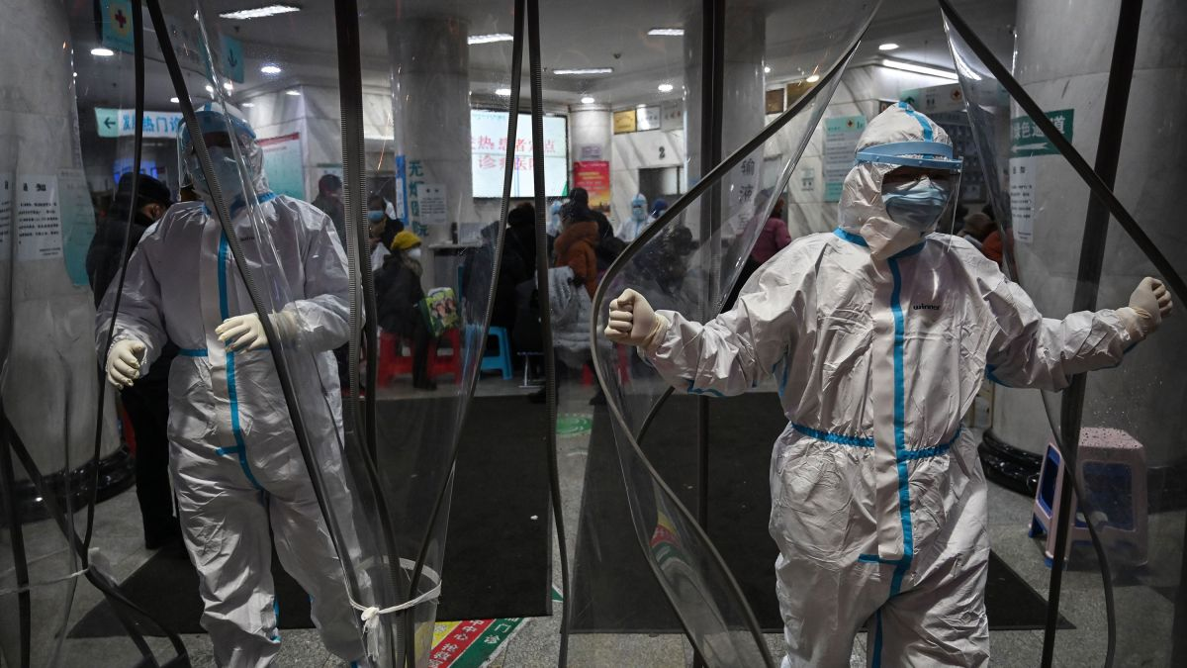
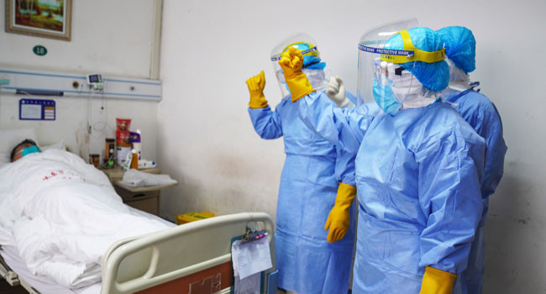
Biogen Laboratory Educational Series
Treatment & Management
لا يوحد علاج للمرض حتى الان
• THERE IS NO TREATMENT FOR CORONAVIRUS
TILL NOW, but medical care can treat most of the
symptoms. Antibiotics do not work on viruses.
Notes:
Coronaviruses (CoV) are a family of viruses that cause sicknesses like the common cold, as well as more severe diseases, such as Middle East Respiratory Syndrome and Severe Acute Respiratory Syndrome. A novel coronavirus (nCoV) is a new strain – one that hasn’t previously been recognized in humans.
Coronaviruses cause diseases in mammals and birds. A zoonotic virus is one that is transmitted between animals and people. When a virus circulating in animal populations infects people, this is termed a “spillover event”.
How does CoVID-19 affect the body? The virus is fitted with protein spikes sticking out of the envelope that forms the surface and houses a core of genetic material. Any virus that enters your body looks for cells with compatible receptors – ones that allow it to invade the cell. Once they find the right cell, they enter and use the cell’s replication machinery to create copies of themselves. It is likely that COVID-19 uses the same receptor as SARS – found in both lungs and small intestines.
It is thought that CoVID-19 shares many similarities with SARS, which has three phases of attack: viral replication, hyper-reactivity of the immune system, and finally pulmonary destruction. Early on in infection, the coronavirus invades two types of cells in the lungs – mucus and cilia cells. Mucus keeps your lungs from drying out and protects them from pathogens. Cilia beat the mucus towards the exterior of your body, clearing debris – including viruses! – out of your lungs. Cilia cells were the preferred hosts of SARS-CoV, and are likely the preferred hosts of the new coronavirus. When these cells die, they slough off into your airways, filling them with debris and fluid. Symptoms include a fever, cough, and breathing difficulties. Many of those infected get pneumonia in both their lungs.
Enter the immune system. Immune cells recognize the virus and flood into the lungs. The lung tissue becomes inflamed. During normal immune function, the inflammatory process is highly regulated and is confined to infected areas. However, sometimes the immune system overreacts, and this results in damage to healthy tissue. More cells die and slough off into the lungs, further clogging them and worsening the pneumonia.
As damage to the lungs increases, stage three begins, potentially resulting in respiratory failure. Patients that reach this stage of infection can incur permanent lung damage or even die. We see the same lesions in the lungs of those infected by the novel coronavirus as those with SARS. SARS creates holes in the lungs, so they look honeycomb-like. This is probably due to the aforementioned over-reactive immune response, which affects tissue both infected and healthy and creates scars that stiffen the lungs. As such, some patients may require ventilators to aid breathing.
The inflammation also results in more permeable alveoli. This is the location of the thin interface of gas exchange, where your lungs replace carbon dioxide in your blood with fresh oxygen you just inhaled. Increased permeability causes fluid to leak into the lungs. This decreases the lungs’ ability to oxygenate blood, and in severe cases, floods them so that you become unable to breathe. Sometimes, this can be fatal.
The immune system’s over-reaction can also cause another kind of damage. Proteins called cytokines are the immune system’s alarm system, recruiting immune cells to the infection site. Over-production of cytokines can result in a cytokine storm, where there is large-scale inflammation in the body. Blood vessels become more permeable and fluid seeps out. This makes it difficult for blood and oxygen to reach the rest of the body and can result in multi-organ failure. This has happened in the most severe cases of CoVid-19. Although there are no specific treatments for coronaviruses, symptoms can be treated through supportive care. Also, vaccines are currently in development.
What can you do to protect yourself from CoVid-19? Basic protocol comes down to regular hand washing, avoiding close contact with anyone coughing or sneezing, avoiding unnecessary contact with animals, washing hands after contact with animals, thoroughly cooking meat and eggs prior to consumption, and covering your mouth and nose while coughing or sneezing. Respiratory viruses are typically transmitted via droplets in sneezes or coughs of those infected, so preventing their travel stops the spread of disease.

Slide 22


Biogen Laboratory Educational Series
Treatment & Management
(جميع الحالات)
Coronavirus Cases:
102,242
Deaths:
3,497 (3.42 %)
Recovered:
57,629 (56.4%)
ACTIVE CASES | CLOSED CASES
41,116 Currently Infected Patients 34,963 (85%)in Mild Condition 6,153 (15%)Serious or Critical | 61,126 Cases which had an outcome: 57,629 (94%)Recovered / Discharged 3,497 (6%)Deaths
(عدد الموتى)
(نسبة الشفاء)
Notes:
Coronaviruses (CoV) are a family of viruses that cause sicknesses like the common cold, as well as more severe diseases, such as Middle East Respiratory Syndrome and Severe Acute Respiratory Syndrome. A novel coronavirus (nCoV) is a new strain – one that hasn’t previously been recognized in humans.
Coronaviruses cause diseases in mammals and birds. A zoonotic virus is one that is transmitted between animals and people. When a virus circulating in animal populations infects people, this is termed a “spillover event”.
How does CoVID-19 affect the body? The virus is fitted with protein spikes sticking out of the envelope that forms the surface and houses a core of genetic material. Any virus that enters your body looks for cells with compatible receptors – ones that allow it to invade the cell. Once they find the right cell, they enter and use the cell’s replication machinery to create copies of themselves. It is likely that COVID-19 uses the same receptor as SARS – found in both lungs and small intestines.
It is thought that CoVID-19 shares many similarities with SARS, which has three phases of attack: viral replication, hyper-reactivity of the immune system, and finally pulmonary destruction. Early on in infection, the coronavirus invades two types of cells in the lungs – mucus and cilia cells. Mucus keeps your lungs from drying out and protects them from pathogens. Cilia beat the mucus towards the exterior of your body, clearing debris – including viruses! – out of your lungs. Cilia cells were the preferred hosts of SARS-CoV, and are likely the preferred hosts of the new coronavirus. When these cells die, they slough off into your airways, filling them with debris and fluid. Symptoms include a fever, cough, and breathing difficulties. Many of those infected get pneumonia in both their lungs.
Enter the immune system. Immune cells recognize the virus and flood into the lungs. The lung tissue becomes inflamed. During normal immune function, the inflammatory process is highly regulated and is confined to infected areas. However, sometimes the immune system overreacts, and this results in damage to healthy tissue. More cells die and slough off into the lungs, further clogging them and worsening the pneumonia.
As damage to the lungs increases, stage three begins, potentially resulting in respiratory failure. Patients that reach this stage of infection can incur permanent lung damage or even die. We see the same lesions in the lungs of those infected by the novel coronavirus as those with SARS. SARS creates holes in the lungs, so they look honeycomb-like. This is probably due to the aforementioned over-reactive immune response, which affects tissue both infected and healthy and creates scars that stiffen the lungs. As such, some patients may require ventilators to aid breathing.
The inflammation also results in more permeable alveoli. This is the location of the thin interface of gas exchange, where your lungs replace carbon dioxide in your blood with fresh oxygen you just inhaled. Increased permeability causes fluid to leak into the lungs. This decreases the lungs’ ability to oxygenate blood, and in severe cases, floods them so that you become unable to breathe. Sometimes, this can be fatal.
The immune system’s over-reaction can also cause another kind of damage. Proteins called cytokines are the immune system’s alarm system, recruiting immune cells to the infection site. Over-production of cytokines can result in a cytokine storm, where there is large-scale inflammation in the body. Blood vessels become more permeable and fluid seeps out. This makes it difficult for blood and oxygen to reach the rest of the body and can result in multi-organ failure. This has happened in the most severe cases of CoVid-19. Although there are no specific treatments for coronaviruses, symptoms can be treated through supportive care. Also, vaccines are currently in development.
What can you do to protect yourself from CoVid-19? Basic protocol comes down to regular hand washing, avoiding close contact with anyone coughing or sneezing, avoiding unnecessary contact with animals, washing hands after contact with animals, thoroughly cooking meat and eggs prior to consumption, and covering your mouth and nose while coughing or sneezing. Respiratory viruses are typically transmitted via droplets in sneezes or coughs of those infected, so preventing their travel stops the spread of disease.

Slide 23
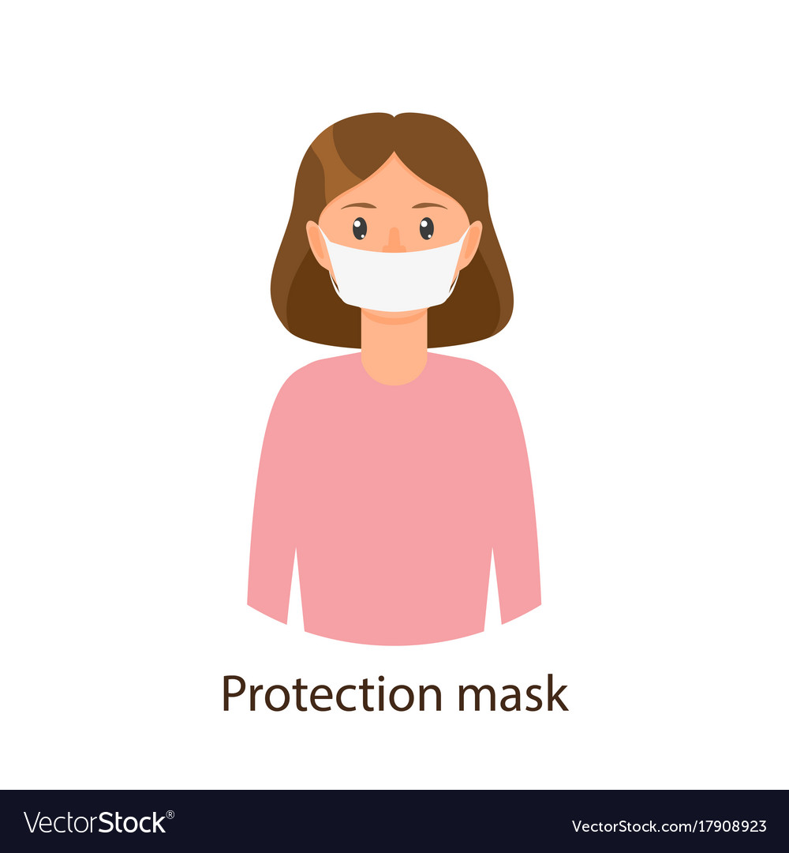
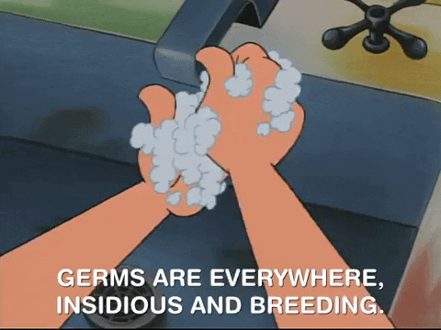


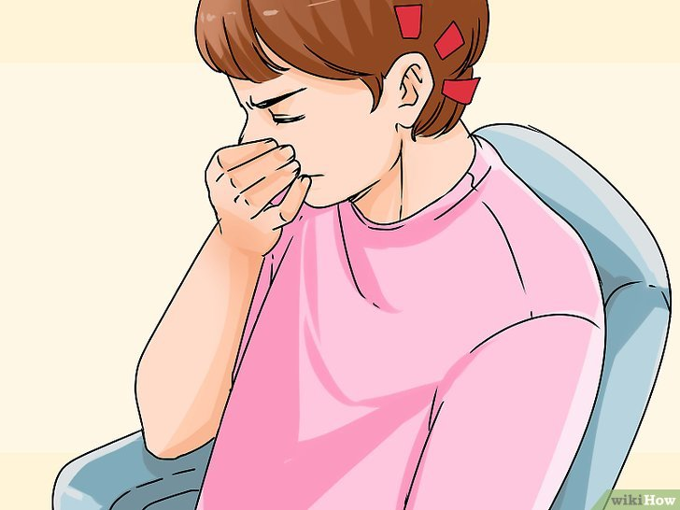
Biogen Laboratory Educational Series
Precautions
عادات غذائية صحية
تجنب الزحام
Have healthy food habits
H
Avoid crowdness
A
W
غطي الأنف والفم
Wash Hands
غسل اليدين
Use protection mask
استعمل القناع الواقي
U
Nose and Mouth
cover
N
Notes:
Coronaviruses (CoV) are a family of viruses that cause sicknesses like the common cold, as well as more severe diseases, such as Middle East Respiratory Syndrome and Severe Acute Respiratory Syndrome. A novel coronavirus (nCoV) is a new strain – one that hasn’t previously been recognized in humans.
Coronaviruses cause diseases in mammals and birds. A zoonotic virus is one that is transmitted between animals and people. When a virus circulating in animal populations infects people, this is termed a “spillover event”.
How does CoVID-19 affect the body? The virus is fitted with protein spikes sticking out of the envelope that forms the surface and houses a core of genetic material. Any virus that enters your body looks for cells with compatible receptors – ones that allow it to invade the cell. Once they find the right cell, they enter and use the cell’s replication machinery to create copies of themselves. It is likely that COVID-19 uses the same receptor as SARS – found in both lungs and small intestines.
It is thought that CoVID-19 shares many similarities with SARS, which has three phases of attack: viral replication, hyper-reactivity of the immune system, and finally pulmonary destruction. Early on in infection, the coronavirus invades two types of cells in the lungs – mucus and cilia cells. Mucus keeps your lungs from drying out and protects them from pathogens. Cilia beat the mucus towards the exterior of your body, clearing debris – including viruses! – out of your lungs. Cilia cells were the preferred hosts of SARS-CoV, and are likely the preferred hosts of the new coronavirus. When these cells die, they slough off into your airways, filling them with debris and fluid. Symptoms include a fever, cough, and breathing difficulties. Many of those infected get pneumonia in both their lungs.
Enter the immune system. Immune cells recognize the virus and flood into the lungs. The lung tissue becomes inflamed. During normal immune function, the inflammatory process is highly regulated and is confined to infected areas. However, sometimes the immune system overreacts, and this results in damage to healthy tissue. More cells die and slough off into the lungs, further clogging them and worsening the pneumonia.
As damage to the lungs increases, stage three begins, potentially resulting in respiratory failure. Patients that reach this stage of infection can incur permanent lung damage or even die. We see the same lesions in the lungs of those infected by the novel coronavirus as those with SARS. SARS creates holes in the lungs, so they look honeycomb-like. This is probably due to the aforementioned over-reactive immune response, which affects tissue both infected and healthy and creates scars that stiffen the lungs. As such, some patients may require ventilators to aid breathing.
The inflammation also results in more permeable alveoli. This is the location of the thin interface of gas exchange, where your lungs replace carbon dioxide in your blood with fresh oxygen you just inhaled. Increased permeability causes fluid to leak into the lungs. This decreases the lungs’ ability to oxygenate blood, and in severe cases, floods them so that you become unable to breathe. Sometimes, this can be fatal.
The immune system’s over-reaction can also cause another kind of damage. Proteins called cytokines are the immune system’s alarm system, recruiting immune cells to the infection site. Over-production of cytokines can result in a cytokine storm, where there is large-scale inflammation in the body. Blood vessels become more permeable and fluid seeps out. This makes it difficult for blood and oxygen to reach the rest of the body and can result in multi-organ failure. This has happened in the most severe cases of CoVid-19. Although there are no specific treatments for coronaviruses, symptoms can be treated through supportive care. Also, vaccines are currently in development.
What can you do to protect yourself from CoVid-19? Basic protocol comes down to regular hand washing, avoiding close contact with anyone coughing or sneezing, avoiding unnecessary contact with animals, washing hands after contact with animals, thoroughly cooking meat and eggs prior to consumption, and covering your mouth and nose while coughing or sneezing. Respiratory viruses are typically transmitted via droplets in sneezes or coughs of those infected, so preventing their travel stops the spread of disease.

Slide 24
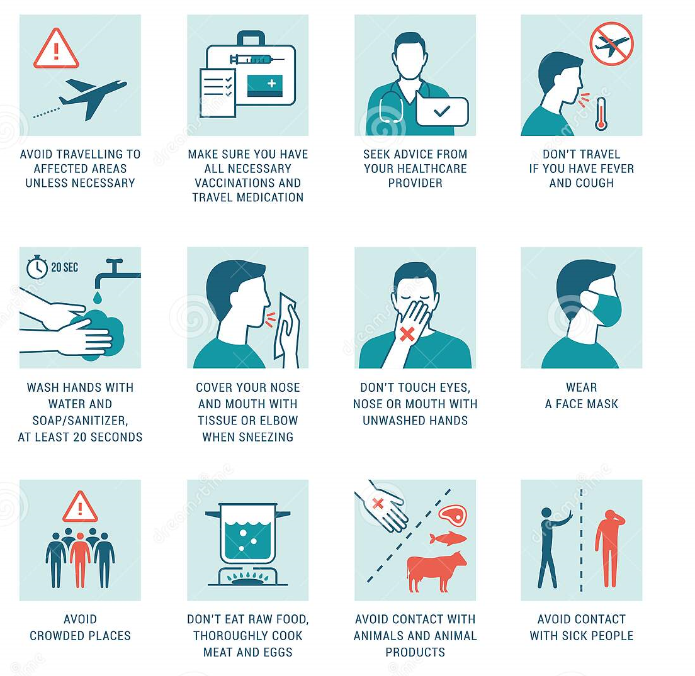
Biogen Laboratory Educational Series
Precautions
Travel Advice
نصائح عند السفر
Notes:
Coronaviruses (CoV) are a family of viruses that cause sicknesses like the common cold, as well as more severe diseases, such as Middle East Respiratory Syndrome and Severe Acute Respiratory Syndrome. A novel coronavirus (nCoV) is a new strain – one that hasn’t previously been recognized in humans.
Coronaviruses cause diseases in mammals and birds. A zoonotic virus is one that is transmitted between animals and people. When a virus circulating in animal populations infects people, this is termed a “spillover event”.
How does CoVID-19 affect the body? The virus is fitted with protein spikes sticking out of the envelope that forms the surface and houses a core of genetic material. Any virus that enters your body looks for cells with compatible receptors – ones that allow it to invade the cell. Once they find the right cell, they enter and use the cell’s replication machinery to create copies of themselves. It is likely that COVID-19 uses the same receptor as SARS – found in both lungs and small intestines.
It is thought that CoVID-19 shares many similarities with SARS, which has three phases of attack: viral replication, hyper-reactivity of the immune system, and finally pulmonary destruction. Early on in infection, the coronavirus invades two types of cells in the lungs – mucus and cilia cells. Mucus keeps your lungs from drying out and protects them from pathogens. Cilia beat the mucus towards the exterior of your body, clearing debris – including viruses! – out of your lungs. Cilia cells were the preferred hosts of SARS-CoV, and are likely the preferred hosts of the new coronavirus. When these cells die, they slough off into your airways, filling them with debris and fluid. Symptoms include a fever, cough, and breathing difficulties. Many of those infected get pneumonia in both their lungs.
Enter the immune system. Immune cells recognize the virus and flood into the lungs. The lung tissue becomes inflamed. During normal immune function, the inflammatory process is highly regulated and is confined to infected areas. However, sometimes the immune system overreacts, and this results in damage to healthy tissue. More cells die and slough off into the lungs, further clogging them and worsening the pneumonia.
As damage to the lungs increases, stage three begins, potentially resulting in respiratory failure. Patients that reach this stage of infection can incur permanent lung damage or even die. We see the same lesions in the lungs of those infected by the novel coronavirus as those with SARS. SARS creates holes in the lungs, so they look honeycomb-like. This is probably due to the aforementioned over-reactive immune response, which affects tissue both infected and healthy and creates scars that stiffen the lungs. As such, some patients may require ventilators to aid breathing.
The inflammation also results in more permeable alveoli. This is the location of the thin interface of gas exchange, where your lungs replace carbon dioxide in your blood with fresh oxygen you just inhaled. Increased permeability causes fluid to leak into the lungs. This decreases the lungs’ ability to oxygenate blood, and in severe cases, floods them so that you become unable to breathe. Sometimes, this can be fatal.
The immune system’s over-reaction can also cause another kind of damage. Proteins called cytokines are the immune system’s alarm system, recruiting immune cells to the infection site. Over-production of cytokines can result in a cytokine storm, where there is large-scale inflammation in the body. Blood vessels become more permeable and fluid seeps out. This makes it difficult for blood and oxygen to reach the rest of the body and can result in multi-organ failure. This has happened in the most severe cases of CoVid-19. Although there are no specific treatments for coronaviruses, symptoms can be treated through supportive care. Also, vaccines are currently in development.
What can you do to protect yourself from CoVid-19? Basic protocol comes down to regular hand washing, avoiding close contact with anyone coughing or sneezing, avoiding unnecessary contact with animals, washing hands after contact with animals, thoroughly cooking meat and eggs prior to consumption, and covering your mouth and nose while coughing or sneezing. Respiratory viruses are typically transmitted via droplets in sneezes or coughs of those infected, so preventing their travel stops the spread of disease.

Slide 25
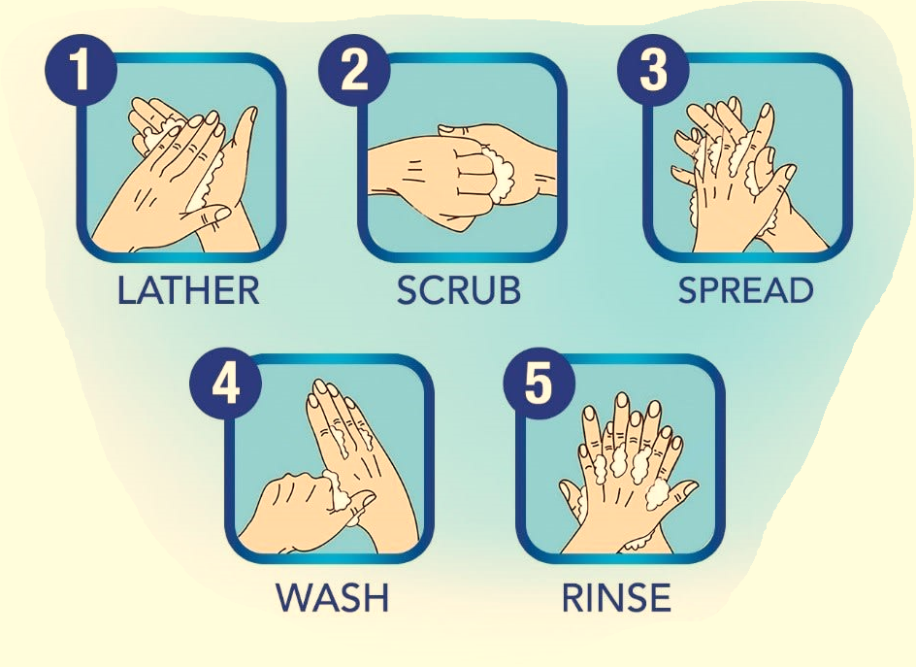
Biogen Laboratory Educational Series
Precautions
Wash Hands Properly
غسل الأيدين بالطريقة الصحيحة
Notes:
Coronaviruses (CoV) are a family of viruses that cause sicknesses like the common cold, as well as more severe diseases, such as Middle East Respiratory Syndrome and Severe Acute Respiratory Syndrome. A novel coronavirus (nCoV) is a new strain – one that hasn’t previously been recognized in humans.
Coronaviruses cause diseases in mammals and birds. A zoonotic virus is one that is transmitted between animals and people. When a virus circulating in animal populations infects people, this is termed a “spillover event”.
How does CoVID-19 affect the body? The virus is fitted with protein spikes sticking out of the envelope that forms the surface and houses a core of genetic material. Any virus that enters your body looks for cells with compatible receptors – ones that allow it to invade the cell. Once they find the right cell, they enter and use the cell’s replication machinery to create copies of themselves. It is likely that COVID-19 uses the same receptor as SARS – found in both lungs and small intestines.
It is thought that CoVID-19 shares many similarities with SARS, which has three phases of attack: viral replication, hyper-reactivity of the immune system, and finally pulmonary destruction. Early on in infection, the coronavirus invades two types of cells in the lungs – mucus and cilia cells. Mucus keeps your lungs from drying out and protects them from pathogens. Cilia beat the mucus towards the exterior of your body, clearing debris – including viruses! – out of your lungs. Cilia cells were the preferred hosts of SARS-CoV, and are likely the preferred hosts of the new coronavirus. When these cells die, they slough off into your airways, filling them with debris and fluid. Symptoms include a fever, cough, and breathing difficulties. Many of those infected get pneumonia in both their lungs.
Enter the immune system. Immune cells recognize the virus and flood into the lungs. The lung tissue becomes inflamed. During normal immune function, the inflammatory process is highly regulated and is confined to infected areas. However, sometimes the immune system overreacts, and this results in damage to healthy tissue. More cells die and slough off into the lungs, further clogging them and worsening the pneumonia.
As damage to the lungs increases, stage three begins, potentially resulting in respiratory failure. Patients that reach this stage of infection can incur permanent lung damage or even die. We see the same lesions in the lungs of those infected by the novel coronavirus as those with SARS. SARS creates holes in the lungs, so they look honeycomb-like. This is probably due to the aforementioned over-reactive immune response, which affects tissue both infected and healthy and creates scars that stiffen the lungs. As such, some patients may require ventilators to aid breathing.
The inflammation also results in more permeable alveoli. This is the location of the thin interface of gas exchange, where your lungs replace carbon dioxide in your blood with fresh oxygen you just inhaled. Increased permeability causes fluid to leak into the lungs. This decreases the lungs’ ability to oxygenate blood, and in severe cases, floods them so that you become unable to breathe. Sometimes, this can be fatal.
The immune system’s over-reaction can also cause another kind of damage. Proteins called cytokines are the immune system’s alarm system, recruiting immune cells to the infection site. Over-production of cytokines can result in a cytokine storm, where there is large-scale inflammation in the body. Blood vessels become more permeable and fluid seeps out. This makes it difficult for blood and oxygen to reach the rest of the body and can result in multi-organ failure. This has happened in the most severe cases of CoVid-19. Although there are no specific treatments for coronaviruses, symptoms can be treated through supportive care. Also, vaccines are currently in development.
What can you do to protect yourself from CoVid-19? Basic protocol comes down to regular hand washing, avoiding close contact with anyone coughing or sneezing, avoiding unnecessary contact with animals, washing hands after contact with animals, thoroughly cooking meat and eggs prior to consumption, and covering your mouth and nose while coughing or sneezing. Respiratory viruses are typically transmitted via droplets in sneezes or coughs of those infected, so preventing their travel stops the spread of disease.

Slide 26

Biogen Laboratory Educational Series
Precautions
Notes:
Coronaviruses (CoV) are a family of viruses that cause sicknesses like the common cold, as well as more severe diseases, such as Middle East Respiratory Syndrome and Severe Acute Respiratory Syndrome. A novel coronavirus (nCoV) is a new strain – one that hasn’t previously been recognized in humans.
Coronaviruses cause diseases in mammals and birds. A zoonotic virus is one that is transmitted between animals and people. When a virus circulating in animal populations infects people, this is termed a “spillover event”.
How does CoVID-19 affect the body? The virus is fitted with protein spikes sticking out of the envelope that forms the surface and houses a core of genetic material. Any virus that enters your body looks for cells with compatible receptors – ones that allow it to invade the cell. Once they find the right cell, they enter and use the cell’s replication machinery to create copies of themselves. It is likely that COVID-19 uses the same receptor as SARS – found in both lungs and small intestines.
It is thought that CoVID-19 shares many similarities with SARS, which has three phases of attack: viral replication, hyper-reactivity of the immune system, and finally pulmonary destruction. Early on in infection, the coronavirus invades two types of cells in the lungs – mucus and cilia cells. Mucus keeps your lungs from drying out and protects them from pathogens. Cilia beat the mucus towards the exterior of your body, clearing debris – including viruses! – out of your lungs. Cilia cells were the preferred hosts of SARS-CoV, and are likely the preferred hosts of the new coronavirus. When these cells die, they slough off into your airways, filling them with debris and fluid. Symptoms include a fever, cough, and breathing difficulties. Many of those infected get pneumonia in both their lungs.
Enter the immune system. Immune cells recognize the virus and flood into the lungs. The lung tissue becomes inflamed. During normal immune function, the inflammatory process is highly regulated and is confined to infected areas. However, sometimes the immune system overreacts, and this results in damage to healthy tissue. More cells die and slough off into the lungs, further clogging them and worsening the pneumonia.
As damage to the lungs increases, stage three begins, potentially resulting in respiratory failure. Patients that reach this stage of infection can incur permanent lung damage or even die. We see the same lesions in the lungs of those infected by the novel coronavirus as those with SARS. SARS creates holes in the lungs, so they look honeycomb-like. This is probably due to the aforementioned over-reactive immune response, which affects tissue both infected and healthy and creates scars that stiffen the lungs. As such, some patients may require ventilators to aid breathing.
The inflammation also results in more permeable alveoli. This is the location of the thin interface of gas exchange, where your lungs replace carbon dioxide in your blood with fresh oxygen you just inhaled. Increased permeability causes fluid to leak into the lungs. This decreases the lungs’ ability to oxygenate blood, and in severe cases, floods them so that you become unable to breathe. Sometimes, this can be fatal.
The immune system’s over-reaction can also cause another kind of damage. Proteins called cytokines are the immune system’s alarm system, recruiting immune cells to the infection site. Over-production of cytokines can result in a cytokine storm, where there is large-scale inflammation in the body. Blood vessels become more permeable and fluid seeps out. This makes it difficult for blood and oxygen to reach the rest of the body and can result in multi-organ failure. This has happened in the most severe cases of CoVid-19. Although there are no specific treatments for coronaviruses, symptoms can be treated through supportive care. Also, vaccines are currently in development.
What can you do to protect yourself from CoVid-19? Basic protocol comes down to regular hand washing, avoiding close contact with anyone coughing or sneezing, avoiding unnecessary contact with animals, washing hands after contact with animals, thoroughly cooking meat and eggs prior to consumption, and covering your mouth and nose while coughing or sneezing. Respiratory viruses are typically transmitted via droplets in sneezes or coughs of those infected, so preventing their travel stops the spread of disease.

Slide 27

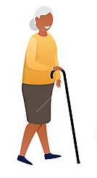
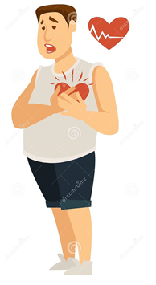

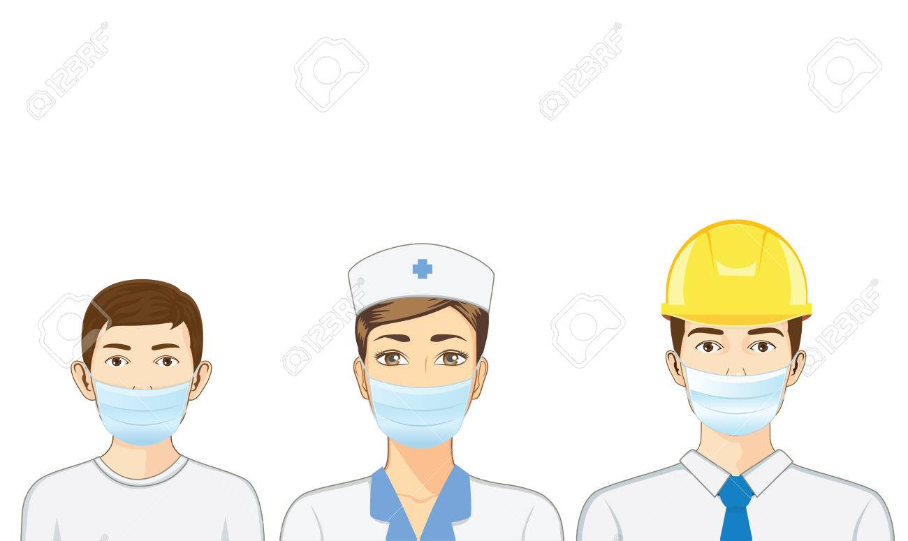
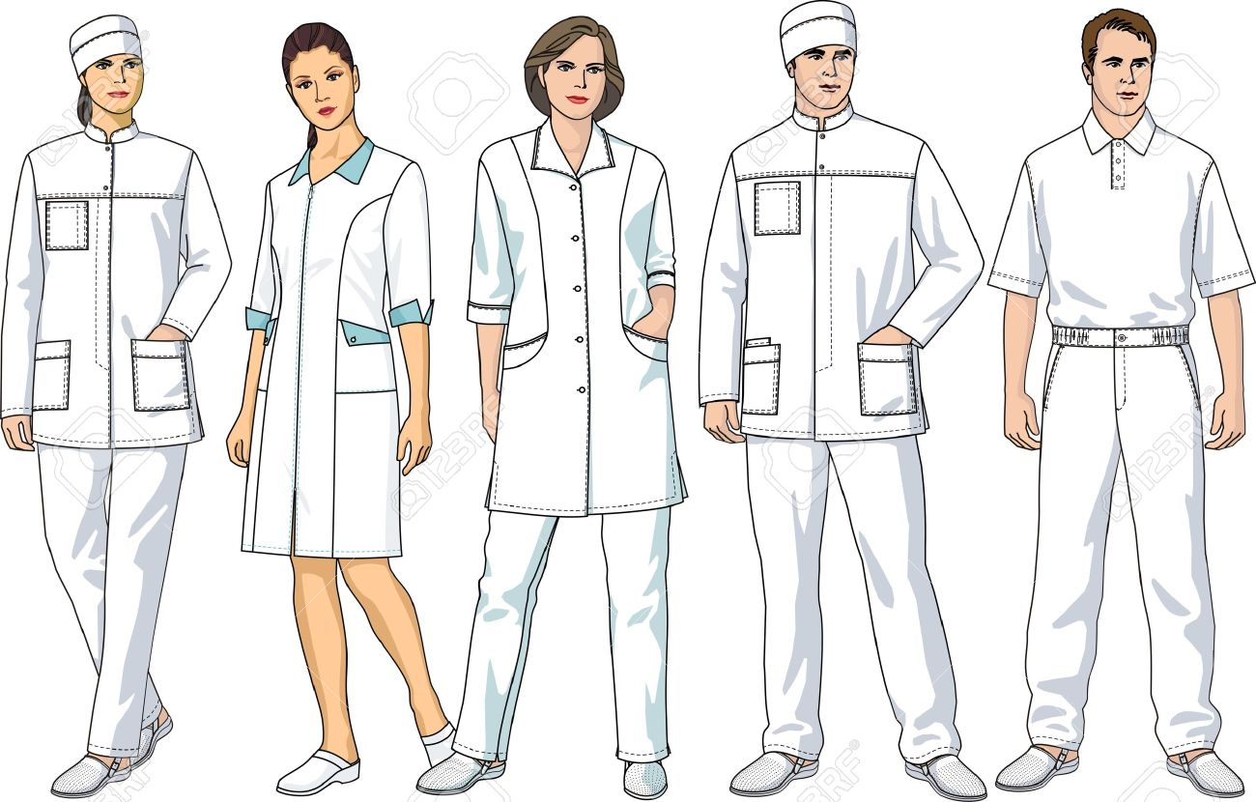
Biogen Laboratory Educational Series
Reminder
Death Risk (Solve the Puzzle)
اكثر مجموعة معرضة للإصابة
(رتب الصور)
Notes:
Coronaviruses (CoV) are a family of viruses that cause sicknesses like the common cold, as well as more severe diseases, such as Middle East Respiratory Syndrome and Severe Acute Respiratory Syndrome. A novel coronavirus (nCoV) is a new strain – one that hasn’t previously been recognized in humans.
Coronaviruses cause diseases in mammals and birds. A zoonotic virus is one that is transmitted between animals and people. When a virus circulating in animal populations infects people, this is termed a “spillover event”.
How does CoVID-19 affect the body? The virus is fitted with protein spikes sticking out of the envelope that forms the surface and houses a core of genetic material. Any virus that enters your body looks for cells with compatible receptors – ones that allow it to invade the cell. Once they find the right cell, they enter and use the cell’s replication machinery to create copies of themselves. It is likely that COVID-19 uses the same receptor as SARS – found in both lungs and small intestines.
It is thought that CoVID-19 shares many similarities with SARS, which has three phases of attack: viral replication, hyper-reactivity of the immune system, and finally pulmonary destruction. Early on in infection, the coronavirus invades two types of cells in the lungs – mucus and cilia cells. Mucus keeps your lungs from drying out and protects them from pathogens. Cilia beat the mucus towards the exterior of your body, clearing debris – including viruses! – out of your lungs. Cilia cells were the preferred hosts of SARS-CoV, and are likely the preferred hosts of the new coronavirus. When these cells die, they slough off into your airways, filling them with debris and fluid. Symptoms include a fever, cough, and breathing difficulties. Many of those infected get pneumonia in both their lungs.
Enter the immune system. Immune cells recognize the virus and flood into the lungs. The lung tissue becomes inflamed. During normal immune function, the inflammatory process is highly regulated and is confined to infected areas. However, sometimes the immune system overreacts, and this results in damage to healthy tissue. More cells die and slough off into the lungs, further clogging them and worsening the pneumonia.
As damage to the lungs increases, stage three begins, potentially resulting in respiratory failure. Patients that reach this stage of infection can incur permanent lung damage or even die. We see the same lesions in the lungs of those infected by the novel coronavirus as those with SARS. SARS creates holes in the lungs, so they look honeycomb-like. This is probably due to the aforementioned over-reactive immune response, which affects tissue both infected and healthy and creates scars that stiffen the lungs. As such, some patients may require ventilators to aid breathing.
The inflammation also results in more permeable alveoli. This is the location of the thin interface of gas exchange, where your lungs replace carbon dioxide in your blood with fresh oxygen you just inhaled. Increased permeability causes fluid to leak into the lungs. This decreases the lungs’ ability to oxygenate blood, and in severe cases, floods them so that you become unable to breathe. Sometimes, this can be fatal.
The immune system’s over-reaction can also cause another kind of damage. Proteins called cytokines are the immune system’s alarm system, recruiting immune cells to the infection site. Over-production of cytokines can result in a cytokine storm, where there is large-scale inflammation in the body. Blood vessels become more permeable and fluid seeps out. This makes it difficult for blood and oxygen to reach the rest of the body and can result in multi-organ failure. This has happened in the most severe cases of CoVid-19. Although there are no specific treatments for coronaviruses, symptoms can be treated through supportive care. Also, vaccines are currently in development.
What can you do to protect yourself from CoVid-19? Basic protocol comes down to regular hand washing, avoiding close contact with anyone coughing or sneezing, avoiding unnecessary contact with animals, washing hands after contact with animals, thoroughly cooking meat and eggs prior to consumption, and covering your mouth and nose while coughing or sneezing. Respiratory viruses are typically transmitted via droplets in sneezes or coughs of those infected, so preventing their travel stops the spread of disease.

Slide 28
Biogen Laboratory Educational Series
Reminder
1-
2-
3-
Notes:
Coronaviruses (CoV) are a family of viruses that cause sicknesses like the common cold, as well as more severe diseases, such as Middle East Respiratory Syndrome and Severe Acute Respiratory Syndrome. A novel coronavirus (nCoV) is a new strain – one that hasn’t previously been recognized in humans.
Coronaviruses cause diseases in mammals and birds. A zoonotic virus is one that is transmitted between animals and people. When a virus circulating in animal populations infects people, this is termed a “spillover event”.
How does CoVID-19 affect the body? The virus is fitted with protein spikes sticking out of the envelope that forms the surface and houses a core of genetic material. Any virus that enters your body looks for cells with compatible receptors – ones that allow it to invade the cell. Once they find the right cell, they enter and use the cell’s replication machinery to create copies of themselves. It is likely that COVID-19 uses the same receptor as SARS – found in both lungs and small intestines.
It is thought that CoVID-19 shares many similarities with SARS, which has three phases of attack: viral replication, hyper-reactivity of the immune system, and finally pulmonary destruction. Early on in infection, the coronavirus invades two types of cells in the lungs – mucus and cilia cells. Mucus keeps your lungs from drying out and protects them from pathogens. Cilia beat the mucus towards the exterior of your body, clearing debris – including viruses! – out of your lungs. Cilia cells were the preferred hosts of SARS-CoV, and are likely the preferred hosts of the new coronavirus. When these cells die, they slough off into your airways, filling them with debris and fluid. Symptoms include a fever, cough, and breathing difficulties. Many of those infected get pneumonia in both their lungs.
Enter the immune system. Immune cells recognize the virus and flood into the lungs. The lung tissue becomes inflamed. During normal immune function, the inflammatory process is highly regulated and is confined to infected areas. However, sometimes the immune system overreacts, and this results in damage to healthy tissue. More cells die and slough off into the lungs, further clogging them and worsening the pneumonia.
As damage to the lungs increases, stage three begins, potentially resulting in respiratory failure. Patients that reach this stage of infection can incur permanent lung damage or even die. We see the same lesions in the lungs of those infected by the novel coronavirus as those with SARS. SARS creates holes in the lungs, so they look honeycomb-like. This is probably due to the aforementioned over-reactive immune response, which affects tissue both infected and healthy and creates scars that stiffen the lungs. As such, some patients may require ventilators to aid breathing.
The inflammation also results in more permeable alveoli. This is the location of the thin interface of gas exchange, where your lungs replace carbon dioxide in your blood with fresh oxygen you just inhaled. Increased permeability causes fluid to leak into the lungs. This decreases the lungs’ ability to oxygenate blood, and in severe cases, floods them so that you become unable to breathe. Sometimes, this can be fatal.
The immune system’s over-reaction can also cause another kind of damage. Proteins called cytokines are the immune system’s alarm system, recruiting immune cells to the infection site. Over-production of cytokines can result in a cytokine storm, where there is large-scale inflammation in the body. Blood vessels become more permeable and fluid seeps out. This makes it difficult for blood and oxygen to reach the rest of the body and can result in multi-organ failure. This has happened in the most severe cases of CoVid-19. Although there are no specific treatments for coronaviruses, symptoms can be treated through supportive care. Also, vaccines are currently in development.
What can you do to protect yourself from CoVid-19? Basic protocol comes down to regular hand washing, avoiding close contact with anyone coughing or sneezing, avoiding unnecessary contact with animals, washing hands after contact with animals, thoroughly cooking meat and eggs prior to consumption, and covering your mouth and nose while coughing or sneezing. Respiratory viruses are typically transmitted via droplets in sneezes or coughs of those infected, so preventing their travel stops the spread of disease.

Slide 29






Biogen Laboratory Educational Series
Reminder
Notes:
Coronaviruses (CoV) are a family of viruses that cause sicknesses like the common cold, as well as more severe diseases, such as Middle East Respiratory Syndrome and Severe Acute Respiratory Syndrome. A novel coronavirus (nCoV) is a new strain – one that hasn’t previously been recognized in humans.
Coronaviruses cause diseases in mammals and birds. A zoonotic virus is one that is transmitted between animals and people. When a virus circulating in animal populations infects people, this is termed a “spillover event”.
How does CoVID-19 affect the body? The virus is fitted with protein spikes sticking out of the envelope that forms the surface and houses a core of genetic material. Any virus that enters your body looks for cells with compatible receptors – ones that allow it to invade the cell. Once they find the right cell, they enter and use the cell’s replication machinery to create copies of themselves. It is likely that COVID-19 uses the same receptor as SARS – found in both lungs and small intestines.
It is thought that CoVID-19 shares many similarities with SARS, which has three phases of attack: viral replication, hyper-reactivity of the immune system, and finally pulmonary destruction. Early on in infection, the coronavirus invades two types of cells in the lungs – mucus and cilia cells. Mucus keeps your lungs from drying out and protects them from pathogens. Cilia beat the mucus towards the exterior of your body, clearing debris – including viruses! – out of your lungs. Cilia cells were the preferred hosts of SARS-CoV, and are likely the preferred hosts of the new coronavirus. When these cells die, they slough off into your airways, filling them with debris and fluid. Symptoms include a fever, cough, and breathing difficulties. Many of those infected get pneumonia in both their lungs.
Enter the immune system. Immune cells recognize the virus and flood into the lungs. The lung tissue becomes inflamed. During normal immune function, the inflammatory process is highly regulated and is confined to infected areas. However, sometimes the immune system overreacts, and this results in damage to healthy tissue. More cells die and slough off into the lungs, further clogging them and worsening the pneumonia.
As damage to the lungs increases, stage three begins, potentially resulting in respiratory failure. Patients that reach this stage of infection can incur permanent lung damage or even die. We see the same lesions in the lungs of those infected by the novel coronavirus as those with SARS. SARS creates holes in the lungs, so they look honeycomb-like. This is probably due to the aforementioned over-reactive immune response, which affects tissue both infected and healthy and creates scars that stiffen the lungs. As such, some patients may require ventilators to aid breathing.
The inflammation also results in more permeable alveoli. This is the location of the thin interface of gas exchange, where your lungs replace carbon dioxide in your blood with fresh oxygen you just inhaled. Increased permeability causes fluid to leak into the lungs. This decreases the lungs’ ability to oxygenate blood, and in severe cases, floods them so that you become unable to breathe. Sometimes, this can be fatal.
The immune system’s over-reaction can also cause another kind of damage. Proteins called cytokines are the immune system’s alarm system, recruiting immune cells to the infection site. Over-production of cytokines can result in a cytokine storm, where there is large-scale inflammation in the body. Blood vessels become more permeable and fluid seeps out. This makes it difficult for blood and oxygen to reach the rest of the body and can result in multi-organ failure. This has happened in the most severe cases of CoVid-19. Although there are no specific treatments for coronaviruses, symptoms can be treated through supportive care. Also, vaccines are currently in development.
What can you do to protect yourself from CoVid-19? Basic protocol comes down to regular hand washing, avoiding close contact with anyone coughing or sneezing, avoiding unnecessary contact with animals, washing hands after contact with animals, thoroughly cooking meat and eggs prior to consumption, and covering your mouth and nose while coughing or sneezing. Respiratory viruses are typically transmitted via droplets in sneezes or coughs of those infected, so preventing their travel stops the spread of disease.

Slide 30

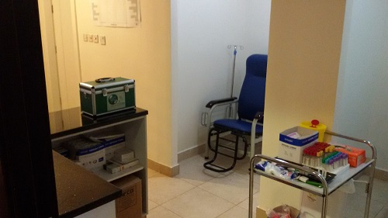

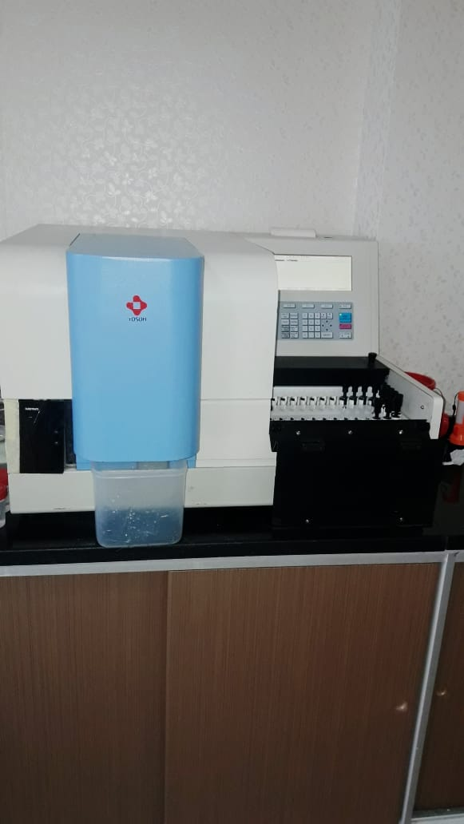
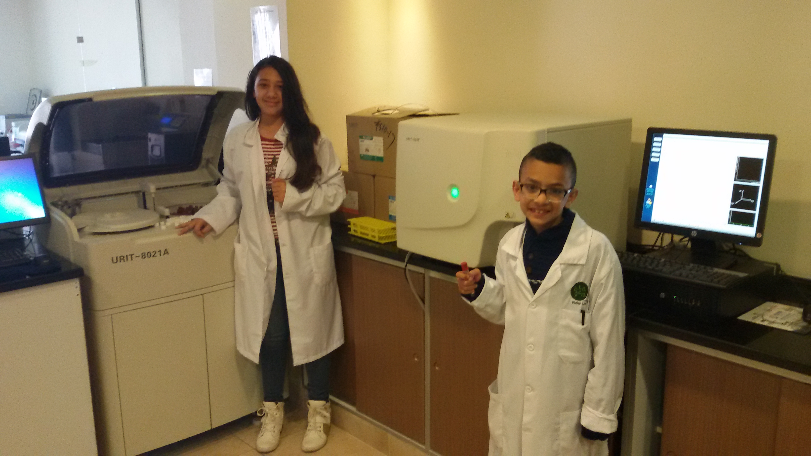
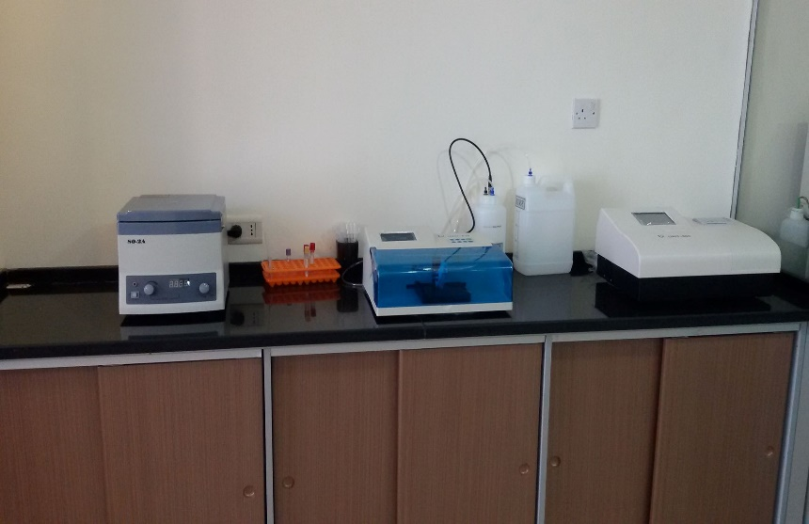
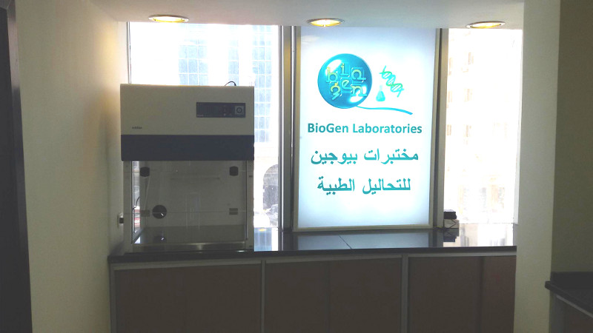

Dr. RAED KANAN

